Slide 1
Chapter 1
Chemistry: An Introduction

Slide 2
Why Is Chemistry Important?
New materials
New pharmaceuticals
New energy sources
Food supplies
Help the environment
Can you think of others?

Slide 3
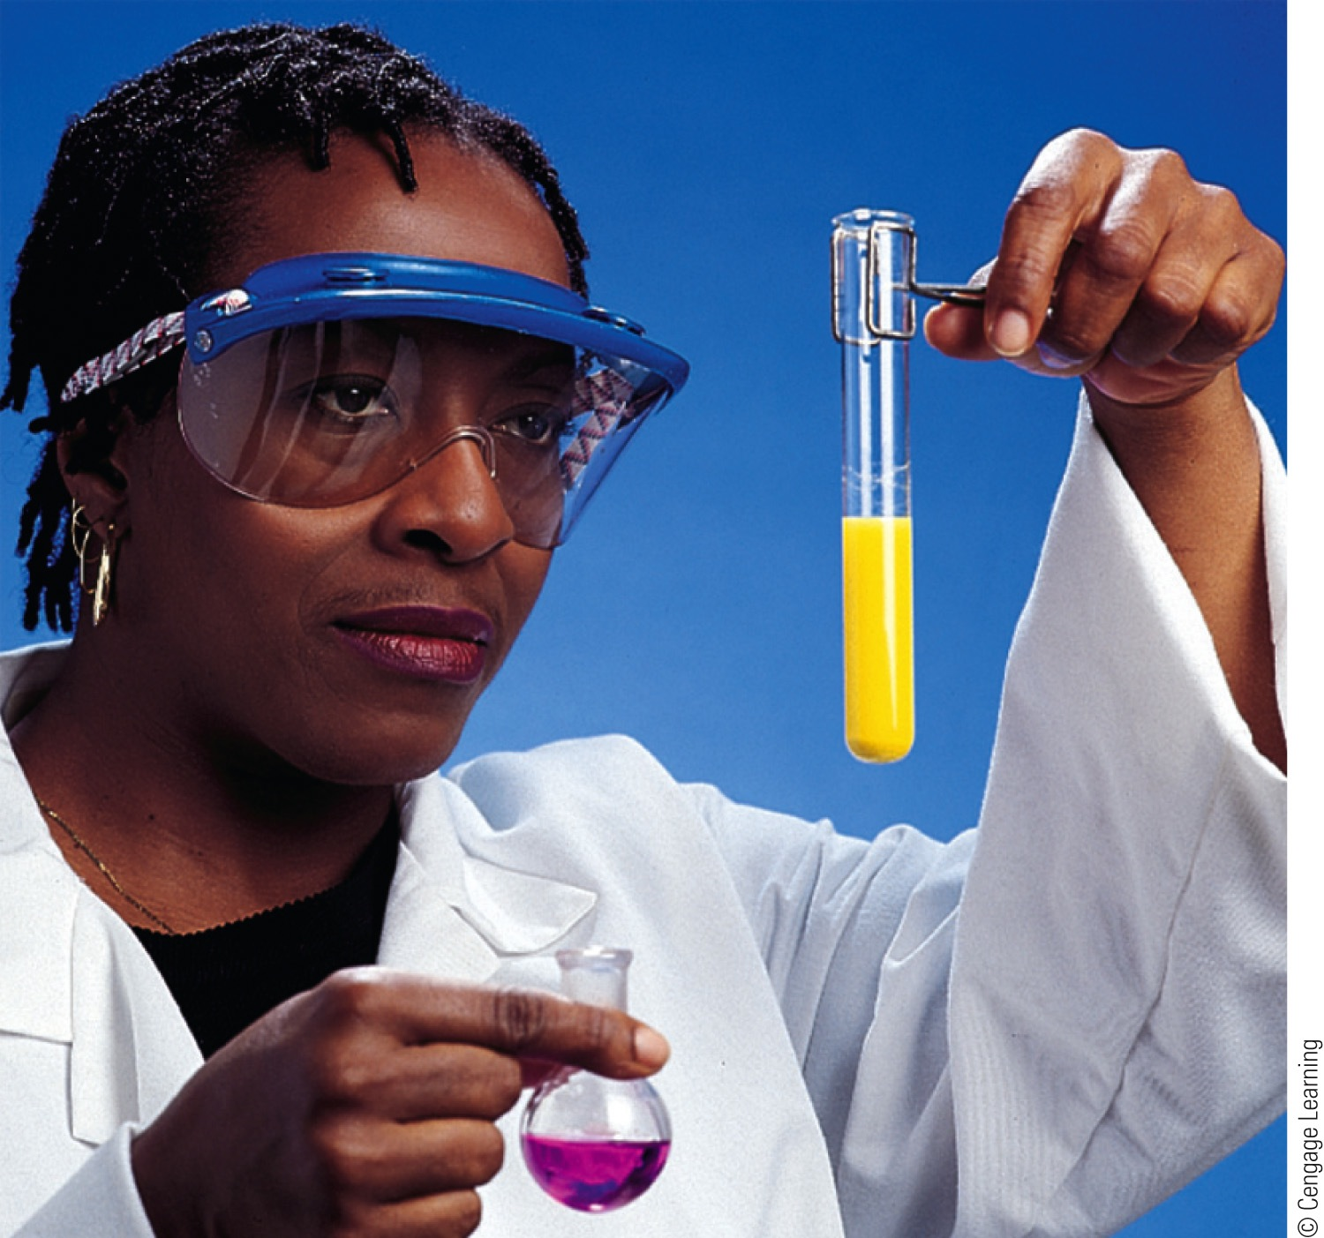
In this course, you will:
Learn the principles of chemistry.
Become a better problem solver!

Slide 4
The science that deals with the materials of the universe and the changes that these materials undergo.
Chemistry is the study of matter: its properties, interactions, reactions, and energy changes.
The central science.
Understanding most other fields of science requires an understanding of chemistry.

Slide 5
Recognize the problem and state it clearly.
Making an observation.

Slide 6
2. Propose possible solutions to the problem or possible explanations for the observation.
Formulating a hypothesis.

Slide 7
3. Decide which of the solutions is the best or decide whether the explanation proposed is reasonable.
Performing an experiment.
Scientific thinking can help you in all parts of your life!

Slide 8
Science
Science is a framework for gaining and organizing knowledge.
Science is a plan of action — a procedure for processing and understanding certain types of information.
Scientists are always challenging our current beliefs about science, asking questions, and experimenting to gain new knowledge.
Scientific method is needed.

Slide 9
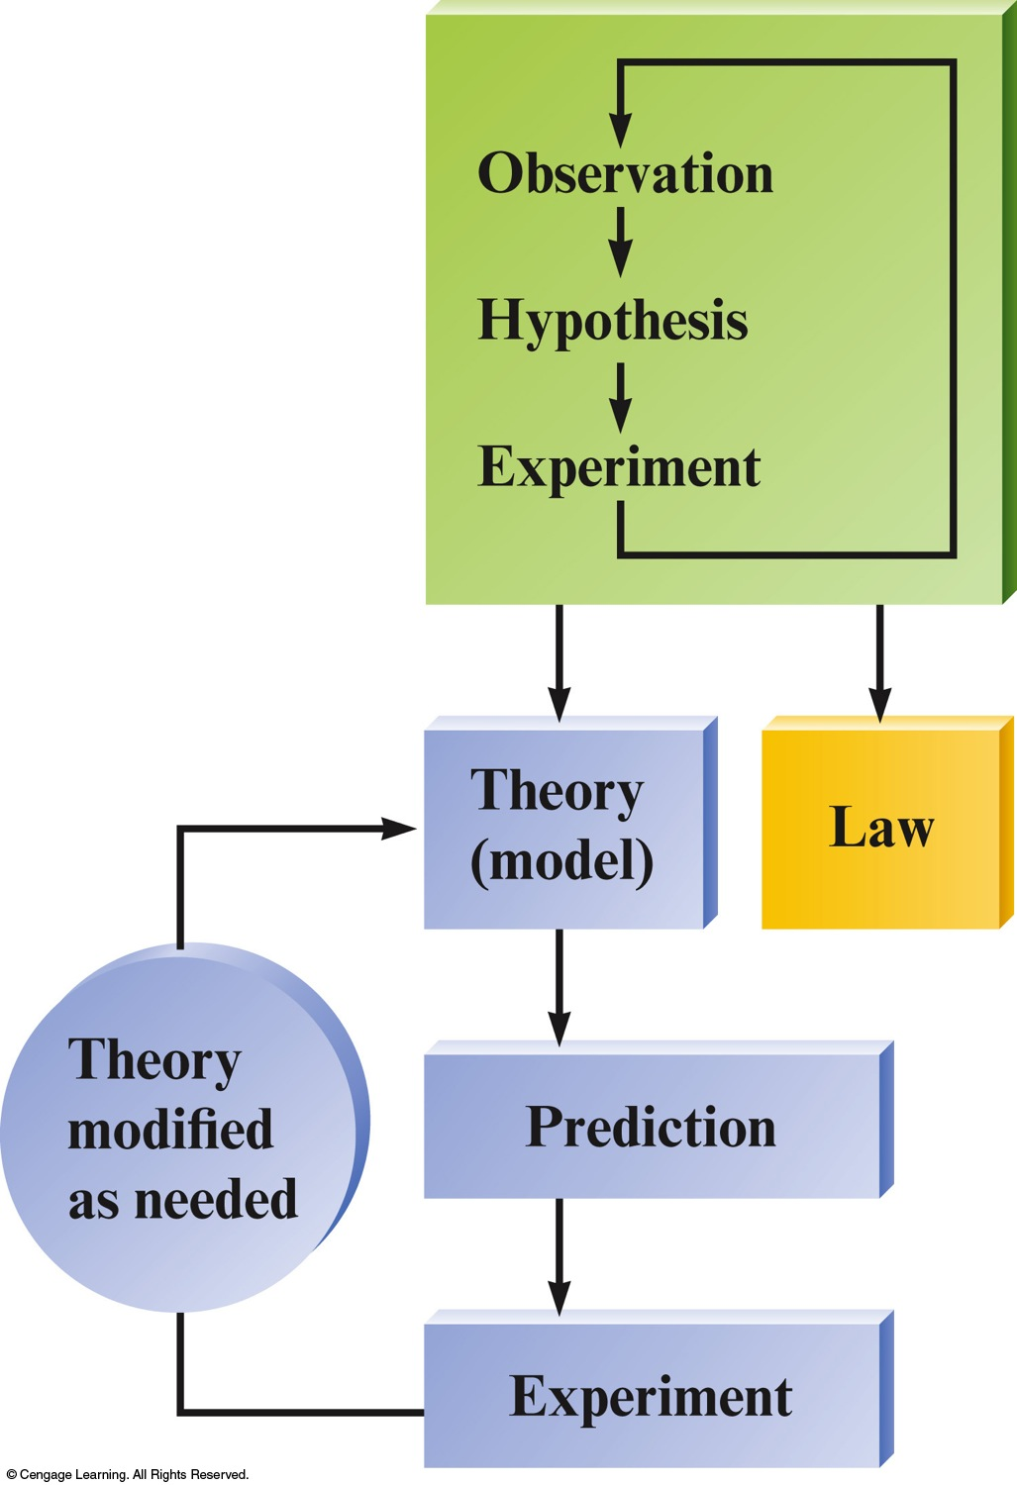
Steps in the Scientific Method
Process that lies at the center of scientific inquiry.

Slide 10
Concept Check
Which of the steps in the scientific method is missing from the following situation?
“Your instructor is holding a balloon and quickly inhales some of the gas inside the balloon. He then speaks and his voice changes to a high-pitched sound (and sounds quite funny!). He then asks you to determine what gas was inside the balloon that he inhaled. Based on your observations, you conclude that the gas must be helium.”
State the problem.
Make observations.
Formulate a hypothesis.
Perform experiments.
Notes:
The correct answer is d. Experiments must be performed to test and see if the gas is in fact helium. For example, a good test to perform would be a flammability test. This would produce new observations that could support or contradict your hypothesis.

Slide 11
Scientific Models
Law
A statement of fact
Summarizes what happens
Hypothesis
A possible explanation for an observation
Attempts to explain why something happens
Theory (Model)
Provides an overall explanation as to why it happens
Set of tested hypotheses that gives an overall explanation of some natural phenomenon.

Slide 12
Learn the vocabulary.
Memorize important information.
Learn and practice solving problems.
Keep working and learning from your mistakes.
Ask questions!

