Slide 1
Chapter 3
Matter

Slide 2
Matter
Anything occupying space and having mass.
Matter exists in three states.
Solid
Liquid
Gas

Slide 3
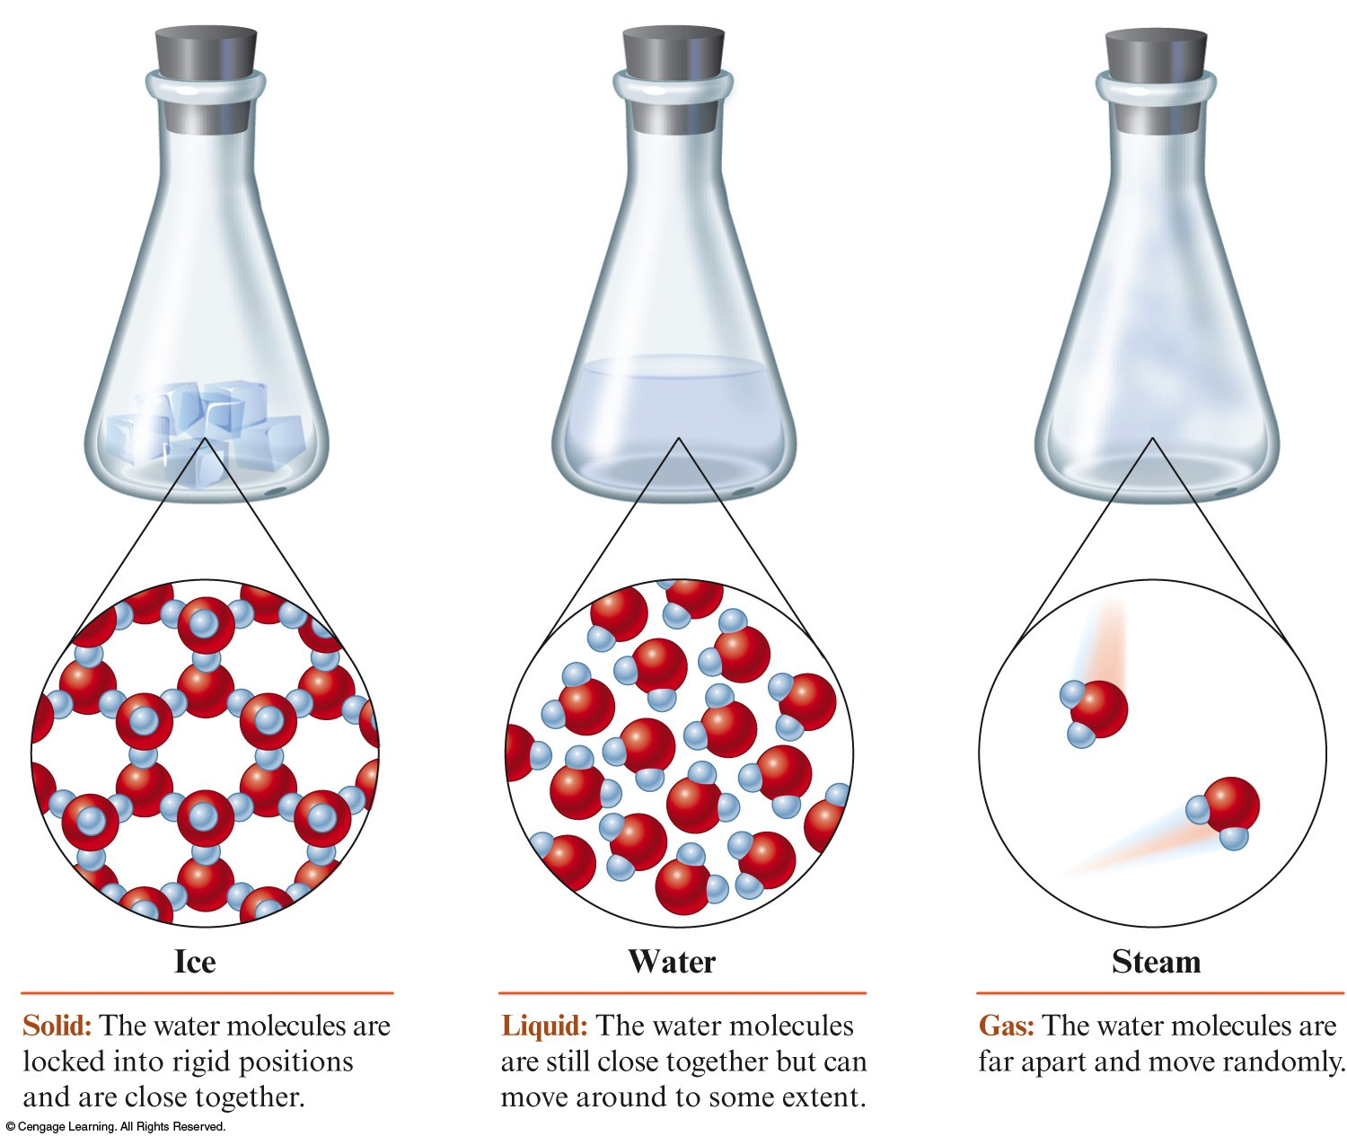
The Three States of Water

Slide 4
Solid
Rigid.
Has a fixed volume and shape.
Examples:
Ice cube, diamond, iron bar

Slide 5
Liquid
Has a definite volume.
Assumes shape of container.
Examples:
Gasoline, water, alcohol, blood

Slide 6
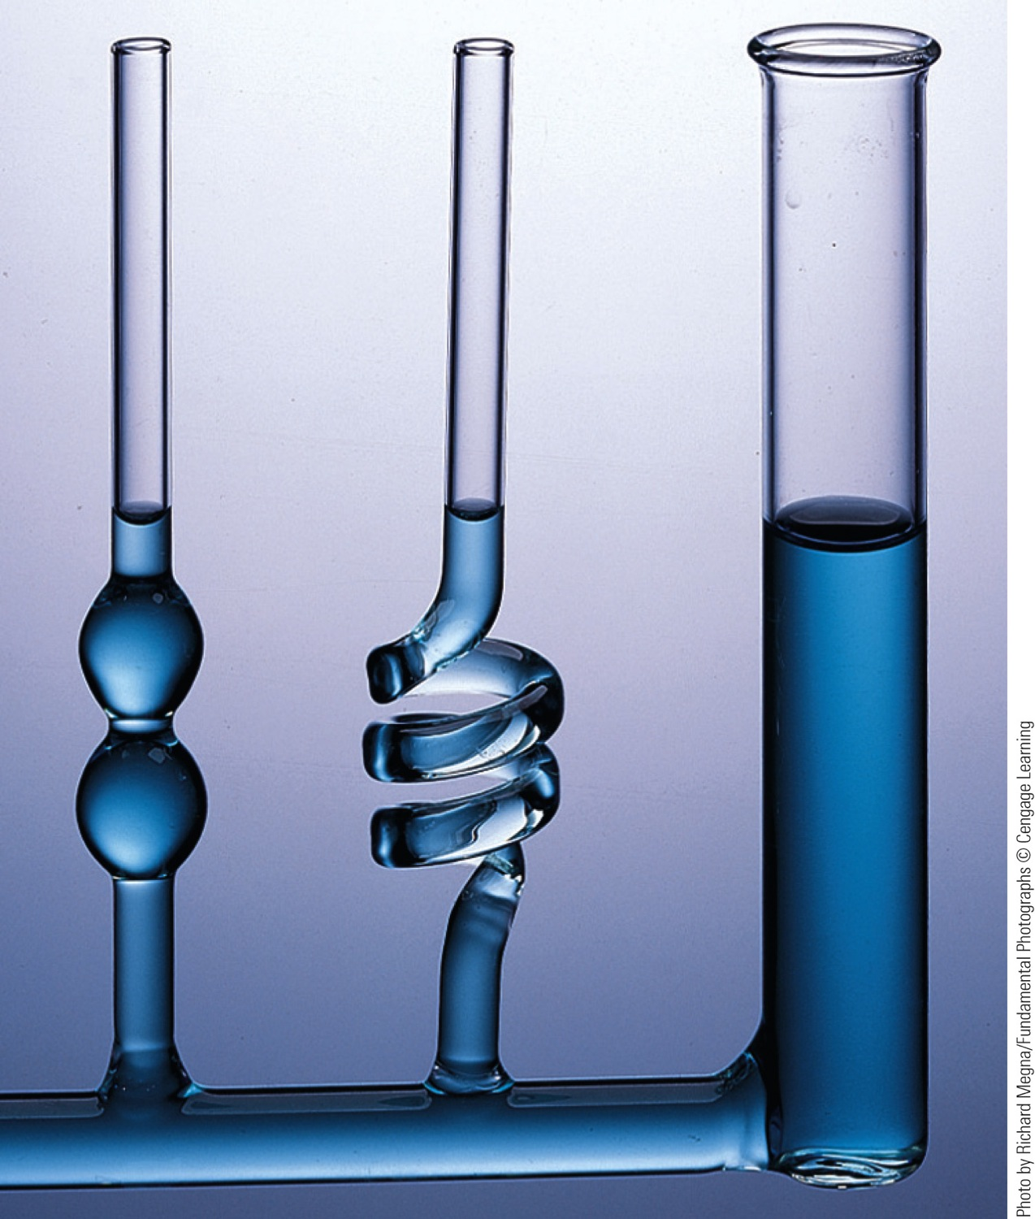
Liquid Water Takes the Shape of Its Container

Slide 7
Gas
Has no fixed volume or shape.
Takes the shape and volume of its container.
Examples:
Air, helium, oxygen

Slide 8
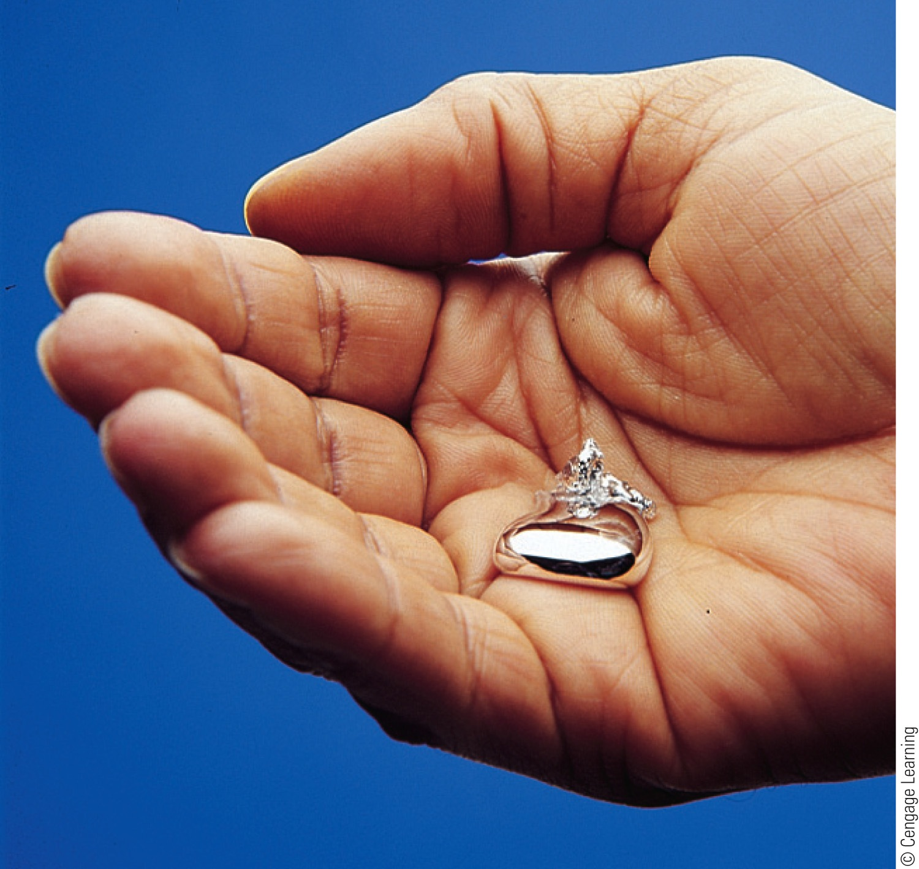
Physical Properties
Characteristics that are directly observable and unique to a substance.
Examples:
Odor, color, volume, state (s, l, or g), density, melting point, and boiling point

Slide 9
Chemical Properties
A substance’s ability to form new substances.
The characteristics that determine how the composition of matter changes as a result of contact with other matter or the influence of energy.
Characteristics that describe the behavior of matter.
Examples:
Flammability, rusting of steel, and the digestion of food

Slide 10
Concept Check
Classify each of the following as a physical or chemical property.
Ethyl alcohol boiling at 78°C
Hardness of a diamond
Sugar fermenting to form ethyl alcohol
physical
physical
chemical
Notes:
Ethyl alcohol boiling at 78°C
Physical property: boiling point is associated with a phase change. It describes an inherent characteristic of alcohol.
Hardness of a diamond.
Physical property: describes an inherent characteristic of diamond – hardness.
Sugar fermenting to form ethyl alcohol.
Chemical property: describes behavior of sugar – forming a new substance (ethyl alcohol) through a chemical reaction.

Slide 11
Physical Change
Change in one or more physical properties of a substance, not in its chemical composition.
Example:
Boiling or freezing water

Slide 12
Three States of Water
In all three phases, water molecules are still intact.
Motions of molecules and the distances between them change.

Slide 13
Chemical Change
A given substance becomes a new substance or substances with different properties and different composition.
Example:
Bunsen burner (methane reacts with oxygen to form carbon dioxide and water)

Slide 14
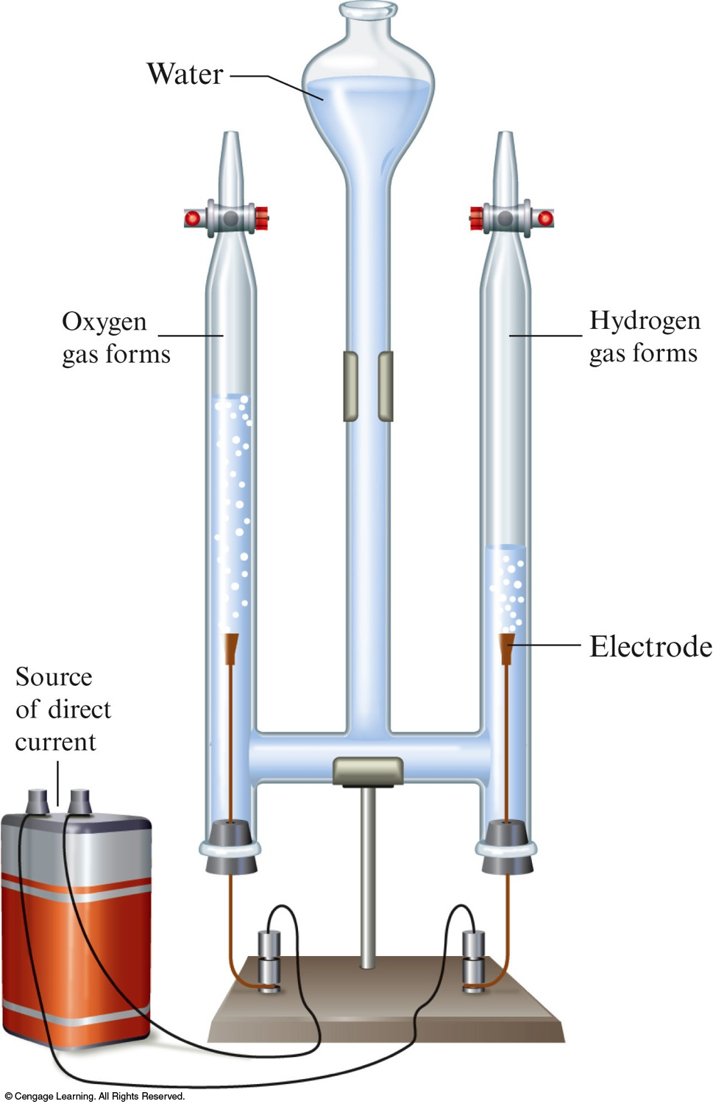
Electrolysis of Water

Slide 15
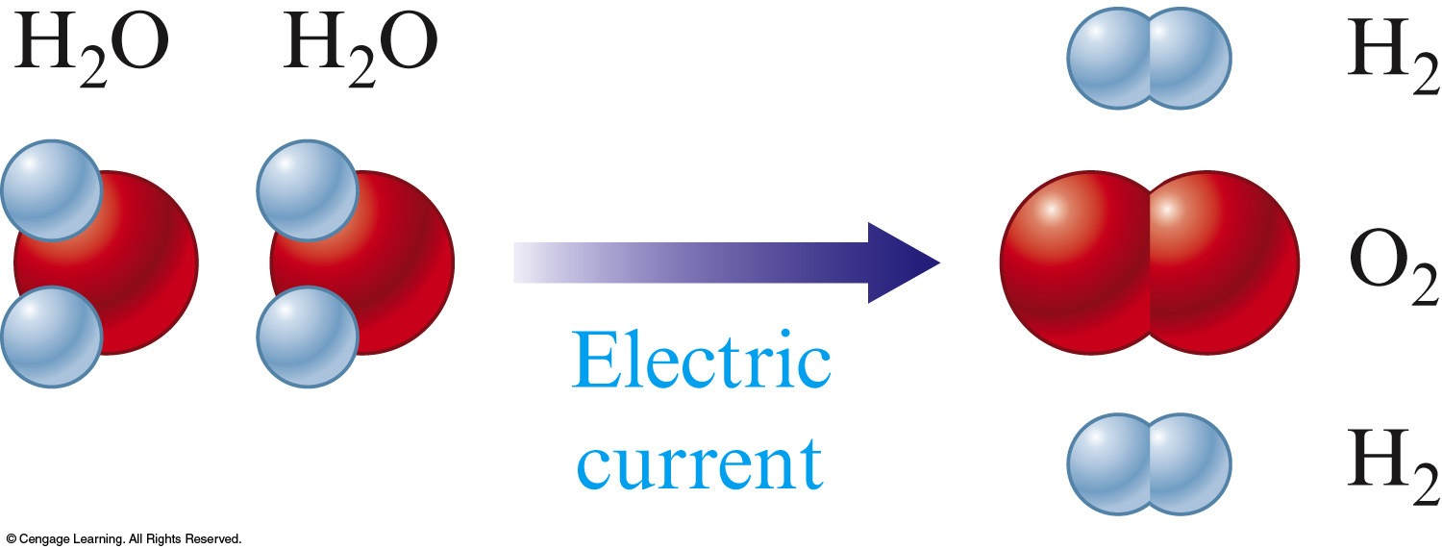
Electrolysis of Water
Water decomposes to hydrogen and oxygen gases.

Slide 16
Concept Check
Which of the following are examples of a chemical change?
Pulverizing (crushing) rock salt
Burning of wood
Dissolving of sugar in water
Melting a popsicle on a warm summer day
Notes:
1 (burning of wood)

Slide 17
Concept Check
Classify each of the following as a physical or chemical change.
Sugar fermenting to form ethyl alcohol
Iron metal melting
Iron combining with oxygen to form rust
chemical
physical
chemical
Notes:
Sugar fermenting to form ethyl alcohol.
Chemical change: describes how sugar forms a new substance (ethyl alcohol) via a chemical reaction.
Iron metal melting.
Physical change: describes a state change, but the material is still iron.
Iron combining with oxygen to form rust.
Chemical change: describes how iron and oxygen react to make a new substance, rust.

Slide 18
Element
A substance that cannot be broken down into other substances by chemical methods.
Examples:
Iron (Fe), aluminum (Al), oxygen (O₂), and hydrogen (H₂)
All of the matter in the world around us contains elements.

Slide 19
Compound
A substance composed of a given combination of elements that can be broken down into those elements by chemical methods.
Examples:
Water (H₂O), carbon dioxide (CO₂), table sugar (C₁₂H₂₂O₁₁)
A compound always contains atoms of different elements.
A compound always has the same composition (same combination of atoms).

Slide 20
Concept Check
How many of the following are compounds?
H₂O, N₂O₄, NaOH, MnO₂, HF
Five – All of the substances are compounds.
Notes:
Five – All of the substances are compounds. Compounds always contain atoms of different elements.

Slide 21
Pure Substances
Always have the same composition.
Either elements or compounds.
Examples:
Pure water (H₂O), carbon dioxide (CO₂), hydrogen (H₂), gold (Au)

Slide 22
Mixtures
Have variable composition.
Examples
Wood, wine, coffee
Can be separated into pure substances: elements and/or compounds.

Slide 23
Homogeneous Mixture
Same throughout.
Consists of visibly indistinguishable parts.
A solution.
Does not vary in composition from one region to another.

Slide 24
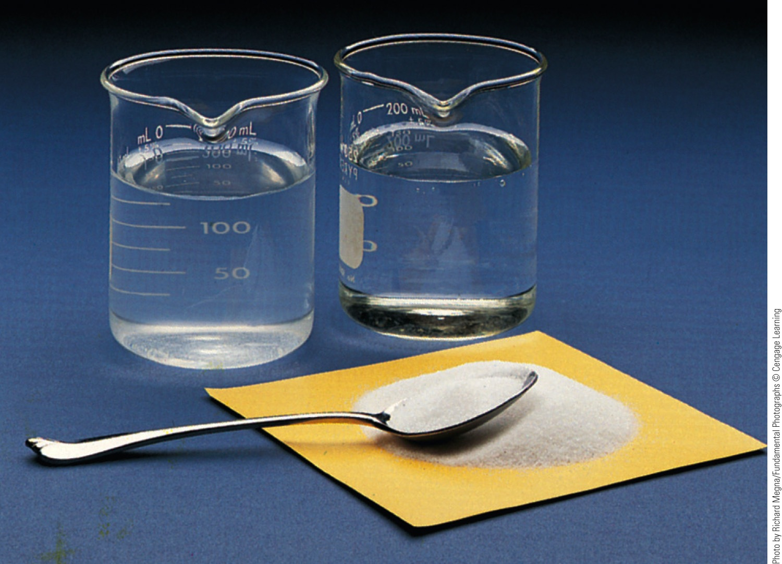
Homogeneous Mixture – Examples
Air around you
Brass
Table salt stirred into water

Slide 25
Heterogeneous Mixture
Consists of visibly distinguishable parts.
Contains regions that have different properties from those of other regions.

Slide 26
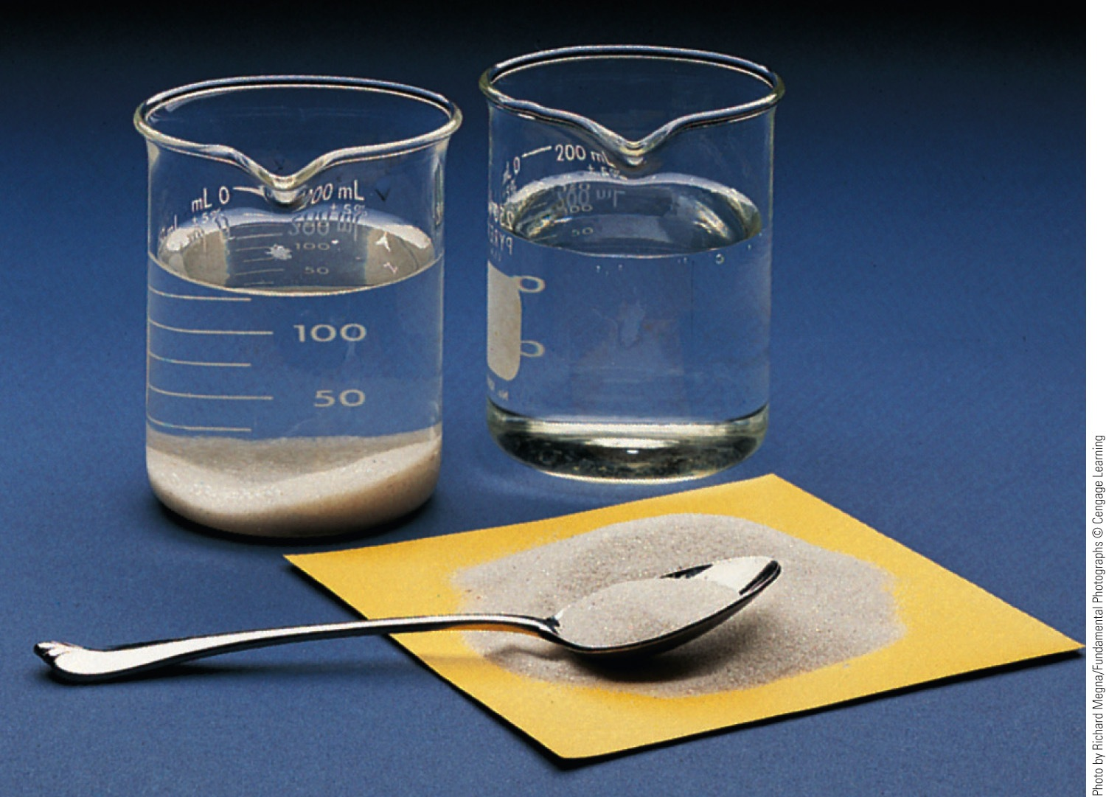
Heterogeneous Mixture – Examples
Oil and vinegar dressing
Sand stirred into water

Slide 27
Concept Check
Which of the following is a homogeneous mixture?
Pure water
Gasoline
Jar of jelly beans
Soil
Copper metal
Notes:
gasoline

Slide 28
Mixtures can be separated based on different physical properties of the components.
Different Physical Property
Technique
Boiling point
Distillation
State of matter
(solid/liquid/gas)
Filtration
Adherence to a surface
Chromatography
Volatility
Evaporation

Slide 29
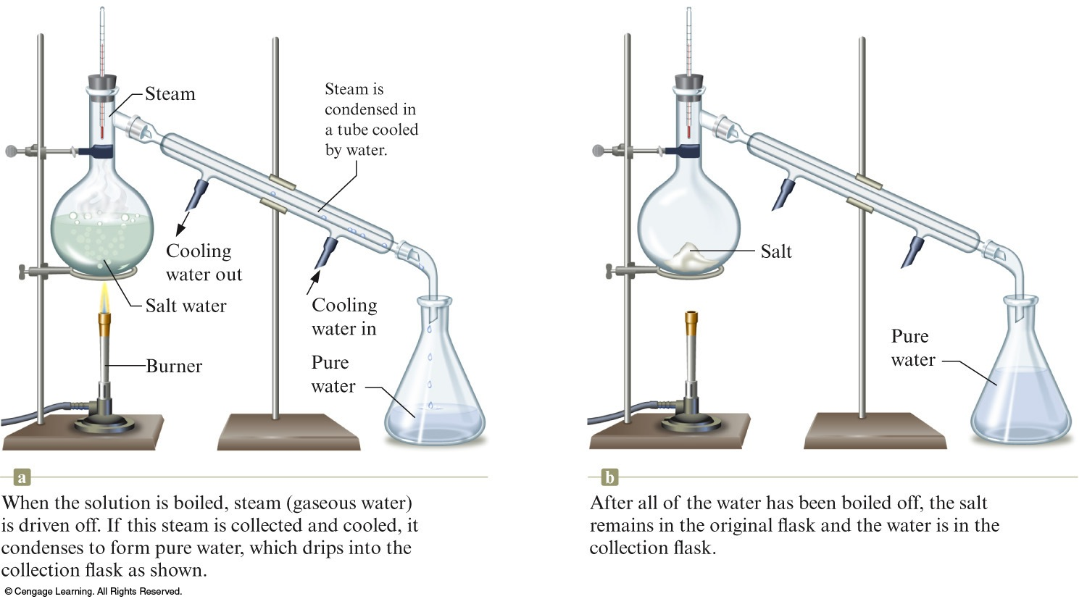
Distillation of a Solution Consisting of Salt Dissolved in Water

Slide 30
No chemical change occurs when salt water is distilled.

Slide 31
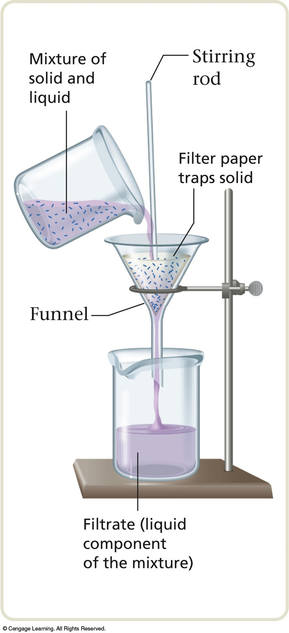
Filtration
Separates a liquid from a solid.

Slide 32
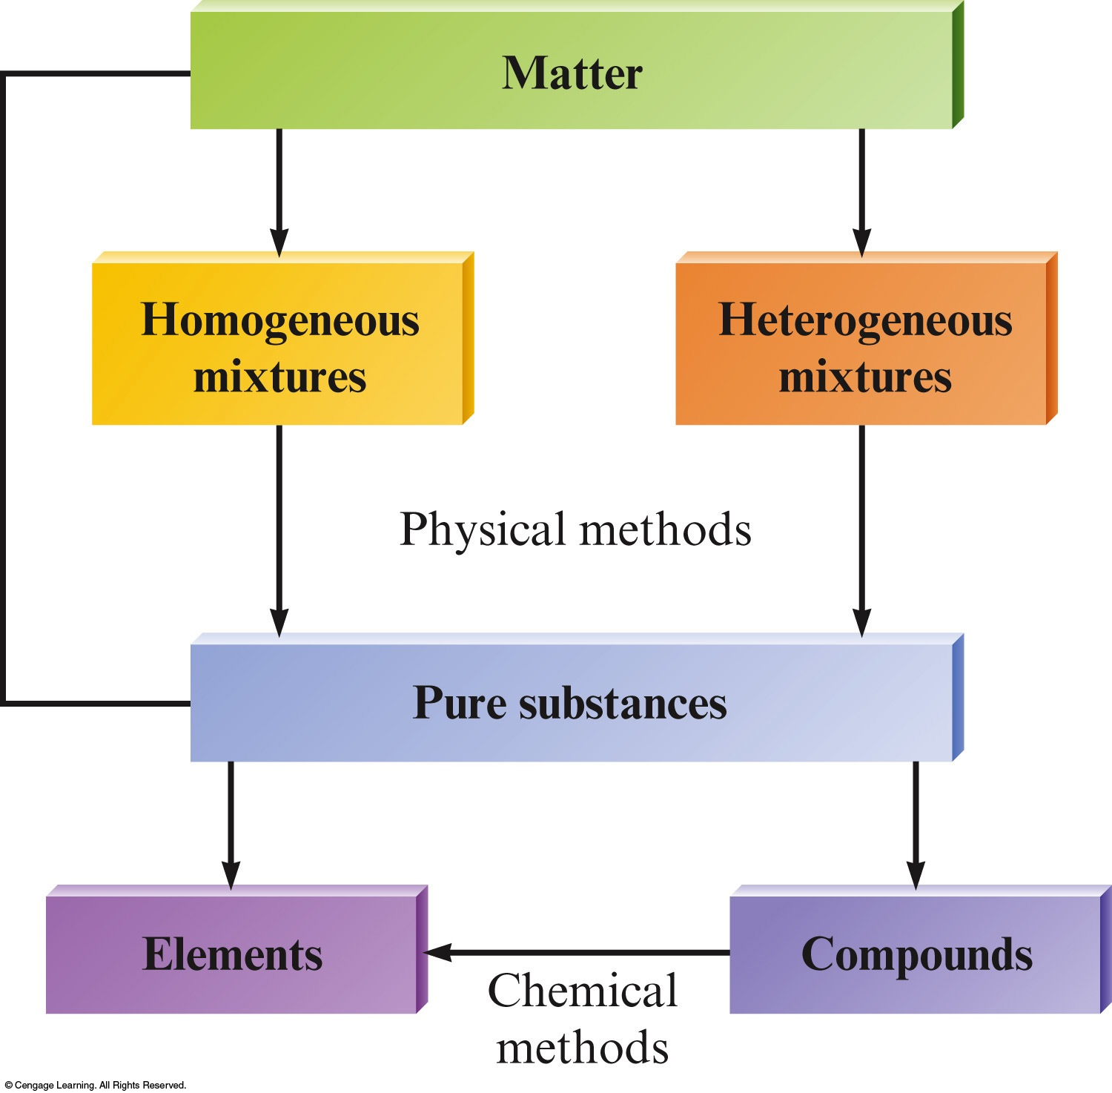
The Organization of Matter

