Slide 1
Chapter 4 (part 1)
Chemical Foundations: Elements, Atoms, and Ions

Slide 2
118 known: 88 found in nature, others are made in laboratories.
Just as you had to learn the 26 letters of the alphabet before you learned to read and write, you need to learn the names and symbols of the chemical elements before you can read and write chemistry.

Slide 3
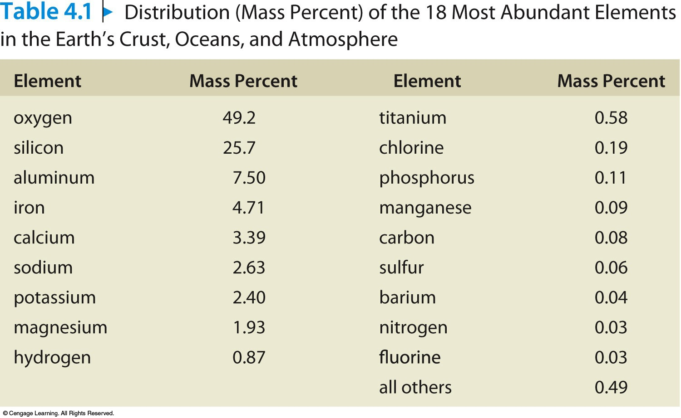

Slide 4
How the Term Element is Used
Could mean a single atom of an element (Ar or H).
Could mean molecules of an element (H₂), which is hydrogen found in its natural state.
Could mean atoms of an element are present in some form (sodium found in the human body).
Look at each particular case to determine its proper use.

Slide 5
Each element has a unique one- or two-letter symbol.
First letter is always capitalized and the second is not.
The symbol usually consists of the first one or two letters of the element’s name.
Examples: Oxygen O Krypton Kr
Sometimes the symbol is taken from the element’s original Latin or Greek name.
Examples: Gold Au aurum Lead Pb plumbum

Slide 6
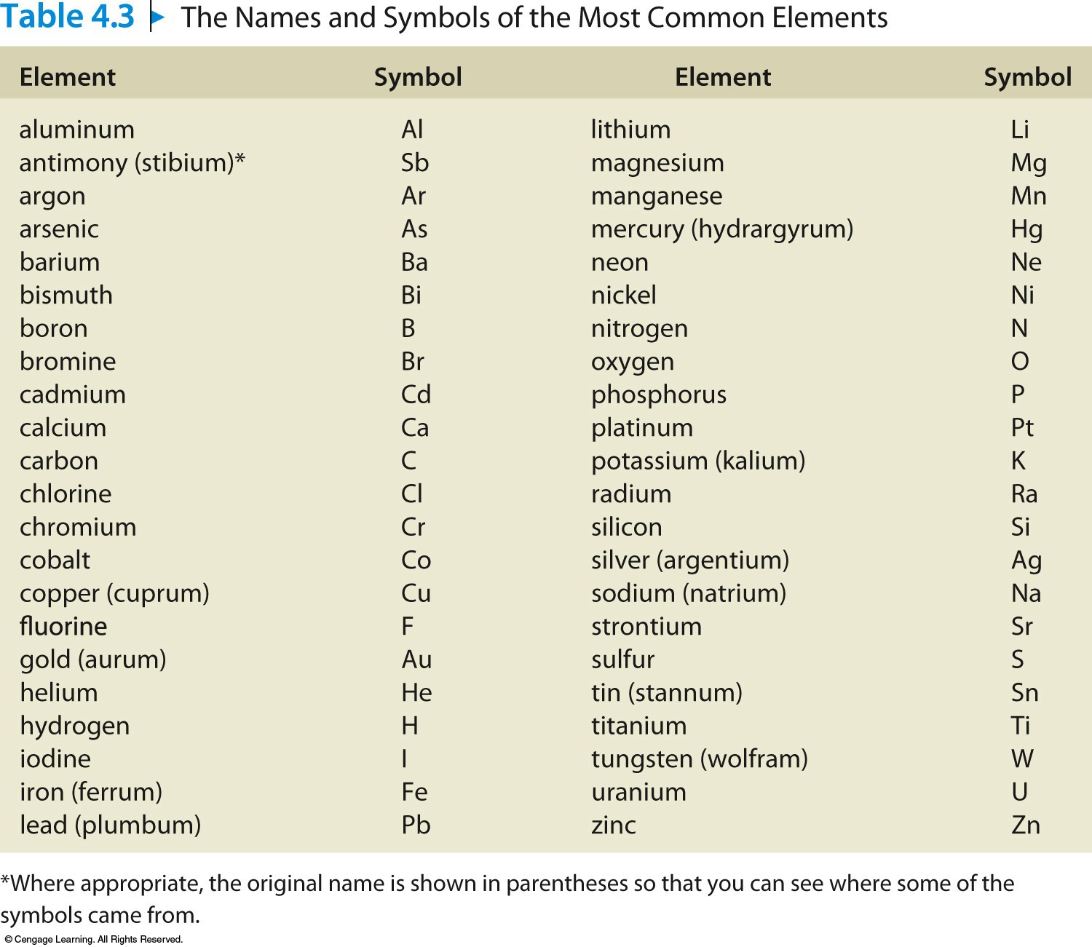
Names and Symbols of the Most Common Elements

Slide 7
Most natural materials are mixtures of pure substances.
Pure substances are either elements or combinations of elements called compounds.
A given compound always contains the same proportions (by mass) of the elements.

Slide 8
Law of Constant Composition
A given compound always has the same composition, regardless of where it comes from.
Water always contains 8 g of oxygen for every 1 g of hydrogen.
Carbon dioxide always contains 2.7 g of oxygen for every 1 g of carbon.

Slide 9
Dalton’s Atomic Theory (1808)
Elements are made of tiny particles called atoms.

Slide 10
Dalton’s Atomic Theory (continued)
2. All atoms of a given element are identical.

Slide 11
Dalton’s Atomic Theory (continued)
3. The atoms of a given element are different from those of any other element.

Slide 12
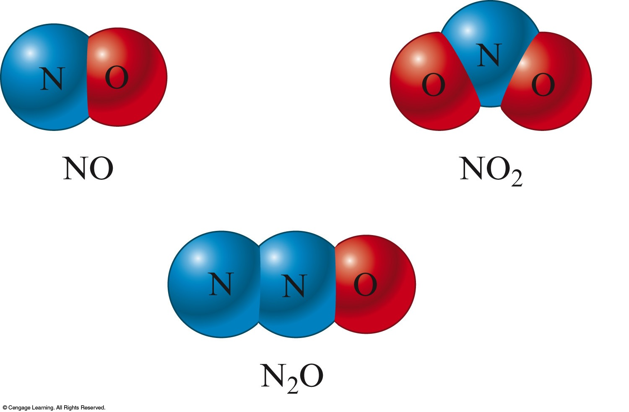
Dalton’s Atomic Theory (continued)
Atoms of one element can combine with atoms of other elements to form compounds. A given compound always has the same relative numbers and types of atoms.

Slide 13
Dalton’s Atomic Theory (continued)
5. Atoms are indivisible in chemical processes. Atoms are not created or destroyed in chemical reactions. A chemical reaction simply changes the way the atoms are grouped together.

Slide 14
Concept Check
Which of the following statements regarding Dalton’s atomic theory are still believed to be true?
Elements are made of tiny particles called atoms.
All atoms of a given element are identical.
A given compound always has the same relative
numbers and types of atoms.
IV. Atoms are indestructible.
Notes:
Statements I and III are true. Statement II is not true (due to isotopes and ions). Statement IV is not true (due to nuclear chemistry).

Slide 15
Chemical Formulas Describe Compounds
Compound – distinct substance that is composed of the atoms of two or more elements and always contains exactly the same relative masses of those elements.
Chemical Formulas – expresses the types of atoms and the number of each type in each unit (molecule) of a given compound.

Slide 16
Rules for Writing Formulas
Each atom present is represented by its element symbol.
The number of each type of atom is indicated by a subscript written to the right of the element symbol.
When only one atom of a given type is present, the subscript 1 is not written.

Slide 17
Exercise
The pesticide known as DDT paralyzes insects by binding to their nerve cells, leading to uncontrolled firing of the nerves. Before most uses of DDT were banned in the U.S., many insects had developed a resistance to it. Write out the formula for DDT. It contains 14 carbon atoms, 9 hydrogen atoms, and 5 atoms of chlorine.
C₁₄H₉Cl₅
Notes:
C₁₄H₉Cl₅

Slide 18
J. J. Thomson (1898—1903)
Postulated the existence of electrons using cathode-ray tubes.
The atom must also contain positive particles that balance exactly the negative charge carried by particles that we now call electrons.

Slide 19
Cathode-Ray Tube

Slide 20
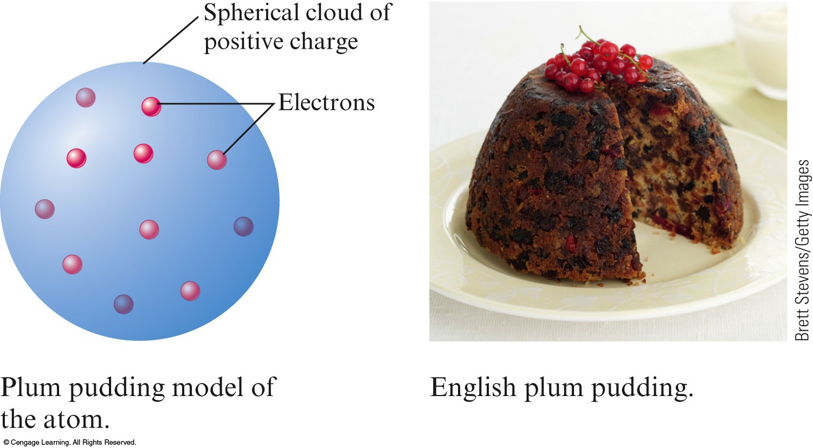
William Thomson (Plum Pudding Model)
Reasoned that the atom might be thought of as a uniform “pudding” of positive charge with enough negative electrons scattered within to counterbalance that positive charge.

Slide 21
Ernest Rutherford (1911)
Explained the nuclear atom.
Atom has a dense center of positive charge called the nucleus.
Electrons travel around the nucleus at a relatively large distance.
A proton has the same magnitude of charge as the electron, but its charge is positive.

Slide 22
Rutherford and Chadwick (1932)
Most nuclei also contain a neutral particle called the neutron.
A neutron is slightly more massive than a proton but has no charge.

Slide 23
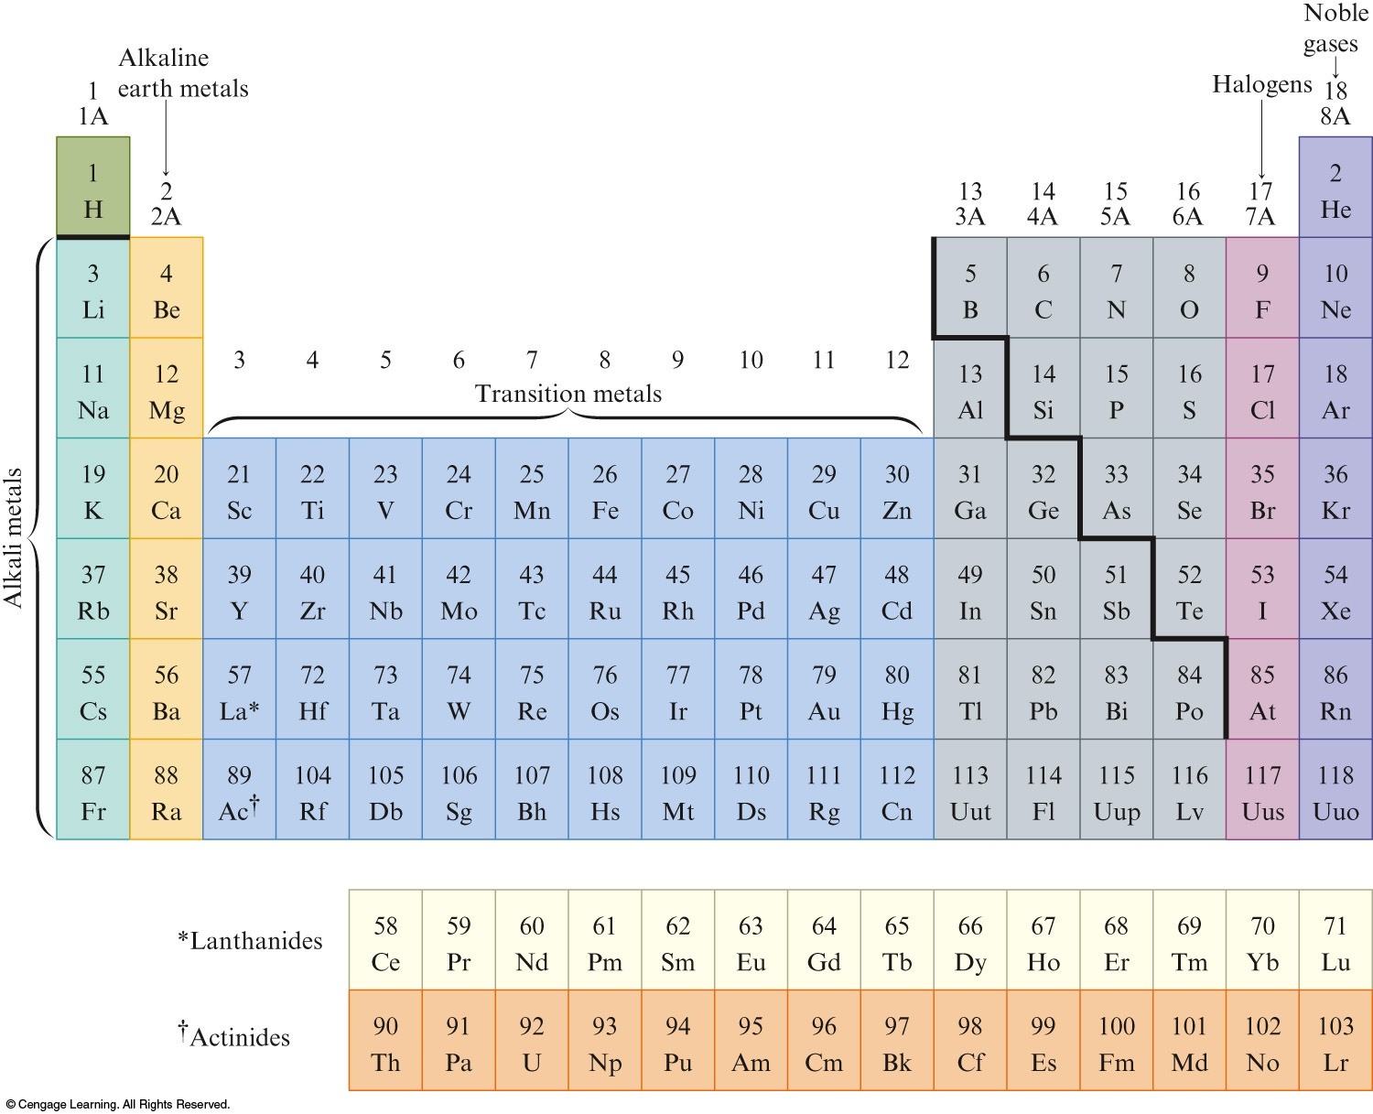
The atom contains:
Electrons – found outside the nucleus; negatively charged
Protons – found in the nucleus; positive charge equal in magnitude to the electron’s negative charge
Neutrons – found in the nucleus; no charge; virtually same mass as a proton

Slide 24
The nucleus is:
Small compared with the overall size of the atom.
Extremely dense; accounts for almost all of the atom’s mass.

Slide 25
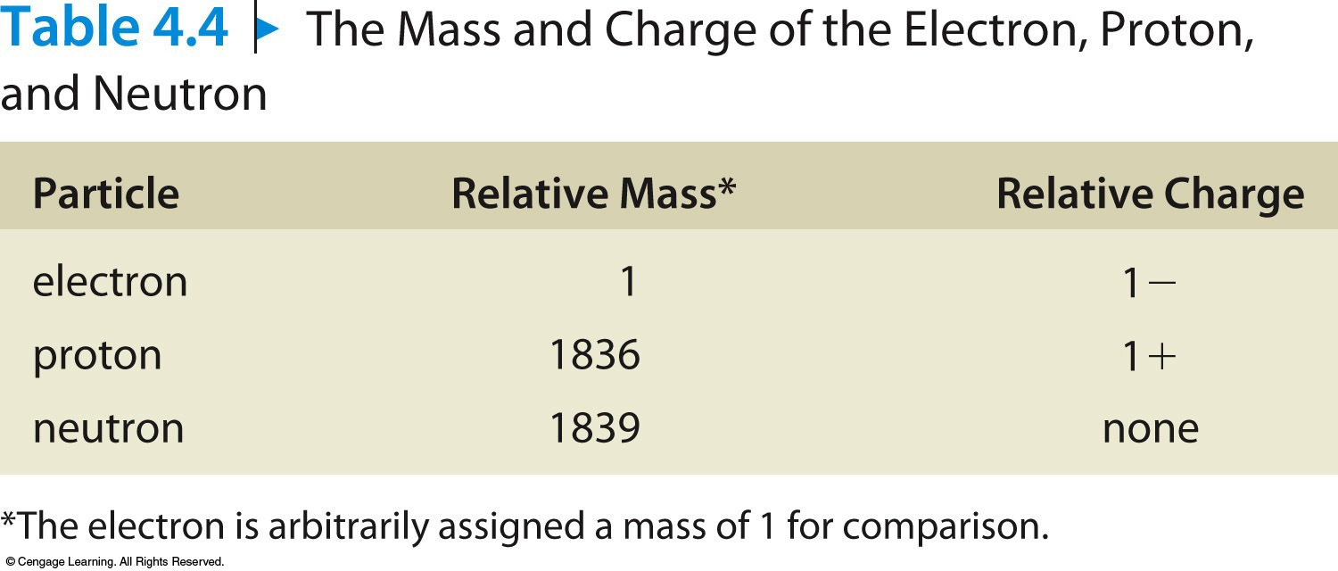

Slide 26
Why do different atoms have different chemical properties?
The chemistry of an atom arises from its electrons.
Electrons are the parts of atoms that “intermingle” when atoms combine to form molecules.
It is the number of electrons that really determines chemical behavior.

Slide 27
Isotopes
Atoms with the same number of protons but different numbers of neutrons.
Show almost identical chemical properties; chemistry of atom is due to its electrons.
In nature most elements contain mixtures of isotopes.

Slide 28
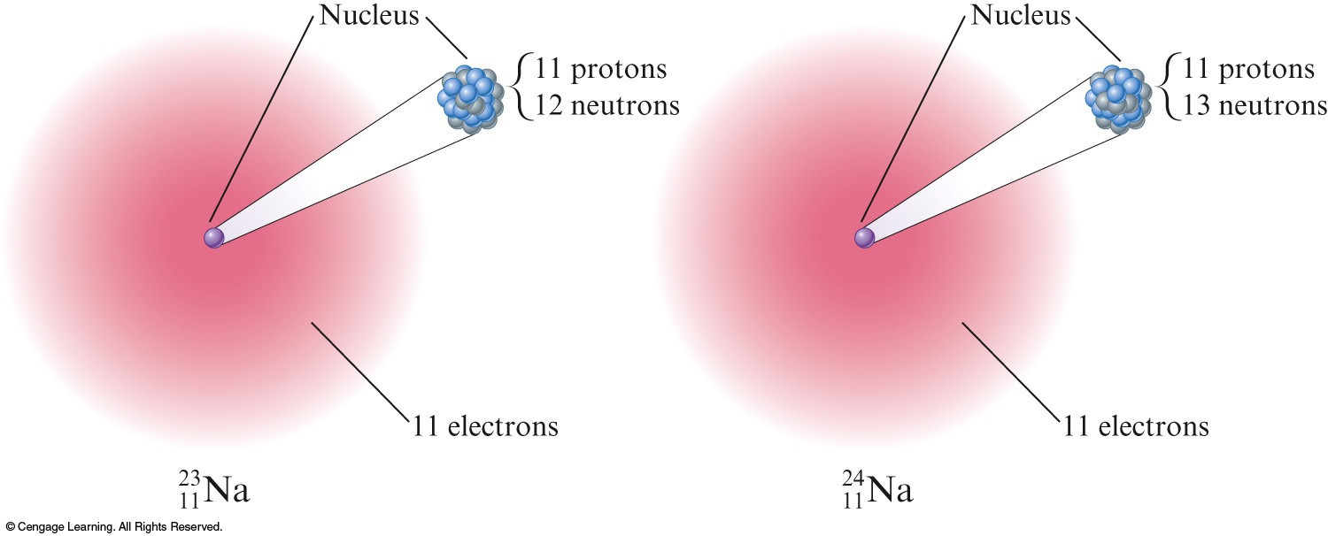
Two Isotopes of Sodium

Slide 29
Isotopes
X = the symbol of the element
A = the mass number (# of protons and neutrons)
Z = the atomic number (# of protons)

Slide 30
Isotopes – An Example
C = the symbol for carbon
6 = the atomic number (6 protons)
14 = the mass number (6 protons and 8 neutrons)
C = the symbol for carbon
6 = the atomic number (6 protons)
12 = the mass number (6 protons and 6 neutrons)

Slide 31
Exercise
A certain isotope X contains 23 protons and 28 neutrons.
What is the mass number of this isotope?
Identify the element.
Mass Number = 51
Vanadium
Notes:
The mass number is 51. Mass Number = # protons + # neutrons. Mass Number = 23 + 28 = 51. The element is vanadium. The number of protons determines the identity of the element.

Slide 32
The Periodic Table
The periodic table shows all of the known elements in order of increasing atomic number.

Slide 33
The Periodic Table
Metals vs. Nonmetals
Groups or Families – elements in the same vertical columns; have similar chemical properties
Periods – horizontal rows of elements

Slide 34
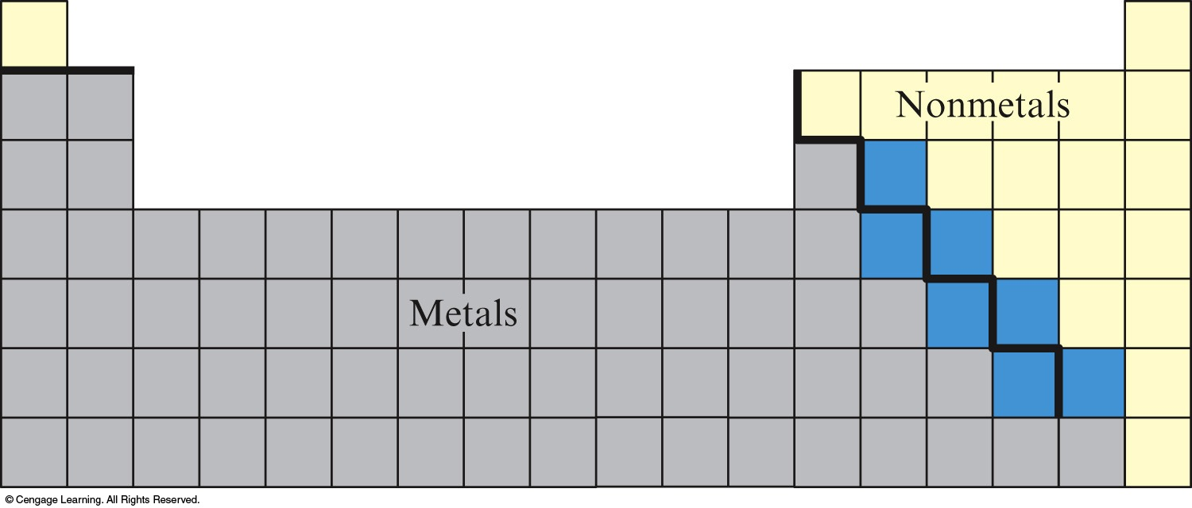
The Periodic Table
Most elements are metals and occur on the left side.
The nonmetals appear on the right side.
Metalloids are elements that have some metallic and some nonmetallic properties.

Slide 35
Physical Properties of Metals
Efficient conduction of heat and electricity
Malleability (they can be hammered into thin sheets)
Ductility (they can be pulled into wires)
A lustrous (shiny) appearance

Slide 36
Physical Properties of Nonmetals
Lack properties of metals
Exhibit much variation in properties
Can be gases, liquids, or solids

Slide 37
Physical Properties of Metalloids
Exhibit a mixture of metallic and non-metallic properties

