Slide 1
Chapter 9
Chemical Quantities

Slide 2
A balanced chemical equation gives relative numbers (or moles) of reactant and product molecules that participate in a chemical reaction.
The coefficients of a balanced equation give the relative numbers of molecules.

Slide 3
C₂H₅OH + 3O₂ → 2CO₂ + 3H₂O
The equation is balanced.
All atoms present in the reactants are accounted for in the products.
1 molecule of ethanol reacts with 3 molecules of oxygen to produce 2 molecules of carbon dioxide and 3 molecules of water.
1 mole of ethanol reacts with 3 moles of oxygen to produce 2 moles of carbon dioxide and 3 moles of water.

Slide 4
Concept Check
One of the key steps in producing pure copper from copper ores is the reaction below:
Cu₂S(s) + Cu₂O(s) → Cu(s) + SO₂(g) (unbalanced)
After balancing the reaction, determine how many dozen copper atoms could be produced from a dozen molecules of the sulfide and two dozen of the oxide of copper (I). Also, how many moles of copper could be produced from one mole of the sulfide and two moles of the oxide?
a) 1 dozen and 1 mole
b) 2 dozen and 2 moles
c) 3 dozen and 3 moles
d) 6 dozen and 6 moles
Notes:
The correct answer is d. The balanced equation is: Cu₂S(s) + 2Cu₂O(s) → 6Cu(s) + SO₂(g)

Slide 5
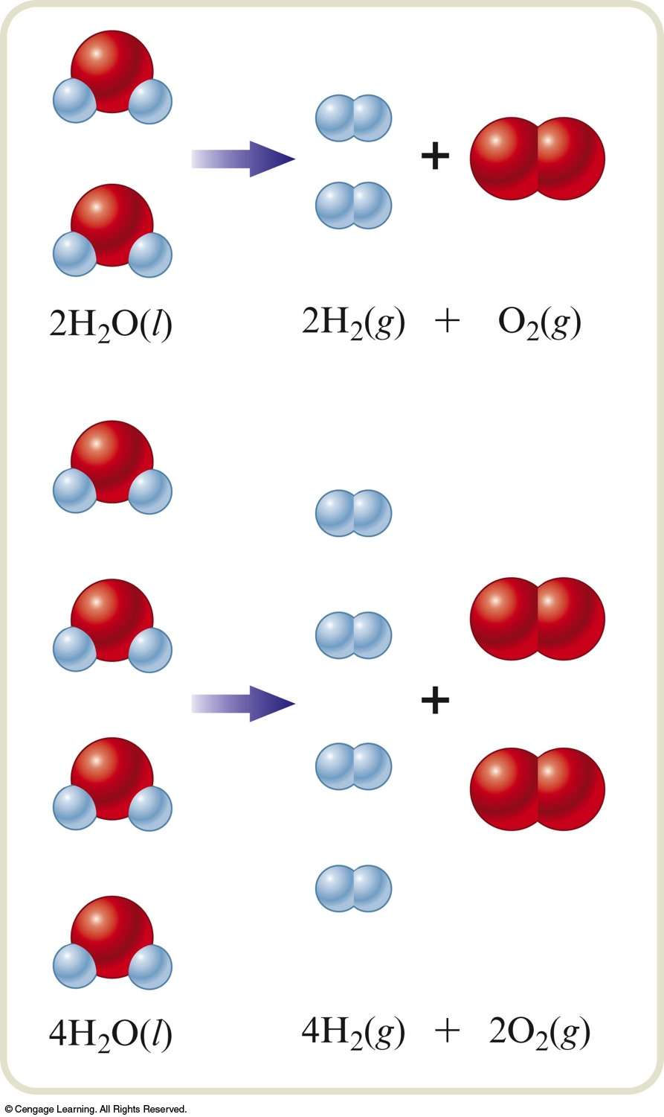
A balanced equation can predict the moles of product that a given number of moles of reactants will yield.
2 mol of H₂O yields 2 mol of H₂ and 1 mol of O₂.
4 mol of H₂O yields 4 mol of H₂ and 2 mol of O₂.
2H₂O(l) → 2H₂(g) + O₂(g)

Slide 6
Mole Ratio
The mole ratio allows us to convert from moles of one substance in a balanced equation to moles of a second substance in the equation.

Slide 7
Example
Consider the following balanced equation:
Na₂SiF₆(s) + 4Na(s) → Si(s) + 6NaF(s)
How many moles of NaF will be produced if 3.50 moles of Na is reacted with excess Na₂SiF₆?
Where are we going?
We want to determine the number of moles of NaF produced by Na with excess Na₂SiF₆.
What do we know?
The balanced equation.
We start with 3.50 mol Na.

Slide 8
Example
Consider the following balanced equation:
Na₂SiF₆(s) + 4Na(s) → Si(s) + 6NaF(s)
How many moles of NaF will be produced if 3.50 moles of Na is reacted with excess Na₂SiF₆?
How do we get there?

Slide 9
Exercise
Propane, C₃H₈, is a common fuel used in heating homes in rural areas. Predict how many moles of CO₂ are formed when 3.74 moles of propane are burned in excess oxygen according to the equation:
C₃H₈ + 5O₂ → 3CO₂ + 4H₂O
a) 11.2 moles
b) 7.48 moles
c) 3.74 moles
d) 1.25 moles
Notes:
The correct answer is a.
(3.74 mol C₃H₈) × (3 mol CO₂/1 mol C₃H₈) = 11.2 mol CO₂

Slide 10
Steps for Calculating the Masses of Reactants and Products in Chemical Reactions
Balance the equation for the reaction.
Convert the masses of reactants or products to moles.
Use the balanced equation to set up the appropriate mole ratio(s).
Use the mole ratio(s) to calculate the number of moles of the desired reactant or product.
Convert from moles back to masses.

Slide 11
Stoichiometry
Stoichiometry is the process of using a balanced chemical equation to calculate the relative masses of reactants and products involved in a reaction.

Slide 12
Example
For the following unbalanced equation:
Cr(s) + O₂(g) → Cr₂O₃(s)
How many grams of chromium(III) oxide can be produced from 15.0 g of solid chromium and excess oxygen gas?
Where are we going?
We want to determine the mass of Cr₂O₃ produced by Cr with excess O₂.

Slide 13
Example
For the following unbalanced equation:
Cr(s) + O₂(g) → Cr₂O₃(s)
How many grams of chromium(III) oxide can be produced from 15.0 g of solid chromium and excess oxygen gas?
What do we know?
The unbalanced equation.
We start with 15.0 g Cr.
We know the atomic masses of chromium (52.00 g/mol) and oxygen (16.00 g/mol) from the periodic table.

Slide 14
Example
For the following unbalanced equation:
Cr(s) + O₂(g) → Cr₂O₃(s)
How many grams of chromium(III) oxide can be produced from 15.0 g of solid chromium and excess oxygen gas?
What do we need to know?
We need to know the balanced equation.
4Cr(s) + 3O₂(g) → 2Cr₂O₃(s)
We need the molar mass of Cr₂O₃.
152.00 g/mol

Slide 15
How do we get there?
4Cr(s) + 3O₂(g) → 2Cr₂O₃(s)
Convert the mass of Cr to moles of Cr.
Determine the moles of Cr₂O₃ produced by using the mole ratio from the balanced equation.

Slide 16
How do we get there?
4Cr(s) + 3O₂(g) → 2Cr₂O₃(s)
Convert moles of Cr₂O₃ to grams of Cr₂O₃.
Conversion string:

Slide 17
Exercise
Tin(II) fluoride is added to some dental products to help prevent cavities. Tin(II) fluoride is made according to the following equation:
Sn(s) + 2HF(aq) → SnF₂(aq) + H₂(g)
How many grams of tin(II) fluoride can be made from 55.0 g of hydrogen fluoride if there is plenty of tin available to react?
a) 431 g
b) 215 g
c) 72.6 g
d) 1.37 g
Notes:
The correct answer is b.
(55.0 g HF) × (1 mol HF/20.008 g HF) × (1 mol SnF₂/2 mol HF) × (156.71 g SnF₂/1 mol SnF₂) = 215 g SnF₂

Slide 18
Exercise
Consider the following reaction:
PCl₃ + 3H₂O → H₃PO₃ + 3HCl
What mass of H₂O is needed to completely react with 20.0 g of PCl₃?
7.87 g
0.875 g
5.24 g
2.62 g
Notes:
The correct answer is a.
(20.0 g PCl₃) × (1 mol PCl₃/137.32 g PCl₃) × (3 mol H₂O/1 mol PCl₃) × (18.016 g H₂O/1 mol H₂O) = 7.87 g H₂O

Slide 19
Exercise
Consider the following reaction where X represents an unknown element:
6 X(s) + 2 B₂O₃(s) → B₄X₃(s) + 3 XO₂(g)
If 175 g of X reacts with diboron trioxide to produce 2.43 moles of B₄X₃, what is the identity of X?
a) Ge
b) Mg
c) Si
d) C
Notes:
The correct answer is d. The identity of X is carbon.
(2.43 mol B₄X₃) × (6 mol X/1 mol B₄X₃) = 14.6 mol X
Molar Mass = # grams/# moles = 175 g X/14.6 mol X = 12.0 g/mol

Slide 20
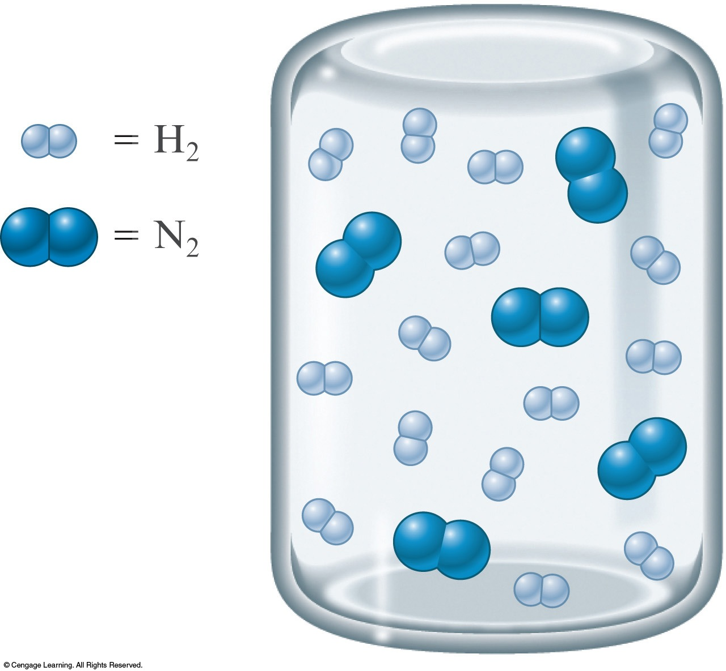
Stoichiometric Mixture
Contains the relative amounts of reactants that matches the numbers in the balanced equation.
N₂(g) + 3H₂(g) → 2NH₃(g)

Slide 21
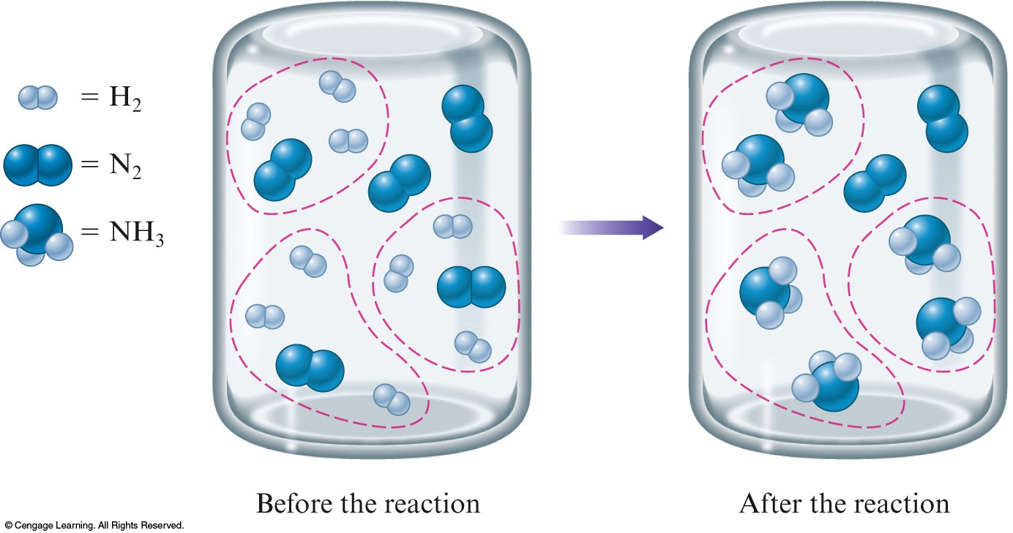
Limiting Reactant Mixture
N₂(g) + 3H₂(g) → 2NH₃(g)

Slide 22
Limiting Reactant Mixture
N₂(g) + 3H₂(g) → 2NH₃(g)
Limiting reactant (reagent) is the reactant that runs out first and thus limits the amounts of product(s) that can form.
H₂

Slide 23
Determine which reactant is limiting to calculate correctly the amounts of products that will be formed.

Slide 24
Limiting Reactants
Methane and water will react to form products according to the equation:
CH₄ + H₂O → 3H₂ + CO

Slide 25
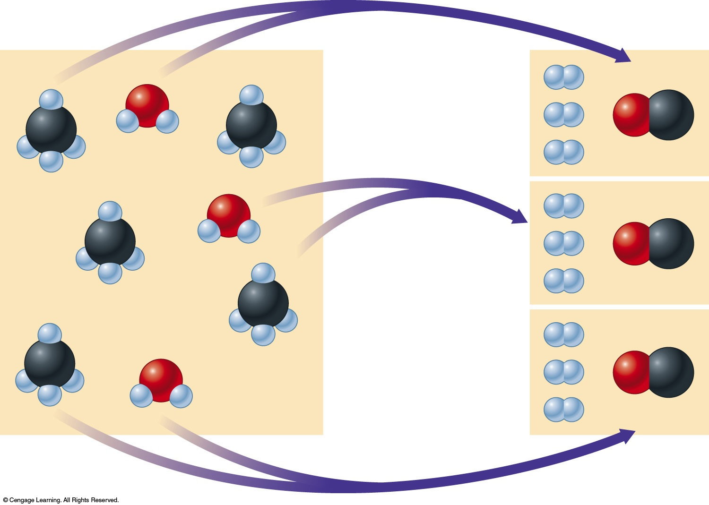
Limiting Reactants
H₂O molecules are used up first, leaving two CH₄ molecules unreacted.

Slide 26
Limiting Reactants
The amount of products that can form is limited by the water.
Water is the limiting reactant.
Methane is in excess.

Slide 27
Steps for Solving Stoichiometry Problems Involving Limiting Reactants by Solving for Limiting Reaction First (Approach A)
1. Write and balance the equation for the reaction.
2. Convert known masses of reactants to moles.
3. Using the numbers of moles of reactants and the appropriate mole ratios, determine which reactant is limiting.
4. Using the amount of the limiting reactant and the appropriate mole ratios, compute the number of moles of the desired product.
5. Convert from moles of product to grams of product, using the molar mass (if this is required by the problem).

Slide 28
Example
You know that chemical A reacts with chemical B. You react 10.0 g of A with 10.0 g of B.
What information do you need to know in order to determine the mass of product that will be produced?

Slide 29
Let’s Think About It
Where are we going?
To determine the mass of product that will be produced when you react 10.0 g of A with 10.0 g of B.
What do we need to know?
The mole ratio between A, B, and the product they form. In other words, we need to know the balanced reaction equation.
The molar masses of A, B, and the product they form.

Slide 30
Example – Continued
You react 10.0 g of A with 10.0 g of B. What mass of product will be produced given that the molar mass of A is 10.0 g/mol, B is 20.0 g/mol, and C is 25.0 g/mol? They react according to the equation:
A + 3B → 2C

Slide 31
Example – Continued
You react 10.0 g of A with 10.0 g of B. What mass of product will be produced given that the molar mass of A is 10.0 g/mol, B is 20.0 g/mol, and C is 25.0 g/mol? They react according to the equation:
A + 3B → 2C
How do we get there?
Convert known masses of reactants to moles.

Slide 32
Example – Continued
You react 10.0 g of A with 10.0 g of B. What mass of product will be produced given that the molar mass of A is 10.0 g/mol, B is 20.0 g/mol, and C is 25.0 g/mol? They react according to the equation:
A + 3B → 2C
How do we get there?
Determine which reactant is limiting.
react with all of the A
Only 0.500 mol B is available, so B is the limiting reactant.

Slide 33
Example – Continued
You react 10.0 g of A with 10.0 g of B. What mass of product will be produced given that the molar mass of A is 10.0 g/mol, B is 20.0 g/mol, and C is 25.0 g/mol? They react according to the equation:
A + 3B → 2C
How do we get there?
Compute the number of moles of C produced.

Slide 34
Example – Continued
You react 10.0 g of A with 10.0 g of B. What mass of product will be produced given that the molar mass of A is 10.0 g/mol, B is 20.0 g/mol, and C is 25.0 g/mol? They react according to the equation:
A + 3B → 2C
How do we get there?
Convert from moles of C to grams of C using the molar mass.

Slide 35
Notice
We cannot simply add the total moles of all the reactants to decide which reactant mixture makes the most product. We must always think about how much product can be formed by using what we are given, and the ratio in the balanced equation.

Slide 36
Steps for Solving Stoichiometry Problems Involving Limiting Reactants by Determining the Possible Moles of Product First (Approach B)
1. Write and balance the equation for the reaction.
2. Convert known masses of reactants to moles.
3. Using the appropriate mole ratios, compute the numbers of moles of product formed if each reactant were consumed
4. Choose the least number of moles of product formed from Step 3.
5. Convert from moles of product to grams of product, using the molar mass (if this is required by the problem).

Slide 37
Example
You know that chemical A reacts with chemical B. You react 10.0 g of A with 10.0 g of B.
What information do you need to know in order to determine the mass of product that will be produced?

Slide 38
Let’s Think About It
Where are we going?
To determine the mass of product that will be produced when you react 10.0 g of A with 10.0 g of B.
What do we need to know?
The mole ratio between A, B, and the product they form. In other words, we need to know the balanced reaction equation.
The molar masses of A, B, and the product they form.

Slide 39
Example – Continued
You react 10.0 g of A with 10.0 g of B. What mass of product will be produced given that the molar mass of A is 10.0 g/mol, B is 20.0 g/mol, and C is 25.0 g/mol? They react according to the equation:
A + 3B → 2C

Slide 40
Example – Continued
You react 10.0 g of A with 10.0 g of B. What mass of product will be produced given that the molar mass of A is 10.0 g/mol, B is 20.0 g/mol, and C is 25.0 g/mol? They react according to the equation:
A + 3B → 2C
How do we get there?
Convert known masses of reactants to moles.

Slide 41
Example – Continued
You react 10.0 g of A with 10.0 g of B. What mass of product will be produced given that the molar mass of A is 10.0 g/mol, B is 20.0 g/mol, and C is 25.0 g/mol? They react according to the equation:
A + 3B → 2C
How do we get there?
Compute the number of moles of product formed from each reactant.

Slide 42
Example – Continued
You react 10.0 g of A with 10.0 g of B. What mass of product will be produced given that the molar mass of A is 10.0 g/mol, B is 20.0 g/mol, and C is 25.0 g/mol? They react according to the equation:
A + 3B → 2C
How do we get there?
Choose the least number of moles of product formed.

Slide 43
Example – Continued
You react 10.0 g of A with 10.0 g of B. What mass of product will be produced given that the molar mass of A is 10.0 g/mol, B is 20.0 g/mol, and C is 25.0 g/mol? They react according to the equation:
A + 3B → 2C
How do we get there?
Convert from moles of C to grams of C using the molar mass.

Slide 44
Concept Check
Which of the following reaction mixtures could produce the greatest amount of product? Each involves the reaction symbolized by the equation:
2H₂ + O₂ → 2H₂O
a) 2 moles of H₂ and 2 moles of O₂
2 moles of H₂ and 3 moles of O₂
2 moles of H₂ and 1 mole of O₂
d) 3 moles of H₂ and 1 mole of O₂
e) Each produce the same amount of product.
Notes:
The correct answer is e. All of these reaction mixtures would produce two moles of water.

Slide 45
Concept Check
Consider the equation: A + 3B → 4C. If 3.0 moles of A is reacted with 6.0 moles of B, which of the following is true after the reaction is complete?
a) A is the leftover reactant because you only need 2 moles of A and have 3.
b) A is the leftover reactant because for every 1 mole of A, 4 moles of C are produced.
c) B is the leftover reactant because you have more moles of B than A.
d) B is the leftover reactant because 3 moles of B react with every 1 mole of A.
Notes:
The correct answer is a.
(6.0 mol B) × (1 mol A/3 mol B) = 2.0 mol A needed

Slide 46
Exercise
How many grams of NH₃ can be produced from the mixture of 3.00 g each of nitrogen and hydrogen by the Haber process?
N₂ + 3H₂ → 2NH₃
a) 2.00 g
b) 3.00 g
c) 3.65 g
d) 1.82 g
Notes:
The correct answer is c. Nitrogen is the limiting reactant.
(0.107 mol N₂) × (2 mol NH₃/1 mol N₂) × (17.034 g NH₃/1 mol NH₃) = 3.65 g NH₃

Slide 47
Percent Yield
An important indicator of the efficiency of a particular laboratory or industrial reaction.

Slide 48
Theoretical Yield
The maximum amount of a given product that can be formed when the limiting reactant is completely consumed.
The actual yield (amount actually produced) of a reaction is usually less than the maximum expected (theoretical yield).

Slide 49
Percent Yield
The actual amount of a given product as the percentage of the theoretical yield.

Slide 50
Example – Recall
You react 10.0 g of A with 10.0 g of B. What mass of product will be produced given that the molar mass of A is 10.0 g/mol, B is 20.0 g/mol, and C is 25.0 g/mol? They react according to the equation:
A + 3B → 2C
We determined that 8.33 g C should be produced. 7.23 g of C is what was actually made in the lab. What is the percent yield of the reaction?
What do we know?
We know the actual and theoretical yields.

Slide 51
Example – Recall
You react 10.0 g of A with 10.0 g of B. What mass of product will be produced given that the molar mass of A is 10.0 g/mol, B is 20.0 g/mol, and C is 25.0 g/mol? They react according to the equation:
A + 3B → 2C
We determined that 8.33 g C should be produced. 7.23 g of C is what was actually made in the lab. What is the percent yield of the reaction?
How do we get there?

Slide 52
Exercise
Find the percent yield of product if 1.50 g of SO₃ is produced from 1.00 g of O₂ and excess sulfur via the reaction:
2S + 3O₂ → 2SO₃
a) 40.0%
b) 80.0%
c) 89.8%
d) 92.4%
Notes:
First we find the maximum yield (theoretical yield) of product:
(1.00 g O₂)(1 mol O₂/32.00 g O₂)(2 mol SO₃/3 mol O₂)(80.06 g SO₃/1 mol SO₃) = 1.67 g (theoretical yield)
We then divide the actual yield by the theoretical yield:
Percent yield = (1.50 g/1.67 g) × 100 = 89.8%

Slide 53
Exercise
Consider the following reaction:
P₄(s) + 6F₂(g) → 4PF₃(g)
What mass of P₄ is needed to produce 85.0 g of PF₃ if the reaction has a 64.9% yield?
a) 29.9 g
b) 46.1 g
c) 184 g
d) 738 g
Notes:
64.9% = (85.0 g PF₃ / x)(100); x = 130.97 g PF₃
(130.97 g PF₃)(1 mol PF₃ / 87.97 g PF₃)(1 mol P₄ / 4 mol PF₃)(123.88 g P₄ / 1 mol P₄) = 46.1 g of P₄ needed

