Slide 1
Chapter 15
Solutions

Slide 2
What is a Solution?
Solution – homogeneous mixture
Solvent – substance present in largest amount
Solutes – other substances in the solution
Aqueous solution – solution with water as the solvent

Slide 3
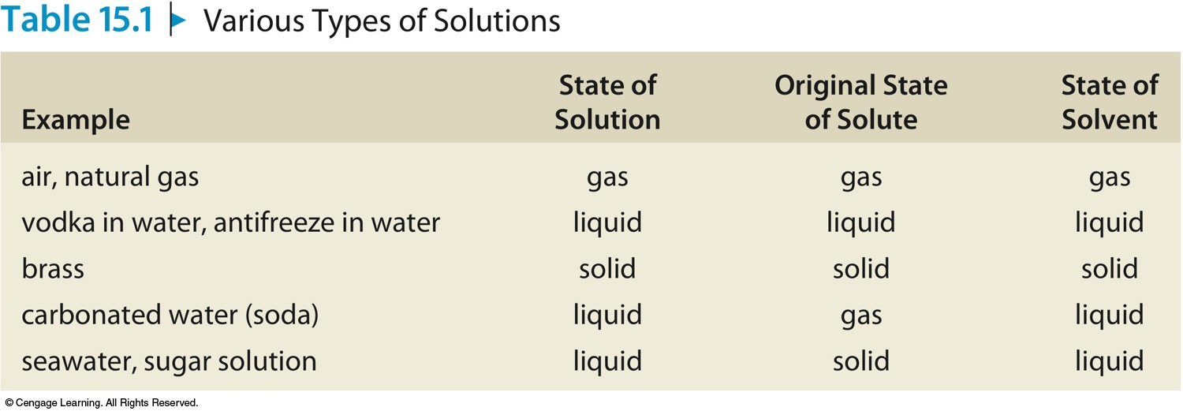
Various Types of Solutions

Slide 4
Molarity (M) = moles of solute per volume of solution in liters:

Slide 5
Exercise
You have 1.00 mol of sugar in 125.0 mL of solution. Calculate the concentration in units of molarity.
8.00 M
1.00 mol / (125.0 / 1000) = 8.00 M
Notes:
1.00 mol / (125.0 / 1000) = 8.00 M

Slide 6
Exercise
A 500.0-g sample of potassium phosphate is dissolved in enough water to make 1.50 L of solution. What is the molarity of the solution?
1.57 M
500.0 g is equivalent to 2.355 mol K₃PO₄ (500.0 g / 212.27 g/mol). The molarity is therefore 1.57 M (2.355 mol/1.50 L).
Notes:
500.0 g is equivalent to 2.355 mol K₃PO₄ (500.0 g / 212.27 g/mol). The molarity is therefore 1.57 M (2.355 mol/1.50 L).

Slide 7
Exercise
You have a 10.0 M sugar solution. What volume of this solution do you need to have 2.00 mol of sugar?
0.200 L
2.00 mol / 10.0 M = 0.200 L
Notes:
2.00 mol / 10.0 M = 0.200 L

Slide 8
Exercise
Consider separate solutions of NaOH and KCl made by dissolving 100.0 g of each solute in 250.0 mL of solution. Calculate the concentration of each solution in units of molarity.
10.0 M NaOH
[100.0 g NaOH / 39.998 g/mol] / [250.0 / 1000] = 10.0 M NaOH
5.37 M KCl
[100.0 g KCl / 74.55 g/mol] / [250.0 / 1000] = 5.37 M KCl
Notes:
[100.0 g NaOH / 39.998 g/mol] / [250.0 / 1000] = 10.0 M NaOH
[100.0 g KCl / 74.55 g/mol] / [250.0 / 1000] = 5.37 M KCl

Slide 9
Concept Check
You have two HCl solutions, labeled Solution A and Solution B. Solution A has a greater concentration than Solution B. Which of the following statements are true?
a) If you have equal volumes of both solutions, Solution B must contain more moles of HCl.
b) If you have equal moles of HCl in both solutions, Solution B must have a greater volume.
c) To obtain equal concentrations of both solutions, you must add a certain amount of water to Solution B.
d) Adding more moles of HCl to both solutions will make them less concentrated.
Notes:
The correct answer is b. Solution B must have a greater volume to make it less concentrated than Solution A since Molarity = moles of solute/liters of solution.

Slide 10
Concentration of Ions
For a 0.25 M CaCl₂ solution:
CaCl₂ → Ca²⁺ + 2Cl–
Ca²⁺: 1 × 0.25 M = 0.25 M Ca²⁺
Cl–: 2 × 0.25 M = 0.50 M Cl–.

Slide 11
Concept Check
Which of the following solutions contains the greatest number of ions?
400.0 mL of 0.10 M NaCl.
300.0 mL of 0.10 M CaCl₂.
200.0 mL of 0.10 M FeCl₃.
800.0 mL of 0.10 M sucrose.
Notes:
a) contains 0.080 mol of ions (0.400 L × 0.10 M × 2). b) contains 0.090 mol of ions (0.300 L × 0.10 M × 3). c) contains 0.080 mol of ions (0.200 L × 0.10 M × 4). d) does not contain any ions because sucrose does not break up into ions. Therefore, letter b) is correct.

Slide 12
Let’s Think About It
Where are we going?
To find the solution that contains the greatest number of moles of ions.
How do we get there?
Draw molecular level pictures showing each solution. Think about relative numbers of ions.
How many moles of each ion are in each solution?

Slide 13
Notice
The solution with the greatest number of ions is not necessarily the one in which:
the volume of the solution is the largest.
the formula unit has the greatest number of ions.

Slide 14
Standard Solution
A solution whose concentration is accurately known.

Slide 15
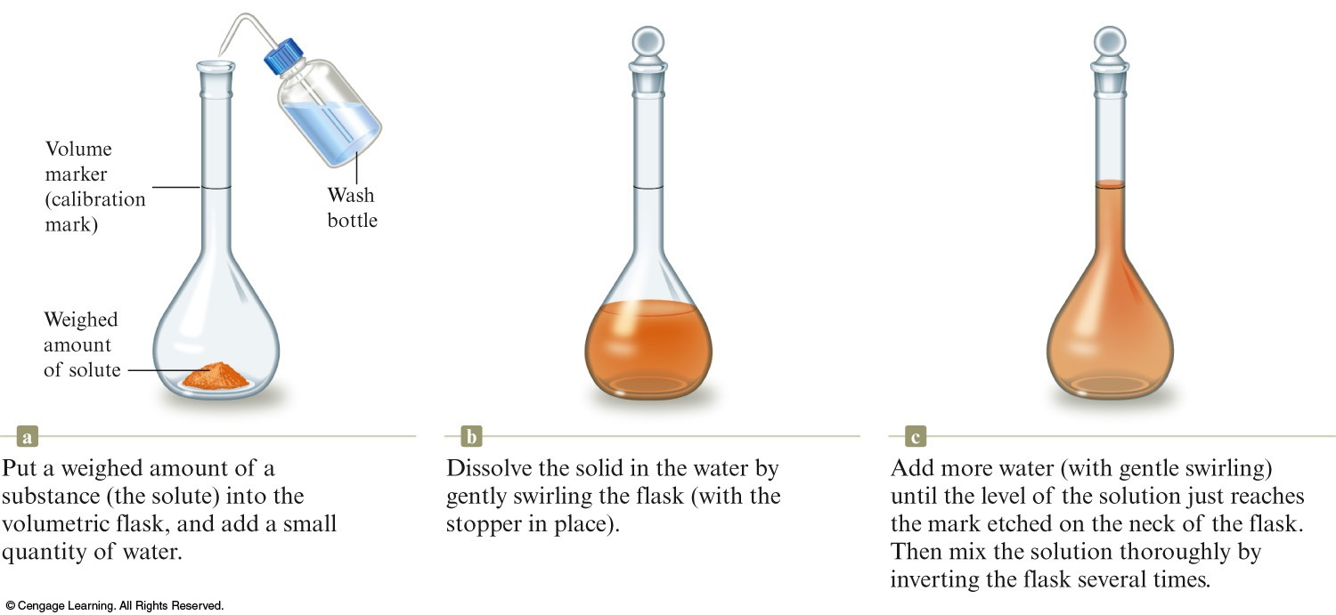
To Make a Standard Solution
Weigh out a sample of solute.
Transfer to a volumetric flask.
Add enough solvent to bring the volume to the mark on flask.

Slide 16
The process of adding water to a concentrated or stock solution to achieve the molarity desired for a particular solution.
Dilution with water does not alter the numbers of moles of solute present.
Moles of solute before dilution = moles of solute after dilution
M₁V₁ = M₂V₂

Slide 17
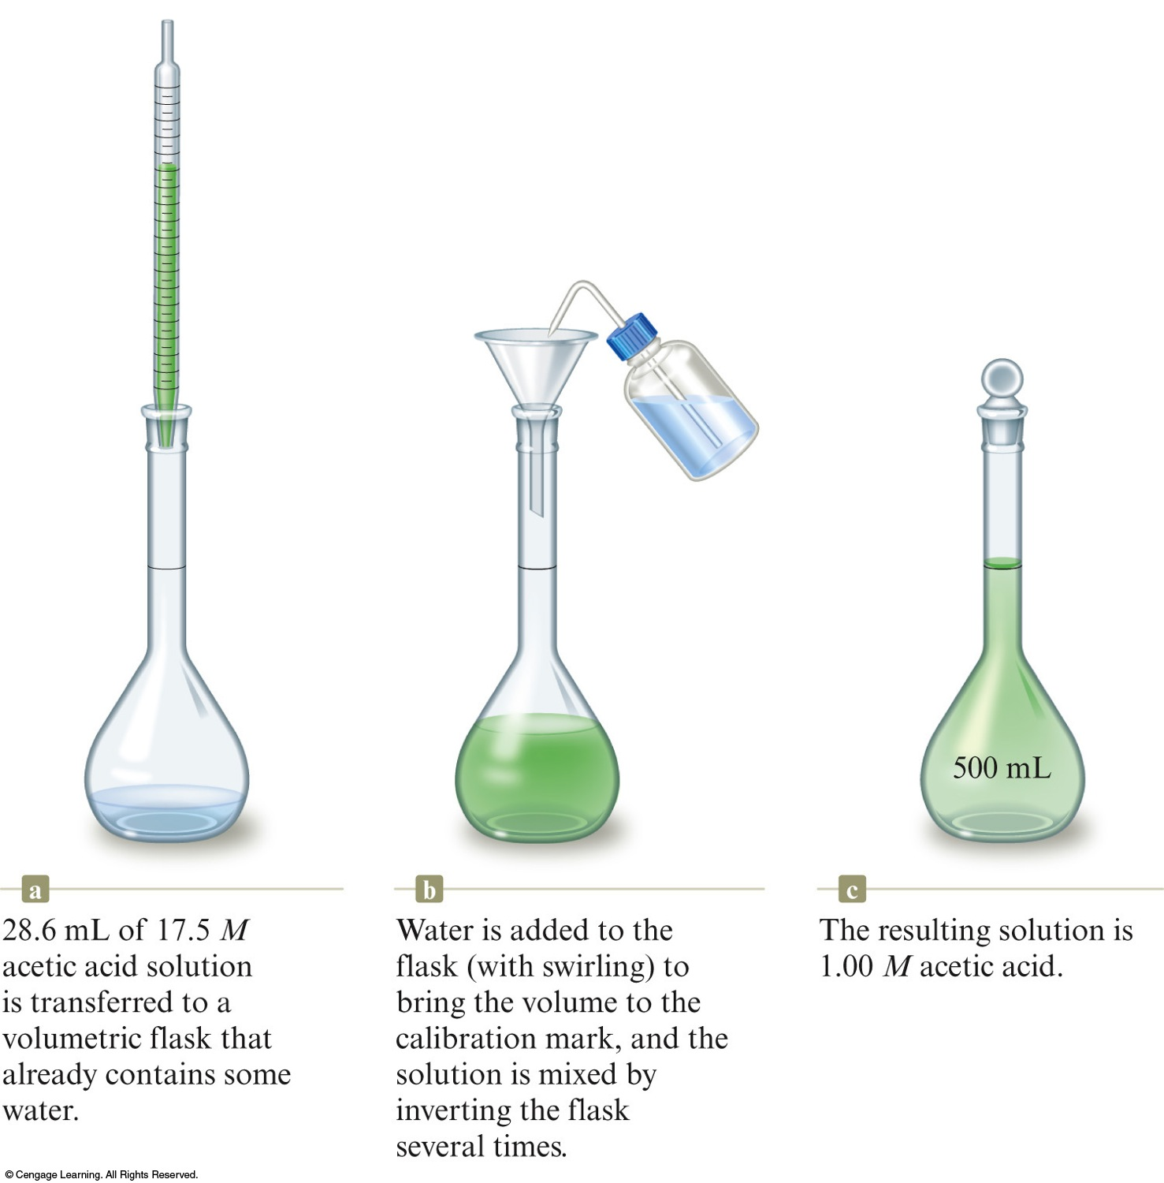
Diluting a Solution
Transfer a measured amount of original solution to a flask containing some water.
Add water to the flask by bringing volume to the mark (with swirling) and mix by inverting the flask.

Slide 18
Concept Check
A 0.50 M solution of sodium chloride in an open beaker sits on a lab bench. Which of the following would decrease the concentration of the salt solution?
Add water to the solution.
Pour some of the solution down the sink drain.
c) Add more sodium chloride to the solution.
d) Let the solution sit out in the open air for a couple of days.
e) At least two of the above would decrease the concentration of the salt solution.
Notes:
For letter a), adding water to the solution will increase the total volume of solution and therefore decrease the concentration. For letter b), pouring some of the solution down the drain will not change the concentration of the salt solution remaining. For letter c), adding more sodium chloride to the solution will increase the number of moles of salt ions and therefore increase the concentration. For letter d), water will evaporate from the solution and decrease the total volume of solution and therefore increase the concentration. Therefore, since only letter a) would decrease the concentration, letter e) cannot be correct.

Slide 19
Exercise
What is the minimum volume of a 2.00 M NaOH solution needed to make 150.0 mL of a 0.800 M NaOH solution?
60.0 mL
M₁V₁ = M₂V₂
(2.00 M)(V₁) = (0.800 M)(150.0 mL)
Notes:
The minimum volume needed is 60.0 mL. M₁V₁ = M₂V₂ (2.00 M)(V₁) = (0.800 M)(150.0 mL)

