Slide 1
CHEMISTRY
Chapter 3
Composition of Substances
and Solutions
Slides by Montgomery College licensed under CC BY 4.0.

Slide 2
chapter 3: Substances and solutions
3.1 Formula Mass and the Mole Concept
3.2 Determining Empirical and Molecular Formula
3.3 Molarity
3.4 Other Units for Solution Concentration

Slide 3
3.1 formula mass and the mole concept
Formula Mass
Covalent Compounds
Calculate the sum of the average atomic masses of the atoms in the formula.
The formula mass for a covalent substance is referred to as the molecular mass.
The molecular formula for chloroform is CHCl₃. The molecular mass is the sum of one carbon atom, one hydrogen atom, and three chlorine atoms.

Slide 4
3.1 formula mass and the mole concept
Aspirin
An aspirin molecule is a covalent compound and has the formula C₉H₈O₄.
The molecular mass is the sum of 9 carbon atoms, 8 hydrogen atoms and 4 oxygen atoms.
The molecular mass for aspirin is 180.15 amu.

Slide 5
3.1 formula mass and the mole concept
Formula Mass
Ionic Compounds
are composed of discrete cations and anions combined in ratios that yield an electrically neutral bulk substance.
do not exist as discrete molecules.
have a formula mass but not a molecular mass.
The atomic mass of an ion are approximately the same as the atomic mass of the neutral atom.

Slide 6
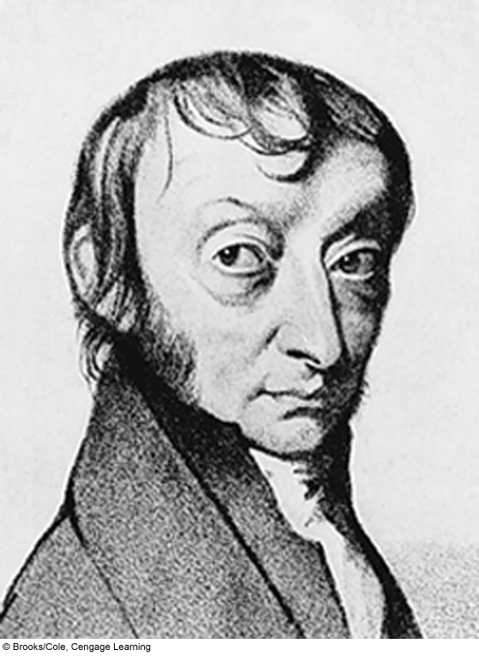
3.1 formula mass and the mole concept
The Mole
is a counting/amount unit similar to a pair or a dozen.
is a specific measure of the number of atoms or molecules in a sample of matter.
is defined by a sample of pure ¹²C weighing exactly 12 g.
1 mole contains 6.022 x 10²³ of anything.
6.022 x 10²³ is known as Avogadro’s Number (N_{A}).
A mole is a fixed number of particles in a chemical unit. One mole always contains the same number of particles, no matter what the substance.

Slide 7
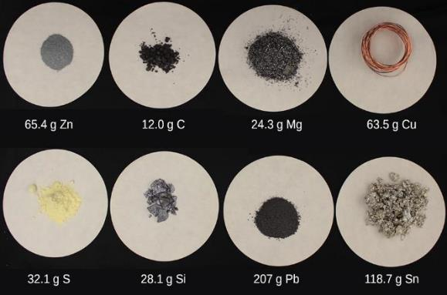
3.1 formula mass and the mole concept
The Mole
Each sample contains one mole of atoms.
Why are the masses of the samples different?

Slide 8
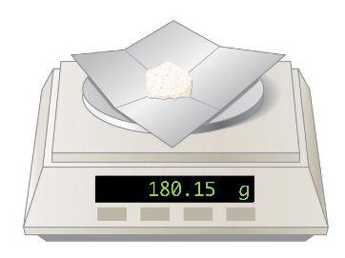
3.1 formula mass and the mole concept
The Mole
Molar mass is the mass (grams) of one mole of a substance.
The units of molar mass are grams per mole (g/mol).
The molar mass of a substance is numerically equivalent to its atomic, molecular, or formula mass in amu.
Aspirin (C₉H₈O₄) has a molecular mass of 180.15 amu and a molar mass of 180.15 g/mol.
If one mole of aspirin is placed on a balance in the lab, the balance would read 180.15 g.
One mole of aspirin.

Slide 9
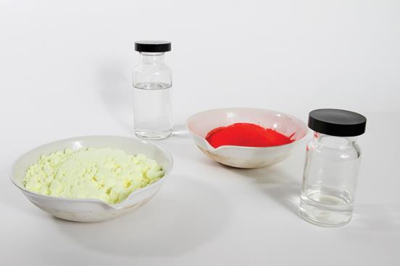
3.1 formula mass and the mole concept
The Mole
Each sample contains 6.022 x 10²³ formula units of a compound or element.
Calculate the mass of each sample.
octanol
C₈H₁₇OH
mercury(II) iodide
HgI₂
pure sulfur
S₈
methanol
CH₃OH

Slide 10
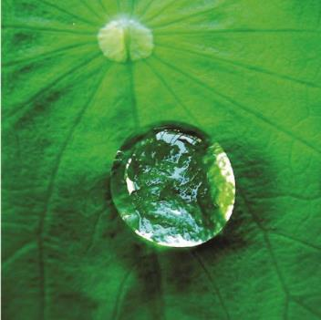
3.1 formula mass and the mole concept
The Mole
The number of water molecules in the droplet of water shown below is approximately 100 billion times greater than the population of earth.
There are roughly 7,442,000,000 people on earth.
How many moles of water are contained in the droplet described above?
How many grams of water are in the droplet?
Be sure to express your answers
in scientific notation and to the correct number of sig figs!

Slide 11
3.1 formula mass and the mole concept
Calculations: Formula Mass, Moles, and Grams
The relationships between formula mass, moles, grams, and number of molecules or atoms are used to calculate quantities that describe the composition and amount of chemical substances.
Avogadro’s Number (N_{A})
1 mole = 6.022 x 10²³ atoms or molecules
Chemical Formula
Use the periodic table to calculate formula mass.
Formula mass is the number of grams per mole (g/mol).

Slide 12
3.1 formula mass and the mole concept
Example 3.3 – Grams to Moles
According to nutritional guidelines from the US Department of Agriculture, the estimated average requirement for dietary potassium is 4.7 g. What is the estimated average requirement of potassium in moles?
Know:
4.7 g of potassium (K)
K is 39.10 amu on the periodic table.
K: 39.10
Want:
moles of potassium (K)
Convert grams → moles.
g
mol
$$4.7 g K × \frac{1 mol}{39.10 g}=0.12 mol K$$
Do not want grams – put grams in the denominator.
Want moles – put in the numerator.
Grams will cancel, and moles will remain.
4.7 g has two significant figures, so the answer must have two significant figures.

Slide 13
3.1 formula mass and the mole concept
Example 3.4 – Moles to Grams
One liter of air contains 9.2 x 10⁻⁴ mol argon. What is the mass of argon in one liter of air?
Know:
1 L of argon (Ar) = 9.2 x 10⁻⁴ mol
Ar is 39.95 amu on the periodic table.
Ar: 39.95
Want:
grams of Ar
Convert moles → grams.
g
mol
$$4.2 × {10}^{−4} mol Ar × \frac{39.95 g}{1 mol}=0.037 g K$$
Do not want moles – put moles in the denominator.
Want moles – put in the numerator.
Moles will cancel, and grams will remain.
9.2 x 10⁻⁴ mol has two significant figures, so the answer must have two significant figures.

Slide 14
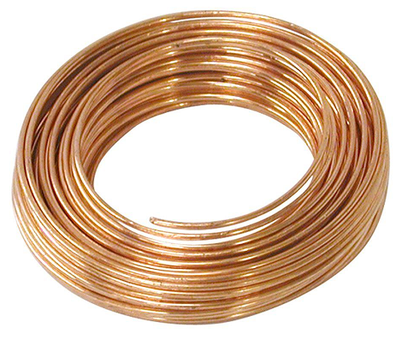
3.1 formula mass and the mole concept
Example 3.5 – Grams to Moles to Atoms
Copper is commonly used to fabricate electrical wire. How many copper atoms are in 5.00 g of copper wire?
Know:
5.00 g Cu wire
Cu: 63.55
N_{A} = 6.022 x 10²³
Want:
atoms in 5.00 g Cu
g
Convert grams → moles → atoms.
mol
When calculating the number of atoms
or molecules, use Avogadro’s Number.
atoms
mol
$$5.00 g Cu × \frac{1 mol}{63.55 g}=0.07868 mol Cu × \frac{6.022 × {10}^{23}atoms}{1 mol}$$
$$=4.74 × {10}^{22}atoms of Cu$$

Slide 15
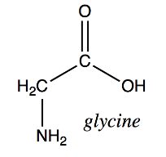
3.1 formula mass and the mole concept
Example 3.6 – Grams to Moles
Our bodies synthesize proteins from small molecules called amino acids. One such amino acid is glycine (C₂H₅O₂N). How many moles are in 28.35 g of glycine?
Know:
28.35 g glycine
C₂H₅O₂N: 75.07
Want:
moles in 28.35 g glycine
g
Convert grams → moles.
mol
Start by finding the molar mass.
$$28.35 g glycine × \frac{1 mol}{75.07 g}=0.3776 mol glycine$$

Slide 16
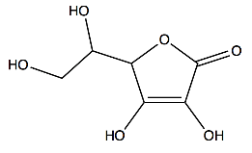
3.1 formula mass and the mole concept
Example 3.7 – Moles to Grams
Vitamin C, or ascorbic acid, is a compound with the molecular formula C₆H₈O₆. The recommended daily dietary allowance of vitamin C for children aged 4-8 years is 1.42 x 10⁻⁴ mol. What is the daily allowance in grams?
Know:
1.42 x 10⁻⁴ mol vitamin C
C₆H₈O₆: 176.124
Want:
grams of vitamin C
g
Convert moles → grams.
mol
$$1.42 × {10}^{−4} mol vitamin C × \frac{176.124 g}{1 mol}$$
$$=0.0250 g vitamin C$$
vitamin C

Slide 17
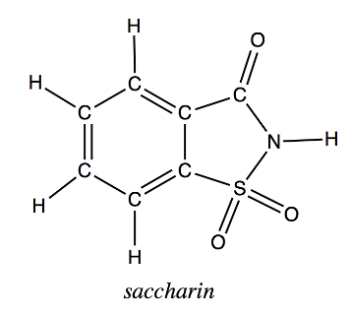
3.1 formula mass and the mole concept
Example 3.8 – Grams to Moles to Molecules
A packet of artificial sweetener contains 40.0 mg of saccharin (C₇H₅NO₃S).
What is the molar mass of saccharin?
How many moles of saccharin are present in the sample?
How many molecules of saccharin are present in the sample?
How many moles of carbon atoms are present in the sample?
How many carbon atoms are present in the sample?

Slide 18
3.2 empirical and molecular formulas
Percent Composition
Chemical formulas are used to represent the elemental makeup of a compound.
The percent composition for a compound is the percent by mass of each element in the compound.
What is the formula mass for ammonia (NH₃)?
One nitrogen atom: 14.01 amu
Three hydrogen atoms: 3 x 1.008 amu = 3.024 amu
The formula mass for NH₃ is therefore 17.03 amu
What percentage of an ammonia sample is nitrogen?
What percentage of an ammonia sample is hydrogen?
$$\%N=\frac{14.01 amu}{17.03 amu} × 100=82.27\%$$
$$\%H=\frac{(3 × 1.008) amu}{17.03 amu} × 100=17.76\%$$

Slide 19
3.2 empirical and molecular formulas
Percent Composition
In the previous section, the molecular mass of aspirin was calculated. What is the percent composition of aspirin?
Carbon?
Hydrogen?
Oxygen?

Slide 20
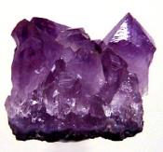
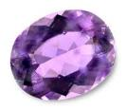
Example – Composition of Amethyst
Amethyst is a purple form of quartz, SiO₂. Amethyst gets its purple color from tiny amounts of iron and manganese in the quartz crystals.
What is the percent (by mass) of silicon in amethyst?
What is the percent (by mass) of oxygen in amethyst?
If you wanted to obtain 250.0 grams of silicon, how much amethyst would you need?

Slide 21
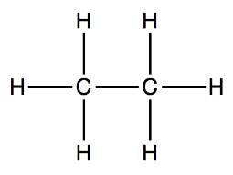
3.2 empirical and molecular formulas
Empirical Formulas
The empirical formula is the chemical formula with the smallest whole number ratio of atoms.
The molecular formula is the formula that represents the entire
The empirical formula is not necessarily the molecular formula!
Percent composition can be used to determine the empirical formula of a substance.
Ethane has the structural formula:
The molecular formula is C₂H₆.
The simplified formula is the
empirical formula, CH₃.

Slide 22
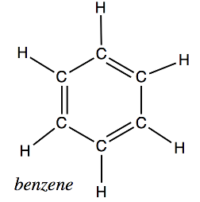
3.2 empirical and molecular formulas
Empirical Formulas
Benzene is made up of six carbon atoms and six hydrogen atoms.
What is the molecular formula for benzene?
What is the empirical formula for benzene?
Determine the percent composition of benzene from its molecular formula.
Determine the percent composition of benzene from its empirical formula.

Slide 23
3.2 empirical and molecular formulas
Example 3.11 – Grams to Empirical Formula
A sample of the black mineral hematite, an oxide of iron found in many iron ores, contains 34.97 g of iron and 15.03 g of oxygen. What is the empirical formula for hematite?
Solution on the next slide.

Slide 24
3.2 empirical and molecular formulas
Example 3.11 – Empirical Formula
A sample of the black mineral hematite, an oxide of iron found in many iron ores, contains 34.97 g of iron and 15.03 g of oxygen. What is the empirical formula for hematite?
Know:
34.97 g Fe Fe: 55.85
15.03 g O O: 15.9994
Want:
empirical formula
g
mol
g
Convert grams → moles.
Divide the smallest # of moles.
mol
$$34.97 g Fe × \frac{mol}{55.85 g}=0.6261 mol Fe$$
$$\frac{0.6261}{0.6261}=1.000 mol × 2=2$$
Fe₂O₃
$$15.03 g O × \frac{mol}{15.9994 g}=0.9395 mol O$$
$$\frac{0.9395}{0.6261}=1.501 mol O × 2=3$$

Slide 25
3.2 empirical and molecular formulas
Empirical Formula Summary
Determine the number of moles of each element.
Divide the number of moles by the smallest number.
If necessary, multiply by an integer value so that all the values end up as whole numbers.

Slide 26
3.2 empirical and molecular formulas
Empirical Formula: Process
Determine the number of moles of each element.
For each element, divide the number of moles by the smallest number of moles.
If all the resultant values are whole numbers, those are the subscripts in the empirical formula.
If necessary, multiply by an integer value so that all the values end up as whole numbers.
In this course, subscripts in a chemical formula must be whole numbers.
Round numbers that are very close to whole numbers.
2.04 → 2
3.98 → 4
2.95 → 3
Other numbers must be multiplied by integer values to get a whole number.
2.50 x ____? 3.25 x ____? 3.80 x ____?
1.33 x ____? 1.20 x ____? 2.75 x ____?

Slide 27
3.2 empirical and molecular formulas
Example 3.12 – Percent Composition to Empirical Formula
The bacterial fermentation of grain to produce ethanol forms a gas with a percent composition of 27.29% C and 72.71% oxygen. What is the empirical formula for this gas?
Assume 100 g of substance.
Convert grams to moles.
For each element, divide the number of moles by the smallest number of moles.
Complete as in previous example.
Solution on the next slide.

Slide 28
3.2 empirical and molecular formulas
Example 3.12 – Percent Composition to Empirical Formula
The bacterial fermentation of grain to produce ethanol forms a gas with a percent composition of 27.29% C and 72.71% oxygen. What is the empirical formula for this gas?
Know:
Assume 100 grams.
C: 27.29% → 27.29 g C: 12.011
O: 72.71% → 72.71 g O: 15.9994
Want:
empirical formula
g
mol
Convert grams → moles.
Divide the smallest # of moles.
g
mol
$$27.29 g C × \frac{mol}{12.011 g}=_______ mol C$$
→ ?
$$72.71 g O × \frac{mol}{15.9994 g}=_______ mol O$$
→ ?

Slide 29
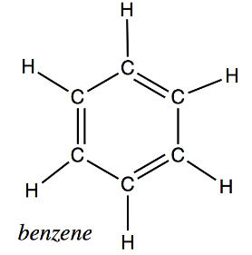
3.2 empirical and molecular formulas
Empirical Formula → Molecular Formula
Benzene has a molecular mass of 78.11 g/mol. The empirical formula for benzene is CH. What is the molecular formula?
Does the molecular formula make sense given the molecular structure of benzene?

Slide 30
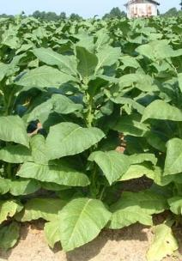
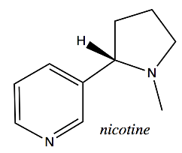
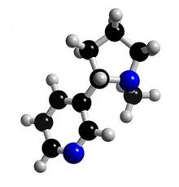
3.2 empirical and molecular formulas
Molecular Formula from Percent Composition
Example 3.13 % Composition → Molecular Formula
Nicotine is a poisonous compound found in tobacco leaves. It is 74.02% carbon, 8.710% hydrogen, and 17.27% nitrogen. Its molar mass is 162.3 g/mol. Determine both the empirical formula and the molecular formula for nicotine.

Slide 31
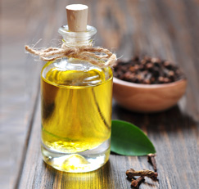
Example – Eugenol
Eugenol is the major component in clove oil, but it can also be extracted from nutmeg, cinnamon, and basil. It has a molar mass of 164.2 g/mol and is 73.14% carbon and 7.37% hydrogen. The remainder is oxygen.
What is the molecular formula?
What is the empirical formula?

Slide 32
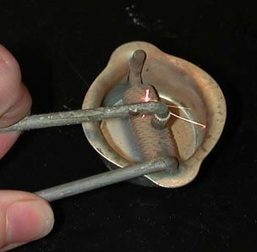
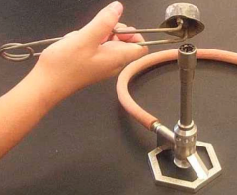
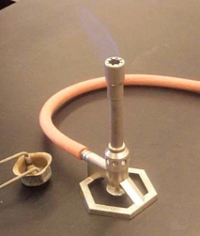
Example – Composition of Striker Flints
The strikers used to light Bunsen burners are made from a mix of iron, magnesium, and several rare earth metals. The substance in strikers is sometimes referred to as ferrocium or fire-steel. If ferrocium is 42.55% cerium, 23.35% lanthanum, 21.35% iron, 4.25% neodymium, 4.25% praseodymium, and 4.25% magnesium, what is the empirical formula?

Slide 33
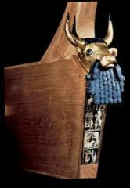
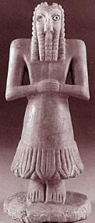
Example – Chemistry and Art
In art of the Ancient Near East (Assyrian Art), sculptures often had carved eyes that were accented with shells set in bitumen, a black tar-like substance. Chemical analysis of bitumen by using a combustion reaction yields 6.575 g CO₂ and 1.346 g H₂O.
What is the empirical formula for bitumen (C_{x}H_{y})?
The molecular weight of C_{x}H_{y} is 78.1134. What is the molecular formula?

Slide 34
3.2 empirical and molecular formulas
Water of Hydration
Hydrates
Solid chemical compounds exposed to the atmosphere often have water adsorbed to the surface of crystals.
The number of water molecules attached to a salt is written after a dot at the end of the formula.
Chemists can drive off the water by gentle heating.
In a method similar to that used to determine empirical formulas, moles of water lost can be used to determine hydrate formulas.
Example hydrates:
CoCl₂ . 6H₂O
SnCl₂ . 2H₂O
KAl(SO₄)₂ . 12H₂O

Slide 35
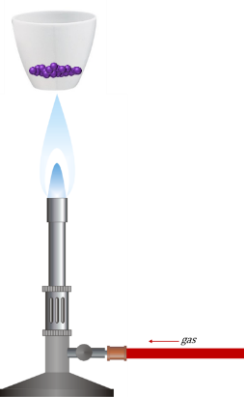
3.2 empirical and molecular formulas
Water of Hydration
Example
A 2.5640 g sample of a magnesium sulfate hydrate was found to contain 1.3125 g of water. Determine the complete formula for the hydrate.
MgSO₄ . x H₂O

Slide 36
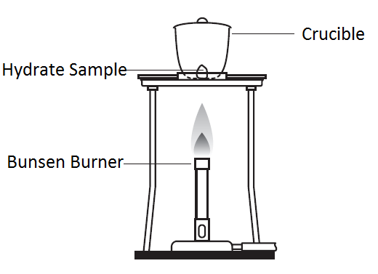
Example – Water of Hydration
A student was given a sample of calcium chloride hydrate. Determine the number of water molecules in the hydrate given the following data:
Mass Crucible: 13.1381 g
Mass Crucible + Sample
before heating 14.8205 g
Mass Crucible + Sample
after heating 13.9897 g

Slide 37
3.3 molarity
Solutions
A solution is a homogeneous mixture of a solute dissolved in a solvent.
The solute is typically the substance present in a relatively small amount.
The solvent is the substance that is used to dissolve the solute.
solute
solvent

Slide 38
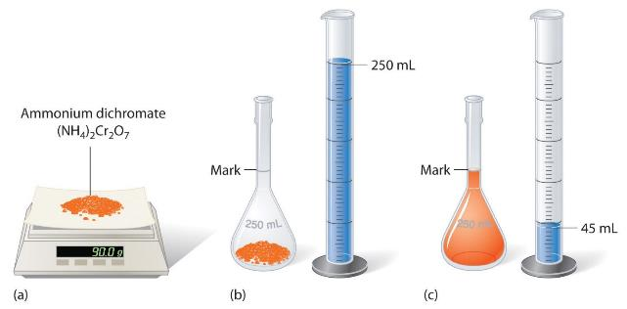
3.3 molarity
Solutions
The concentration of a solution can be expressed as a molarity.
Molarity (M) is the amount of solute (mol) dissolved in some volume (L) of solution.
Molarity can be used as a conversion factor in calculations.
$$M=\frac{mol solute}{liters solution}$$
What is the molarity of the solution?
solvent
solute

Slide 39
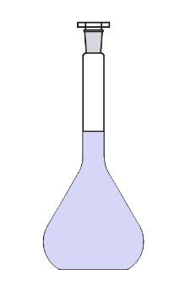
3.3 molarity
Example 3.17 – Molarity to Mass
How many grams of sodium chloride are contained in 0.250 L of a 5.30 M aqueous solution?
Square brackets can be used to denote concentration. [NaCl] = 5.30 M.
Know:
NaCl: 58.44 [NaCl] = 5.30 M
0.250 L of a 5.30 solution
Want:
grams of NaCl
g
mol
mol
L
volume
molarity
→ # moles
mol
5.30
L
$$0.250 L × \frac{5.30 mol }{1 L}=1.325 mol NaCl$$
$$1.325 mol NaCl × \frac{58.44 g }{mol}=77.4 g NaCl$$
250 mL

Slide 40
3.3 molarity
Example 3.18 – Molarity to Volume
The concentration of a vinegar sample is 0.839 M. What volume of vinegar contains 75.6 g of acetic acid (CH₃COOH)?
Know:
75.6 g CH₃COOH
CH₃COOH: 60.05
[CH₃COOH] = 0.839 M = 0.839
Want:
liters of vinegar
g
mol
mol
L
$$75. 6 g {CH}_{3}COOH × \frac{mol }{60.05 g}=1.259 mol {CH}_{3}COOH$$
$$1.259 mol {CH}_{3}COOH × \frac{L}{0.839 mol}=1.50 L vinegar$$

Slide 41
Example – Molarity of a Solution
A solution was made by dissolving 10.00 g of potassium sulfate in 250.0 mL of water.
What is the concentration (molarity) of the solution?
What is the concentration of potassium ions?
What is the concentration of sulfate ions?

Slide 42
3.3 molarity
Dilution
A concentrated stock solution of known concentration can be used to make a dilute solution of a desired concentration.

Slide 43
3.3 molarity
Dilutions
In this course, use dimensional analysis and the number of moles to perform dilution calculations.
M₁V₁ = M₂V₂
Note: The formula M₁V₁ = M₂V₂ works for dilution but not titration. To avoid confusion, please use dimensional analysis for all calculations in this course.

Slide 44
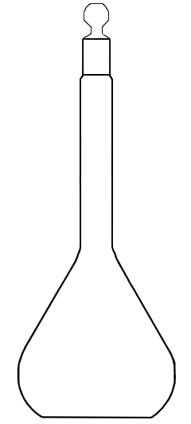
3.3 molarity
Example: Dilutions
A stock solution of 2.00 M NaOH is available. An experiment requires 250.0 mL of a 1.50 M solution. Describe how to prepare such a solution.
2.00 M NaOH
sodium
hydroxide
250 mL

Slide 45
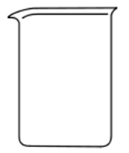
3.3 molarity
Example: Dilutions
If 0.850 L of a 5.00 M copper(II) nitrate solution is diluted to a volume of 1.80 L by the addition of water, what is the molarity of the diluted solution?
1.80 L
5.00 M
Cu(NO₃)₂
copper(II)
nitrate

Slide 46
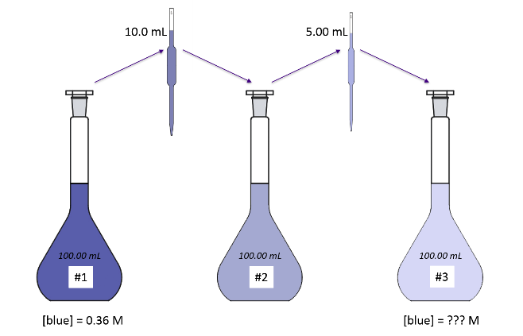
3.3 molarity
Example: Serial Dilutions
A sample of blue dye with a concentration of 0.36 M is diluted twice. In the first step, 10.0 mL of the 0.36 M solution is diluted to 100.00 mL to make solution #2. In the next step, 5.00 mL of solution #2 is diluted to 100.00 mL. What is the concentration of dye in the resulting solution?

Slide 47
3.4 concentration
Other Concentration Units
Mass Percentage
is the ratio of a component’s mass to the solution’s mass expressed as a percentage.
is also known as %mass, %weight, and (w/w)%.
is used for many consumer products.
The active component of bleach is sodium hypochlorite, NaOCl.
Bleach has an NaOCl concentration of 7.4 (w/w)%.
100 g of bleach therefore contains 7.4 g of NaOCl.

Slide 48
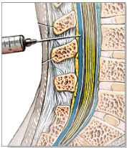
3.4 concentration
Other Concentration Units
Example 3.22 – Spinal Fluid
A 5.0 g sample of spinal fluid contains 3.75 mg of glucose. What is the percent by mass of glucose in spinal fluid?
scripps.org

Slide 49
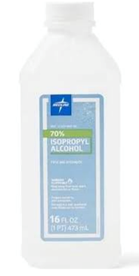
3.4 concentration
Other Concentration Units
Volume Percentage
is used to represent the concentration of a solution formed by dissolving a liquid solute in a solvent.
%vol or (v/v)%
is also used in many consumer products.
Example 3.24 – Volume/Volume Percentage
Rubbing alcohol, also called isopropyl alcohol, is usually sold as a 70 (v/v)% solution. If this density of an isopropyl alcohol solution is 0.785 g/mL, how many grams of the alcohol are present in a 355 mL bottle?

Slide 50
3.4 concentration
Other Concentration Units
Mass-Volume Percentage
is a ratio of solute mass to solution volume expressed as a percentage: (m/v)%
is commonly used in medical settings.
Example – Mass/Volume Percentage
Physiological saline solution used for intravenous fluids is typically 0.9 (m/v)%. If an IV bag contains 100 mL solution, what mass of solute (NaCl) does it contain?

Slide 51
3.4 concentration
Other Concentration Units
Parts per Million and Parts per Billion
are units used to express concentrations of extremely dilute solutions.
are often used to refer to trace contaminant levels in water, air, or other solvents.
$$ppm=\frac{mass solute}{mass solution} × {10}^{6}$$
$$ppb=\frac{mass solute}{mass solution} × {10}^{9}$$

Slide 52
3.4 concentration
Flint Water Crisis 2017
Example – Lead Levels in Water
The graphic on the next slide shows some data from a study conducted by Virginia Tech scientists.
In one sample, the lead concentration was 158 ppb. How many micrograms of lead would be present in a glass of water that contains 355 mL?
In another sample, the lead concentration was 13,000 ppb. How many micrograms of lead would be present in a glass of water that contains 355 mL?
cbsnews.com

Slide 53
michiganlivemedia.org

Slide 54
Challenge Problem
Two unknown elements A and Z combine to produce two different compounds: A₂Z₃ and AZ₂. If 0.15 mol A₂Z₃ has a mass of 15.90 g and 0.15 mol AZ₂ has a mass of 9.30 g, what are the atomic masses of A and Z?

Slide 55
end of chapter problems – chapter 3
Atomic Mass and Molar Mass: #1, 5, 11, 15, 17, 19, 23, 29, 31
Chemical Formulas and
The Mole Concept: #25, 33, 35, 37, 39, 41, 43
Molarity: #47, 49, 51, 53, 59, 61
For detailed solutions to these problems, go to the OpenStax Chemistry website and download the Student Solution Guide.

Slide 56
videos – chapter 3
Gram to Mole to Atoms Conversions
https://www.youtube.com/watch?v=aQw-2oPvfK0
http://screencast.com/t/ofLlIvVxC
Chemical Formula and Mole Conversion
http://youtu.be/PrRvmwkLs38
http://screencast.com/t/V5nTAsvDJd
Calculating Empirical and Molecular Formulas
(not an MC video - posted on YouTube by Step-by-Step Science)
https://youtu.be/ZiXtpuDZlP8
Calculating Molarity
http://screencast.com/t/w4R7NcDjfa4
Dilution Calculations
http://screencast.com/t/6MphEryfyQlG
*All videos were created by MC Chemistry faculty unless otherwise indicated.

Slide 57
simulations – chapter 3
Sugar and Salt Solutions (Solutions, Ionic, Covalent)
https://phet.colorado.edu/en/simulation/legacy/sugar-and-salt-solutions
Molarity
https://phet.colorado.edu/en/simulation/molarity

