Slide 1
CHEMISTRY
Chapter 6
Electronic Structure and Periodic Properties of the Elements
Slides by Montgomery College licensed under CC BY 4.0.

Slide 2
Learning Goals for chapter 6
Apply equations relating c, λ, ν, E, and h.
Understand concept of quantized atom and relation to line spectra.
Describe Heisenberg’s uncertainty principle and the de Broglie relation.
Draw the Bohr model.
Describe shapes of orbitals.
Understand and assign quantum numbers.
Use the Rydberg equation make calculations associated with absorption and emission of energy.
Write electron configurations.
Explain trends in atomic/ionic radius, ionization energy, electron affinity, and metallic character.

Slide 3
chapter 6: Electronic structure
6.1 Electromagnetic Energy
6.2 The Bohr Model
6.3 Development of Quantum Theory
6.4 Electronic Structure of Atoms
6.5 Periodic Trends

Slide 4
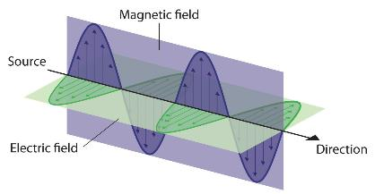
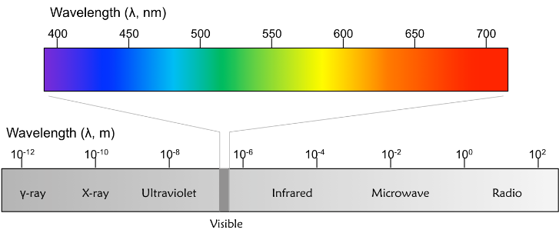
6.1 electromagnetic energy
Light is the visible part of a vast spectrum of electromagnetic waves.

Slide 5
6.1 electromagnetic energy
Electromagnetic Radiation
Newton and Maxwell
In the late 18th century, scientists thought the universe was made of two, easily explained domains.
Particles
governed by Newton’s laws of motion
classical mechanics
Waves - Electromagnetic
governed by Maxwell’s equations
classical electromagnetism
Many paradoxes were noted and led to the contemporary framework that involves wave-particle duality.
Newton
Maxwell

Slide 6
6.1 electromagnetic energy
Wave Characterization: Wavelength, Frequency, and Energy
frequency, ν , expressed in cycles per second is hertz or (s⁻¹).
wavelength, λ, in nm or m
energy, E, in J or kJ
c =
E =
E =
A
B

Slide 7
6.1 electromagnetic radiation
The yellow light given off by a sodium vapor lamp (some street lights) has a wavelength of 589 nm. What is the frequency of this radiation?

Slide 8
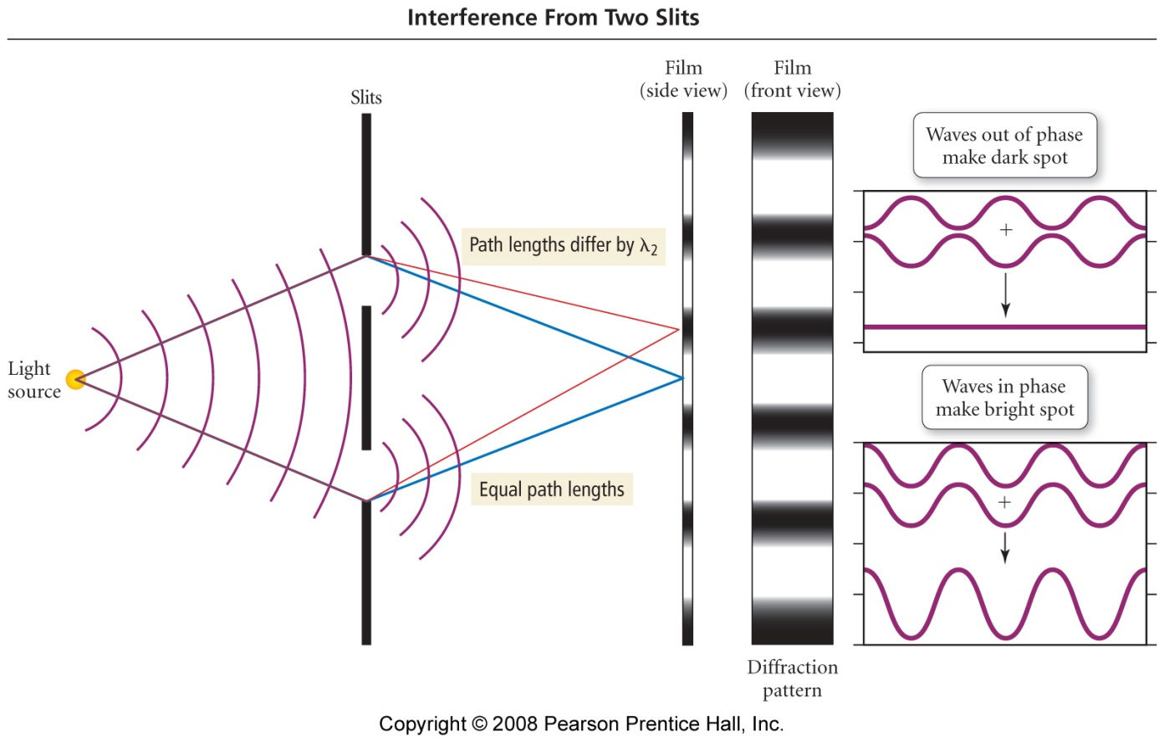
6.1 electromagnetic radiation
So far we’ve talked about light as though it is a wave. Light’s behavior is characteristic of waves. Young’s double slit experiment showed that light exhibited the constructive and destructive interference characteristic of waves (all waves—not just light waves). Young’s double slit experiment supports the wave theory of light.

Slide 9
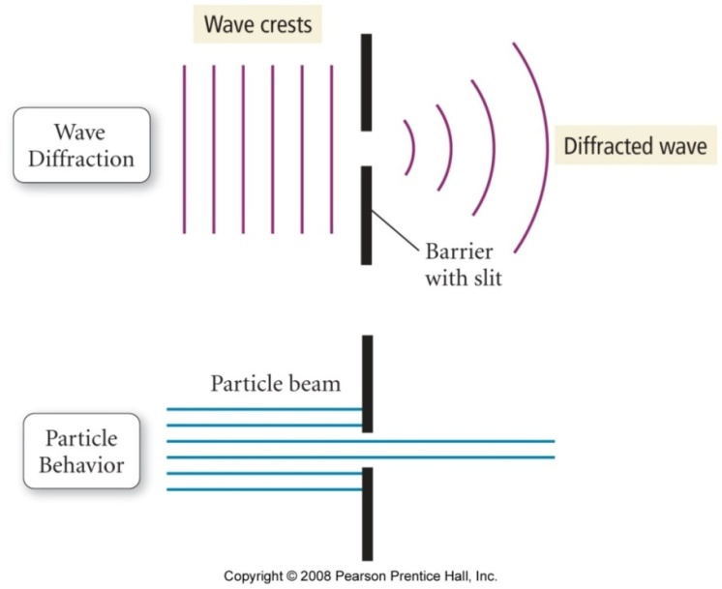
6.1 electromagnetic radiation
When a wave reaches an obstacle or a slit, the wave bends around it. This behavior is called diffraction. A particle would reach the obstacle and bounce back or through the slit and pass through. The fact that light is diffracted supports the wave theory of light.

Slide 10
6.1 electromagnetic radiation
In 1900, Max Planck assumed that energy can be absorbed or released only in certain discrete amounts, which he called quanta. Like picking up pennies, you can pick them up in 1 penny increments—even several at a time—but you can’t pick up fractions of a penny. Likewise, energy can’t be absorbed or released in fractions of a ________. Energy is absorbed or released in 1 or multiples of ___________.

Slide 11
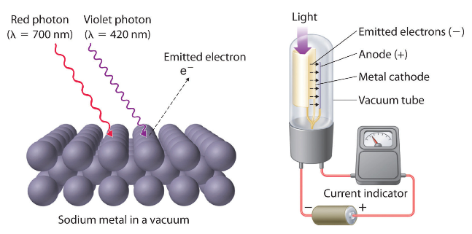
6.1 electromagnetic energy
The Photoelectric Effect
In 1905 (100 years after Thomas Young’s experiment), Einstein cast light of different frequency on a metal surface.
Blue light caused e- to be emitted. Red light did not. Increasing the intensity of the red light didn’t matter. Which is higher energy? _________
Notes:
Einstein explained that only light at or above a threshold freq. will cause e– to be ejected from a metal surface and called this the photoelectric effect.

Slide 12
6.1 electromagnetic energy
$$E=hν=\frac{hc}{λ}$$
Wave-Particle Duality
The photoelectric effect suggests that light is a particle (rather than a _______). Einstein proposed that light exists as packets—little bundles of energy—called ___________. A light “particle” that carries a quantum of energy is a photon.
Young’s double slit experiment supports the _______________ theory of light. Einstein’s photoelectric effect supports the ___________ theory of light. So it seems that light has both ___________-like and ____________-like qualities. Is light a particle or a wave? It’s both! Called wave-particle duality.

Slide 13
6.1 electromagnetic energy
$$E=\frac{hc}{λ}$$
A nitrogen gas laser pulse with a wavelength of 337 nm contains 3.83 mJ of energy. How many photons does it contain?
Calculate the energy of mole of photons of yellow light whose wavelength is 589 nm.

Slide 14
6.1 electromagnetic energy
$$E=\frac{hc}{λ}$$
A laser used in eye surgery to fuse detached retinas emits radiation with a frequency of 4.69 x 10¹⁴ Hz. Find the wavelength of this radiation and the energy of one of its photons. Then find the energy for a mole of photons.
Arrange the following 3 types of electromagnetic radiation—vis, x-ray, and microwave—in order of increasing wavelength, frequency and energy per photon.
wavelength:
frequency:
energy per photon:

Slide 15
6.1 electromagnetic energy
$$E=hν=\frac{hc}{λ}$$
Example 6.2
When we see light from a neon sign, we are observing radiation from excited neon atoms. If this radiation has a wavelength of 640 nm, what is the energy of the photon being emitted?

Slide 16
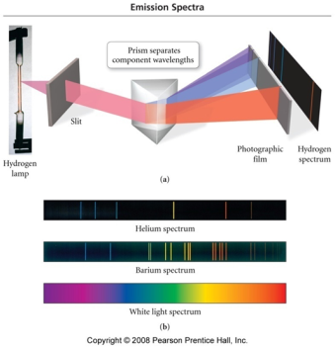
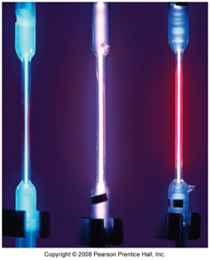
6.1 electromagnetic energy
Line Spectra and the Bohr Model
Ordinary white light is dispersed by a prism into a _____________ spectrum.
These are gas discharge lamps. Different gases emit different characteristic colors. These are Hg, He, and H₂. If we observe a lamp through a spectroscope (prism), we do not see a continuous spectrum, but a ________________ spectrum, simply called a ______________ spectrum, also called an___________________ or _____________________ spectrum.

Slide 17
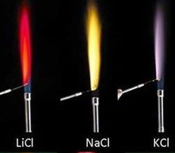
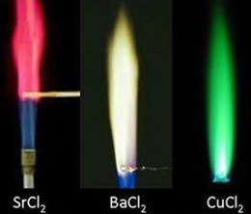
6.1 electromagnetic energy
What is causing the line spectra?
Niels Bohr took Planck’s quantum idea and applied it to the e– in atoms.
After an atom is energized by absorbing energy as ____________, __________, or ______________, the atom then emits the energy. When the atom absorbs energy, the e- in the atom get _______________. If the e- absorbs sufficient energy, it is promoted to a __________ energy level in the Bohr model of the atom. The e- can be promoted by 1 or more energy levels depending on how much energy is absorbed. When the e- is promoted to a higher energy level, the higher level is called the ___________________________.
Flame test. If viewed through a spectroscope (prism), ________________ spectra are observed.

Slide 18
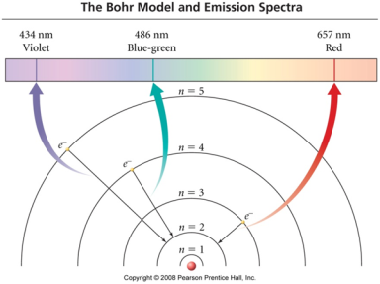
6.1 electromagnetic energy
What is causing the line spectra?
When the e- emits energy, the e- falls (relaxes) to a ____________ principal energy level, n. When the e- falls to any lower energy level, it emits energy. If the energy is associated with a wavelength in the VIS spectrum, we see light. The e- can fall down 1 step or multiple steps at a time. When the e- returns to its original level—its original principal energy level, n, the e- is said to be in the ________________ state.
Can the e- exist between energy levels? _________

Slide 19
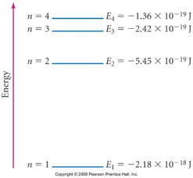
6.1 electromagnetic energy
Which transition is more energetic?
Examine the energy diagram below. Which releases more energy—an e- falling from n=4 to n=2 or an e- falling from n=2 to n=1?

Slide 20
6.1 electromagnetic energy
Which transition is more energetic?
We see light when an e- falls to n=2.
From what energy levels did the e- fall to generate this Hydrogen Line Spectrum (The Balmer Series)?
400 nm
500 nm
600 nm
700 nm

Slide 21
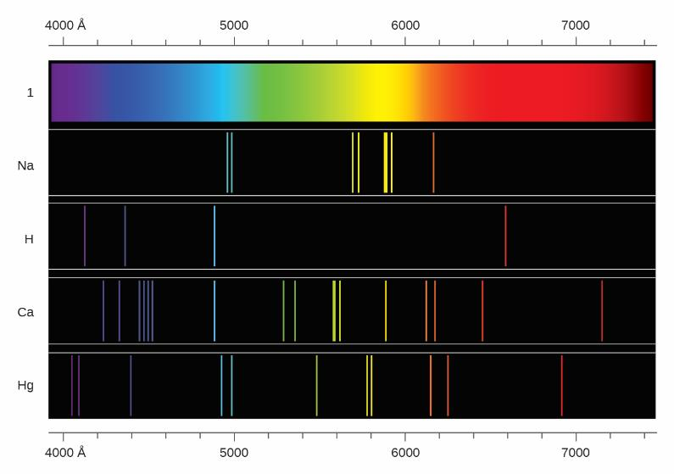
6.1 electromagnetic energy
Line Spectra: Atomic Fingerprints

Slide 22
6.1 electromagnetic energy
Line Spectrum for Hydrogen
Calculate the wavelength of the hydrogen emission line that corresponds to the transition of an e- from n = 5 to n = 2. Is this wavelength visible?
$ΔE=E_{f}−E_{i}$= hν = $\frac{hc}{λ}=−2.18 x 10−18 J \left(\frac{1}{n_{f}^{2}}−\frac{1}{n_{i}^{2}}\right)$

Slide 23
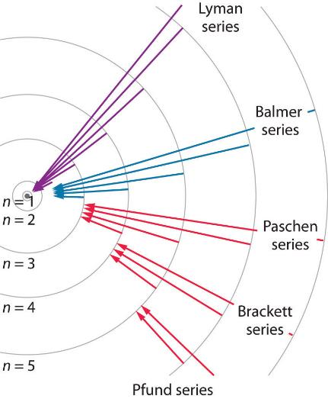
6.1 electromagnetic energy
Line Spectrum for Hydrogen: Other Series

Slide 24
6.2 The Bohr Model
Which of the following transitions will result in emitted light with the shortest wavelength?
n = 5 → n = 4
n = 4 → n = 3
n = 3 → n = 2
What does it mean to ionize hydrogen?
Notes:
In 1900, Max Planck assumed that energy can be absorbed or released only in certain discrete amounts, which he called quanta. Like picking up pennies, you can pick them up in 1 penny increments—even several at a time—but you can’t pick up fractions of a penny. Likewise, energy can’t be absorbed or released in fractions of a ________. Energy is absorbed or released in 1 or multiples of ___________.

Slide 25
6.2 The Bohr Model
Example 6.5
What is the energy, in joules, and the wavelength, in meters, of the line spectrum of hydrogen that represents e- movement from n = 4 to n = 6? What is the energy for a mole of photons? Is this absorption or emission of energy? What kind of radiation is this? Sketch the levels and draw an arrow representing the transition.

Slide 26
6.2 The Bohr Model
Insights from the Bohr Model
The energies (energy levels) in an atom are quantized.
The levels are described by using quantum numbers.
The arrangement of electrons in an atom are described by specific quantum numbers.
The energy of an electron increases as the electron’s distance from the nucleus increases.
The lines in an emission spectrum correspond to quantized electronic energies.
For this work, Niels Bohr was awarded the Nobel Prize for Physics in 1922.

Slide 27
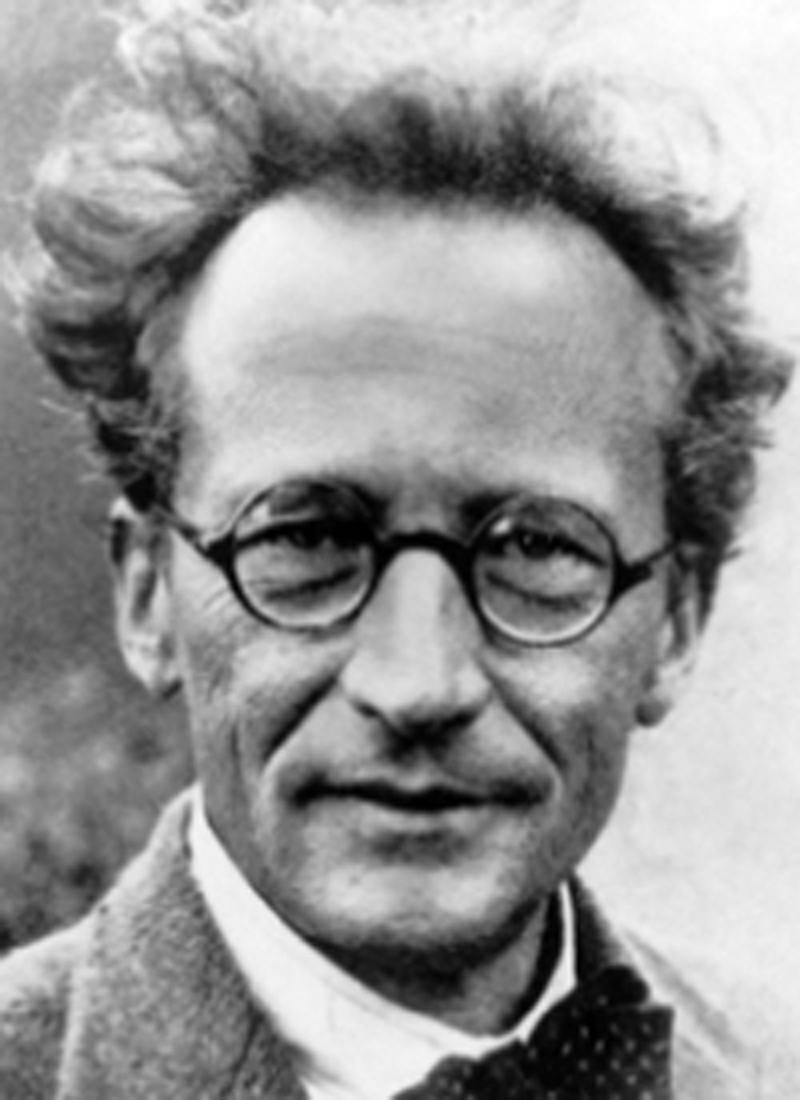
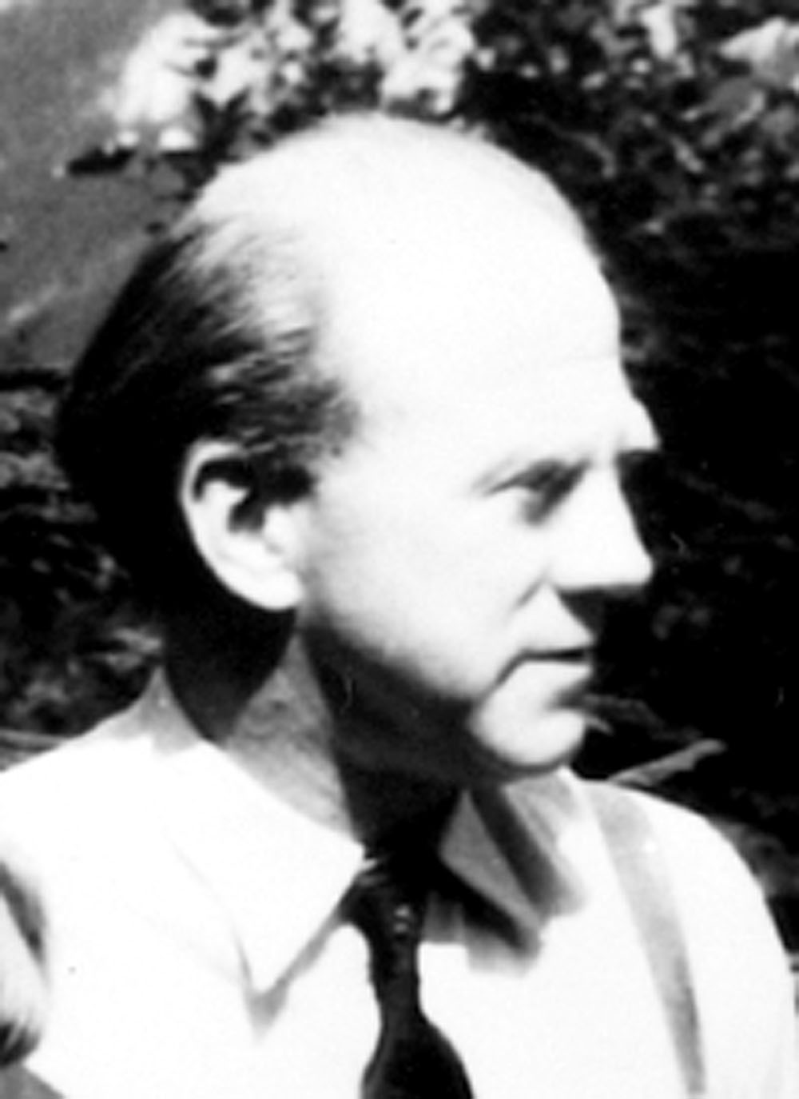
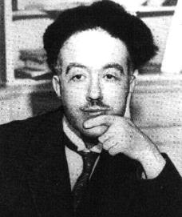
6.3 Development of Quantum Theory
Problems with the Bohr Model
Bohr’s model of the atom only holds for one electron system.
The electron-electron interactions for other atoms must be considered.
This led to the development of quantum theory.
Schrödinger
Heisenberg
deBroglie

Slide 28
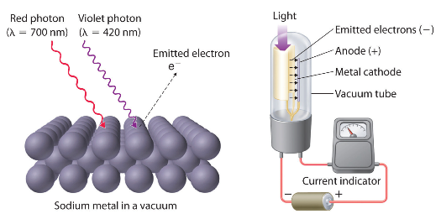
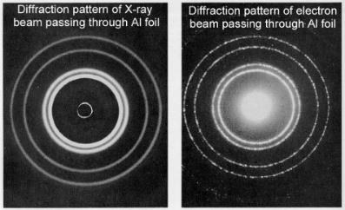
6.3 Development of Quantum Theory
Behavior in the Microscopic World
Classical mechanics does a good job of describing objects/movement in the macroscopic world.
Matter behaves in a special way in the microscopic world.
deBroglie asked: If waves of electromagnetic radiation can behave like a particle, can particles behave like waves?
The Photoelectric Effect
Electron Diffraction

Slide 29
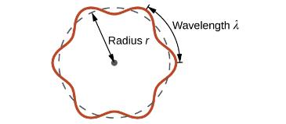
6.3 Development of Quantum Theory
Wave-Particle Duality
deBroglie: A particle with mass m and velocity v (in m/s) and linear momentum p should exhibit wave behavior with a wavelength λ according to:
$$λ=\frac{h}{mv}=\frac{h}{ρ}$$
deBroglie suggested that the quantization of energy levels in an atom occurs if an electron is treated like a circular standing wave.
An integer number of wavelengths must fit exactly within the orbit of an electron.
What happens when the fit is not exact?

Slide 30
6.3 Development of Quantum Theory
Other Aspects of Quantum Theory
The Heisenberg Uncertainty Principle: It is impossible to determine simultaneously and exactly both the momentum and the position of a particle.
a consequence of wave-particle duality
distinguishes modern quantum theory from classical mechanics
measurements induce changes in the system being observed
Schrödinger extended deBroglie’s work with wavefunctions ($ψ$).
electrons are still particles and …
waves represented by $ψ$ are complex probability amplitudes
$ψ$² describes the probability of the quantum particle being present in a certain area of space.

Slide 31
6.3 Development of Quantum Theory
Quantum Theory in Atoms
Quantum theory can be used to describe orbitals (the locations of electrons in atoms), orbital energies, and other properties.
Electrons in atoms can exist only in discrete energy levels.
Electrons cannot exist between these levels.
An electron can be described by using four quantum numbers.
Symbol
Quantum Number
n = principal
ℓ = angular momentum
m_{ℓ} = magnetic
m_{s} = spin

Slide 32
6.3 Development of Quantum Theory
Using Quantum Numbers
The quantum numbers describing the orbital where an electron resides are integers.
Four integers (n, ℓ, m_{ℓ}, m_{s}) together describe the probability of finding one electron in a certain area of space around the nucleus.
Three integers (n, ℓ, m_{ℓ}) can be used to describe an orbital.
n = principal
ℓ = angular momentum
m_{ℓ} = magnetic
m_{s} = spin
[n = 1,2,3,4, …]
[ℓ = 0, 1, 2, 3, … (n-1)]
[m_{ℓ}= 0,±1, ±2, ±3, … ± ℓ ]
[m_{s}= +½ or -½]

Slide 33
6.3 Development of Quantum Theory
Quantum Numbers and Probability Densities
principal quantum number (n)
describes the location energy of an orbital
angular momentum quantum number (ℓ)
defines the shape of an orbital
if ℓ = 0 the orbital is designated s
if ℓ = 1 the orbital is designated p
if ℓ = 2 the orbital is designated d
magnetic quantum number (m_{ℓ})
specifies the z component of angular momentum
describes the shape/orientation of an orbital when more than one is possible (ℓ = 1 and above)
Shells
Subshells
A node occurs when there is no probability of finding an electron and $ψ$= 0.
Specific Orbitals

Slide 34
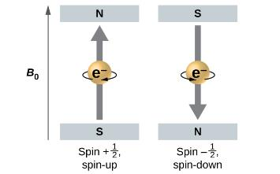
6.3 Development of Quantum Theory
The Spin Quantum Number
Any electron, regardless of the atomic orbital it is located in, can only have one of two values (½ and -½) of the spin quantum number (m_{s}).
If one electron has m_{s} = ½ and another has m_{s} = -½, the energies of the electrons are different if a magnetic field is applied.
An electron acts like a tiny magnet with its moment direct up for spin +½ and down for spin -½. B_{o} represent an applied magnetic field.

Slide 35
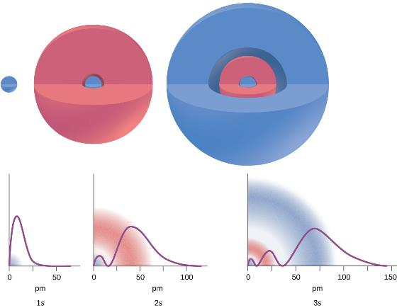
6.3 Development of Quantum Theory
Quantum Numbers and Probability Densities
The graphs show the probability (y axis) of finding an electron for the 1s, 2s, 3s orbitals as a function of distance from the nucleus.

Slide 36
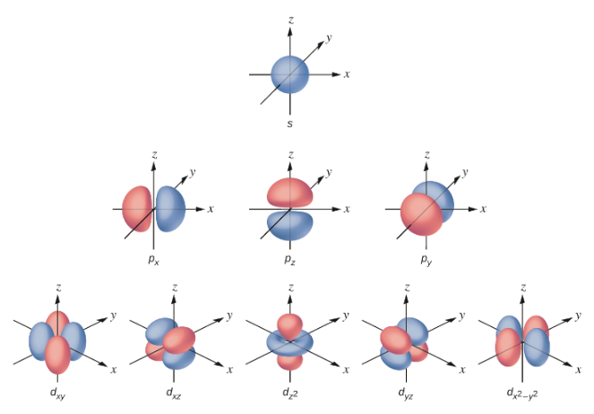
6.3 Development of Quantum Theory
Quantum Numbers and Probability Densities
ℓ = 0
ℓ = 1
ℓ = 2
Shapes of s, p, and d orbitals.

Slide 37
6.3 Development of Quantum Theory
Energy Level Diagram: One-electron Atom
Shells
n = 4
4s
4p
4d
4f
n = 3
3s
3p
3d
Energy
n = 2
The energy levels of the orbitals each shell are at the same energy or degenerate.
2s
2p
n = 1
1s
Subshells
ℓ = 0
ℓ = 1
ℓ = 2
ℓ = 3

Slide 38
6.3 Development of Quantum Theory
Energy Level Diagram: Multi-electron Atom
Shells
4f
4d
4p
n = 4
3d
4s
3p
n = 3
3s
Energy
The energy levels of the orbitals in each subshell are at the same energy or degenerate.
n = 2
2p
2s
n = 1
1s
Subshells
ℓ = 0
ℓ = 1
ℓ = 2
ℓ = 3

Slide 39
6.3 Development of Quantum Theory
Where’s the electron?
4f
4d
4p
4s
3d
3p
3s
Energy
Place each electron in its proper orbital.
n = 1
ℓ = 0
m_{ℓ} = 0
m_{s} = -½
n = 3
ℓ = 1
m_{ℓ} = 0
m_{s} = +½
n = 4
ℓ = 2
m_{ℓ} = -2
m_{s} = +½
2p
2s
1s

Slide 40
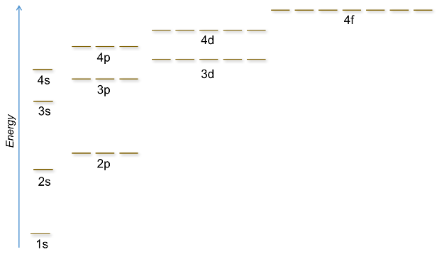
6.4 electron configurations
Filling an Electron Orbital Diagram
Aufbau Principle: Lower energy orbitals fill first.
Hund’s Rule: Degenerate orbitals (those of the same energy) are filled with electrons until all are half filled before pairing up of electrons can occur.
Pauli Exclusion Principle: Individual orbitals only hold two electrons (+½ or -½).

Slide 41
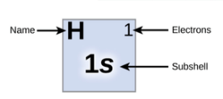
6.4 electron configurations
Filling an Electron Orbital Diagram: Hydrogen
3s
3p
3d
A hydrogen atom contains one electron.
shell n = 1
subshell ℓ = 0 = s orbital
configuration: 1s¹
A box diagram may also be used:
Energy
2s
2p
↿
↿
1s
1s
This is a one-electron atom, so the energy levels within each shell are degenerate.

Slide 42
6.4 electron configurations
Filling an Electron Orbital Diagram: Helium
3p
3s
A helium atom contains two electrons.
shell n = 1
subshell ℓ = 0 = s orbital
configuration: 1s²
A box diagram may also be used:
2p
Energy
2s
⥮
⥮
1s
1s

Slide 43
6.4 electron configurations
Filling an Electron Orbital Diagram: Lithium
3p
3s
↿
A lithium atom contains three electrons.
shell n = 1, 2
subshell ℓ = 0 = s orbital for both shells
configuration: 1s² 2s¹
A box diagram may also be used:
2p
Energy
2s
⥮
⥮
↿
1s
1s
2s

Slide 44
6.4 electron configurations
Filling an Electron Orbital Diagram: Boron
3p
3s
↿
⥮
2p
A boron atom contains five electrons.
shell n = 1, 2
subshell ℓ = 0 = s orbitals
but also ℓ = 1 = p orbitals
configuration: 1s² 2s² 2p¹
A box diagram may also be used:
Energy
2s
⥮
1s
⥮
⥮
↿
1s
2s
2p
ℓ = 0
s orbitals
ℓ = 1
p orbitals

Slide 45
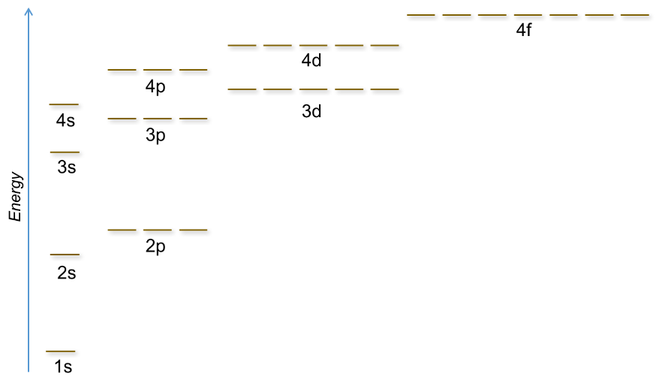
6.4 electron configurations
Filling an Electron Orbital Diagram: Neon
A neon atom contains ______ electrons.
electron configuration:

Slide 46
6.4 electron configurations
Filling an Electron Orbital Diagram: Magnesium
A magnesium atom contains ______ electrons.
full electron configuration:
notation with a noble gas core:

Slide 47
6.4 electron configurations
Filling an Electron Orbital Diagram: Potassium
A potassium atom has _____ electrons.
Fill according to the Aufbau principle.
4s before 3d
electron configuration:

Slide 48
6.4 electron configurations
*exception!
Filling an Electron Orbital Diagram: Chromium*
A chromium atom has _____ electrons.
electron configuration:

Slide 49
6.4 electron configurations
*exception!
Filling an Electron Orbital Diagram: Copper*
A copper atom has _____ electrons.
electron configuration:

Slide 50
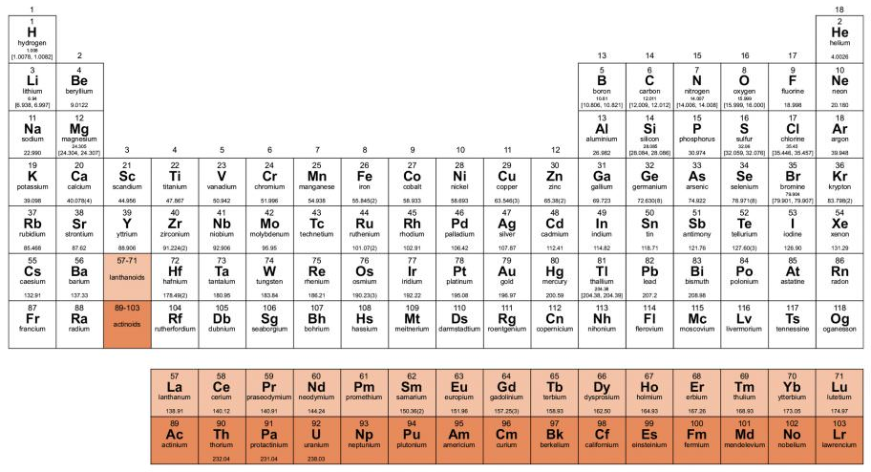
6.4 electron configurations
Electron Configuration and the Periodic Table
The periodic table is arranged so that elements having the same chemical properties recur periodically.
The chemical reactive outer shell electrons, or valence electrons, for these elements is the same.
Elements in a group/column have the same number of valence electrons.
Alkali metals all have one valence electron.
Alkaline earths have _____ valence electrons.
Halogens have _____ valence electrons.

Slide 51
6.4 electron configurations
Electron Configuration of Ions
A cation forms when one or more electrons are removed from a parent atom.
For main group elements, electrons added last are removed first. *Note that electrons are removed from the highest n first!
For transition metals and inner transition metals, electrons in the s orbital are easier to remove than the d or f electrons
An anion forms when one or more electrons are added to an atom.
The added electrons fill in the order predicted by the Aufbau principle.

Slide 52
6.4 Electron Configurations
Example 6.11
What is the electron configuration for each of the following?
Na⁺
P³⁻
Al³⁺
Fe²⁺
Sm³⁺
Ti²⁺
Cu⁺
Se²⁻
Ni²⁺

Slide 53
6.5 Periodic Trends
Variations in Element Properties
Atomic Size
Ionic Size
Ionization Energy
Electron Affinity
Electronegativity
Effective Nuclear Charge
Z_{eff} or Z*
pull exerted on an electron by the positively charged nucleus
larger atoms have more protons and therefore larger Z_{eff}
the pull diminishes for electrons further from the nucleus
inner electrons partially shield the outer electrons from the pull

Slide 54
6.5 Periodic Trends
Atomic Size
The radius of an atom is defined as one half the distance between the nuclei in a molecule consisting of two identical atoms joined by a covalent bond.

Slide 55
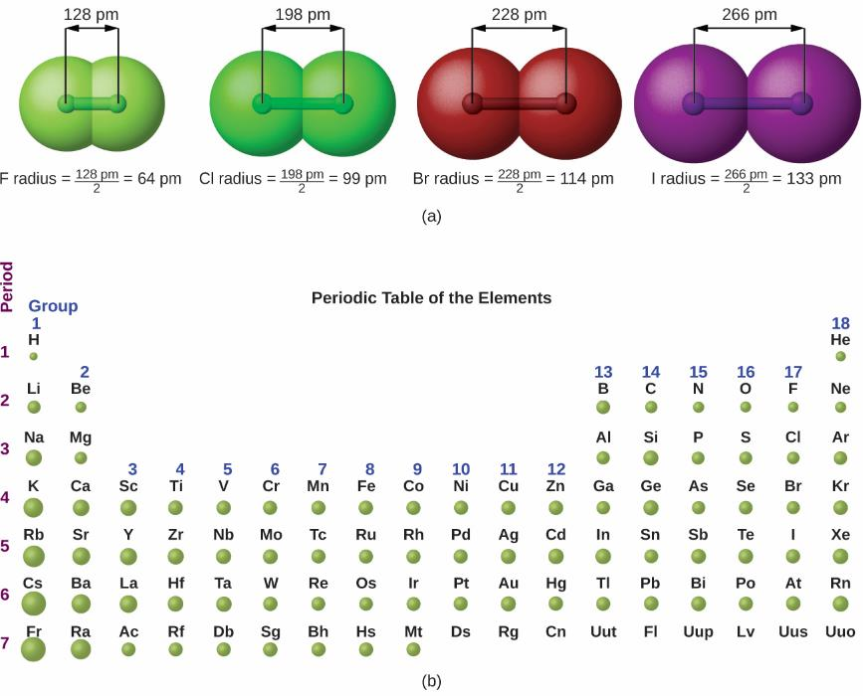
6.5 Periodic Trends
Atomic Size
Study how atomic size changes across periods and down groups on the periodic table.
What generalizations can you make about periods?
What generalizations can you make about groups?

Slide 56
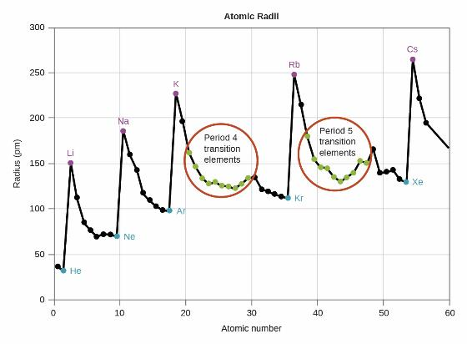
6.5 Periodic Trends
Atomic Size
Within each period, the trend in atomic radius decreases as Z increases; for example, from K to Kr.
Within each group (e.g., the alkali metals shown in purple), the trend is that atomic radius increases as Z increases.
Explain these trends in terms of effective nuclear charge.

Slide 57
6.5 Periodic Trends
Ionic Size
Orbitals holding electrons take up a relatively large amount of space, so adding or removing electrons to create ions result in large changes in size.
A cation has fewer electrons and the same number of protons as the parent atom.
Z_{eff} draws the electrons closer to the nucleus.
A cation is smaller than its neutral atom.
An anion has more electrons but the same number of protons as the parent atom.
Electrons occupy a fairly large amount of space.
An anion is larger than its neutral atom.

Slide 58
6.5 Periodic Trends
Ionic Size
Atoms and ions that have the same electron configuration are said to be isoelectronic.
N^{3–}, O^{2–}, F–, Ne, Na⁺, Mg²⁺, Al³⁺
P^{3–}, S^{2–}, Cl–, Ar, K⁺, Ca²⁺, Sc³⁺
For atoms or ions that are isoelectronic, what trend would expect to see for ionic size?
Write the electron configurations for:
P^{3–} S^{2–} Cl– Ar K⁺ Ca²⁺ Sc³⁺

Slide 59
6.5 Periodic Trends
Ionic Size
The relative ionic sizes of some species are shown.
Li⁺
Be²⁺
Na⁺
Mg²⁺
Al³⁺
N³$−$
O²$−$
F$−$
K⁺
Ca²⁺
Ga³⁺
S²$−$
Cl$−$
Rb⁺
Sr²⁺
In³⁺
Se²$−$
Br$−$
Cs⁺
Ba²⁺
Tl³⁺
Te²$−$
I$−$

Slide 60
6.5 Periodic Trends
Ionization Energy
The amount of energy required to remove the most loosely bound electron from a gaseous species is the ionization energy.
The energy to remove the first electron is IE₁.
The energy to remove the second electron once the first electron has already been removed is IE₂ and so on.
X(g) → X⁺(g) + e⁻
IE₁
X⁺(g) → X²⁺(g) + e⁻
IE₂

Slide 61
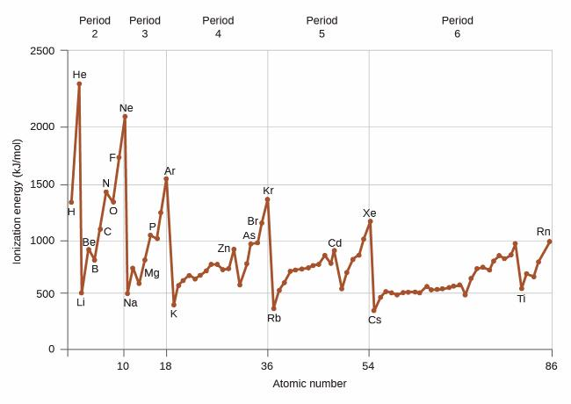
6.5 Periodic Trends
Ionization Energy
The relationship between the first ionization energy in the first five periods are plotted:

Slide 62
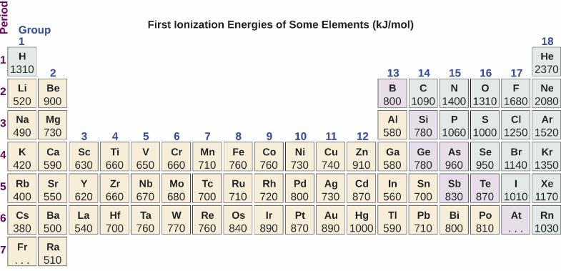
6.5 Periodic Trends
Ionization Energy
Study the first ionization energies in the period table below.
How do the energies change across a period and between periods?

Slide 63
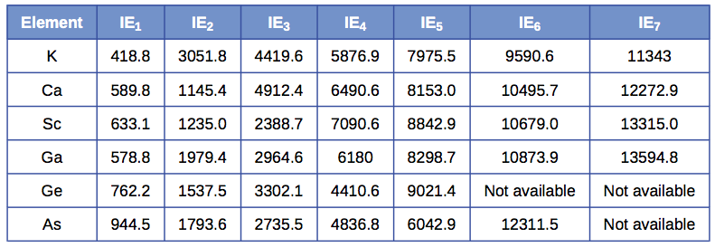
6.5 Periodic Trends
Ionization Energy
Successive ionization energies for selected elements are given.
Use what you know about electron configurations to explain the trends.

Slide 64
6.5 Periodic Trends
Electron Affinity
Electron affinity, EA, is the energy change associated with an atom in the gaseous form gaining an electron.
X(g) + e⁻ → X⁻ (g)
EA
Cl(g) + e⁻ → Cl⁻(g)
exothermic
EA = −349 kJ/mol
ΔE < 0 means that energy is released.
Be(g) + e⁻ → Be⁻(g)
endothermic
EA = +116kJ/mol
ΔE > 0 means that energy is supplied.

Slide 65
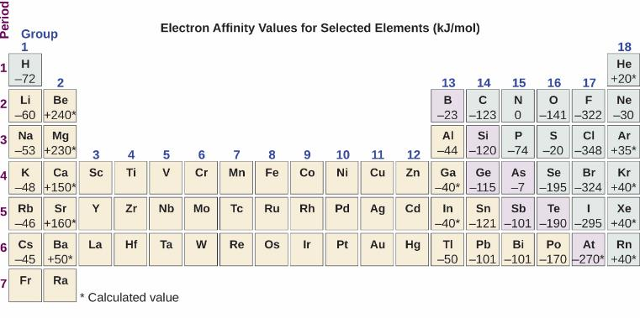
6.5 Periodic Trends
Electron Affinity
Study the periodic table below and note the trends in electron affinity.

Slide 66
6.5 Periodic Trends
Electron Affinity vs. Electronegativity
Be careful not to confuse electronegativity and electron affinity.
The electron affinity of an element is a measurable physical quantity: energy released or absorbed when an isolated gas-phase atom acquires an electron (kJ/mol).
The electronegativity describes how tightly an atom attracts electrons in a bond.
a dimensionless quantity that is calculated, not measured.
derived by Pauling as he compared the amounts of energy required to break different types of bonds
on an arbitrary relative scale ranging from 0 to 4

Slide 67
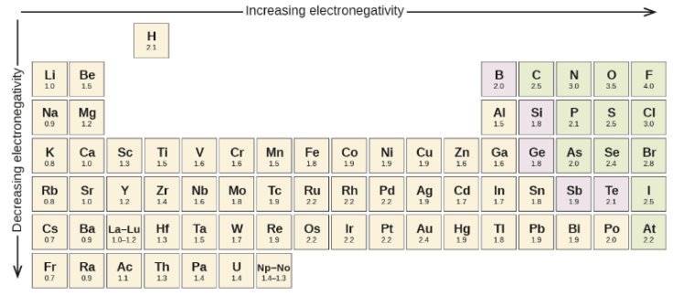
6.5 Periodic Trends
Electronegativity
The electronegativity ($χ$) of an atom is its relative tendency to attract an electron and polarize a bond.
What trends are observed in the listed Pauling electronegativities?

Slide 68
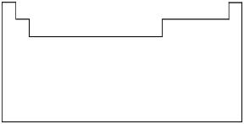
6.5 Periodic Trends
Examples
Use the blank periodic tables to sketch the trends.
increasing
increasing
Atomic Size
Ionic Size
Ionization Energy
Electron Affinity
Electronegativity

Slide 69
6.5 Periodic Trends
Examples
Arrange the atoms in order of increasing atomic size.
Ga, Br, Ca, K (smallest) ______<______<______<______ (largest)
Arrange the atoms in order of increasing electronegativity.
P, F, O, Sb, Se (smallest) ______<______<______<______<______ (largest)
Arrange the species in order of decreasing ionic radius.
Al, Cl, P, S, K, Ca (Make the ion first.)
(largest) ______>______>______>______>______>______ (smallest)
Arrange the species in order of increasing ionic radius.
O, Te, S, Se (Make the ion first.)
(smallest) ______<______<______<______ (largest)
Arrange the species in order of increasing second ionization energy (IE₂)
Sr, K, In, Rb, Sb (smallest) ______<______<______<______<______ (largest)

Slide 70
end of chapter problems – chapter 6
The Nature of Light: #3, 7, 9, 23
Quantum Mechanics: #35, 37, 41
Electron Configurations: #49, 51, 53, 55, 57
Periodic Properties: #67, 69, 73, 75, 77
For detailed solutions to these problems, go to the OpenStax Chemistry website and download the Student Solution Guide.

Slide 71
videos – chapter 6
Wavelength/Frequency Calculations
http://youtu.be/0TDhxW-OAUE
Explanation of Quantum Numbers
http://screencast.com/t/ZfORuHmy4U
Pauli Exclusion Principle
http://screencast.com/t/KmUiOdw2O7y
Writing Electron Configurations
http://youtu.be/oV4IN1ZP0XQ
http://screencast.com/t/avKpuSr19di
Effective Nuclear Charge
http://screencast.com/t/RyaHyMCj
Radii of Atoms and Their Corresponding Ions
http://screencast.com/t/Xjfk3o5gckx5
http://screencast.com/t/xao8arllCo
Trends in Ionization Energy
http://screencast.com/t/mfX8t3WQ46
http://screencast.com/t/EgByYlpK
Trends in Electron Affinity
http://screencast.com/t/h4dGJSNrJ5
*All videos were created by MC Chemistry faculty unless otherwise indicated.

Slide 72
simulations – chapter 6
Models of the Hydrogen Atom (Quantum mechanics, Bohr Model)
https://phet.colorado.edu/en/simulation/legacy/hydrogen-atom
Wave Interference
https://phet.colorado.edu/en/simulation/legacy/wave-interference
Quantum Wave Interference (Quantum mechanics, photons, electrons)
https://phet.colorado.edu/en/simulation/legacy/quantum-wave-interference

