Slide 1
Gases Chapter 5
Ch. 9: Gases
OpenStax
Joseph DePasquale

Slide 2
Air – Our most familiar Gas
Air has been known to exist since ancient times
The Greeks considered air one of the four fundamental elements of nature along with earth, water, and fire.
18th Century
Lavoisier, Cavendish and Priestley: Determined that Air is actually a mixture of gases.

Slide 3
Air and contemporary issues
Air in the news
Ozone depletion in the stratosphere.
Carbon dioxide and global warming.

Slide 4
Common Gases

Slide 5
Chapter 9 Outline
9.1: Gas Pressure
9.2: Relating Pressure, Volume, Amount, and Temperature: The Ideal Gas Law
9.3: Stoichiometry of Gaseous Substances, Mixtures, and Reactions
Omit sections 9.4 – 9.6
In Ch. 10 we will discuss liquids and solids

Slide 6
9.1: Gas Pressure
Pressure is defined as the force exerted on a given area.
Gas pressure is a result of the force exerted by gas molecules colliding with the surface of objects.
English system units for pressure: pounds per square inch (psi).
A mercury barometer is a device commonly used to measure the atmospheric pressure.

Slide 7
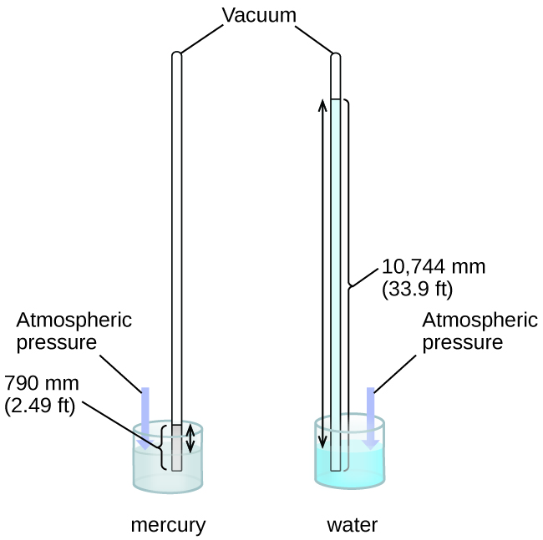
Measuring Atmospheric Pressure
The barometer measures pressure in terms of the height of a column of liquid mercury.
The atmosphere exerts a force on the liquid mercury causing it to rise.
Commonly, the pressure of the atmosphere at sea level pushes the column of mercury ~760 mm high.
In a barometer, the height, h, of the column of liquid is used as a measurement of the air pressure. Using very dense liquid mercury (left) permits the construction of reasonably sized barometers, whereas using water (right) would require a barometer more than 30 feet tall.

Slide 8
Atmospheric Pressure and Altitude
Pressure varies with the height of the column of air above.
We don’t notice atmospheric pressure but do notice changes in atmospheric pressure

Slide 9
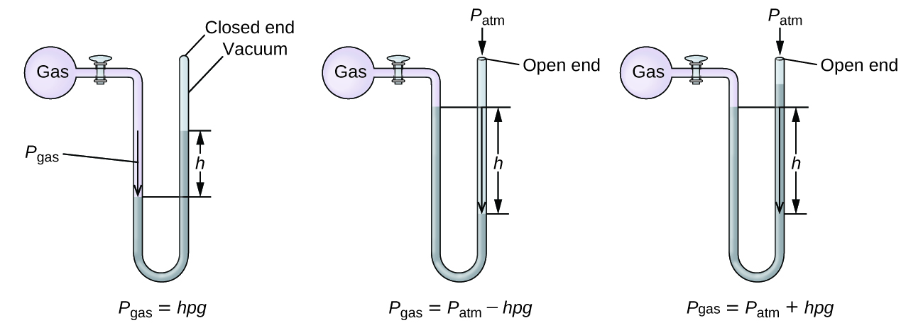
Measuring the Pressure of a Confined Gas - The Manometer
The force of the gas in the flask is measured relative to the force of the atmosphere (atmospheric pressure).
The distance and direction that the Hg travels is related to the pressure of the gas.
A manometer can be used to measure the pressure of a gas. The (difference in) height between the liquid levels (h) is a measure of the pressure. Mercury is usually used because of its large density.

Slide 10
Units of Pressure
Due to the way gas pressure is measured, millimeters of mercury (mmHg) is a commonly used unit of pressure.
Probably the most common unit of gas pressure is the atmosphere (atm).
1 atm is the “normal atmospheric pressure”
1 atm = 760 mmHg

Slide 11
Units of Pressure
SI unit for pressure is the Pascal (Pa).
1 Pa is defined as the pressure exerted by a 0.1 mm high film of water on the surface beneath it.
Kilopascal (kPa)
A related unit of pressure is the bar.
1 bar = 10⁵ Pa
Pressure conversions:
1.013 bar = 1 atm = 760 mmHg = 760 torr
= 14.7 psi = 101.3 kPa

Slide 12
9.2: Relating Pressure, Volume, Amount, and Temperature: The Ideal Gas Law
Four physical properties describe a gas:
Volume
Amount
Temperature
Pressure

Slide 13
Volume of a Gas
At constant temperature and pressure, a gas expands uniformly to fill the container in which it is contained.

Slide 14
Relating Pressure, Volume, Amount, and Temperature
There are many different types of gases.
Elements: Ar, He, H₂, N₂, O₂
Compounds: CO₂, CO, H₂O, NH₃
All gases have the same dependence on those 4 properties.
Volume, Amount, Temperature, and Pressure

Slide 15
Pressure and Temperature
The pressure of a gas is directly proportional to its temperature in K.
At constant V and n
This is Amonton’s Law or Gay-Lussac’s Law
For a constant volume and amount of air, the pressure and temperature are directly proportional, provided the temperature is in kelvin. (Measurements cannot be made at lower temperatures because of the condensation of the gas.) When this line is extrapolated to lower pressures, it reaches a pressure of 0 at –273 °C, which is 0 on the kelvin scale and the lowest possible temperature, called absolute zero.

Slide 16
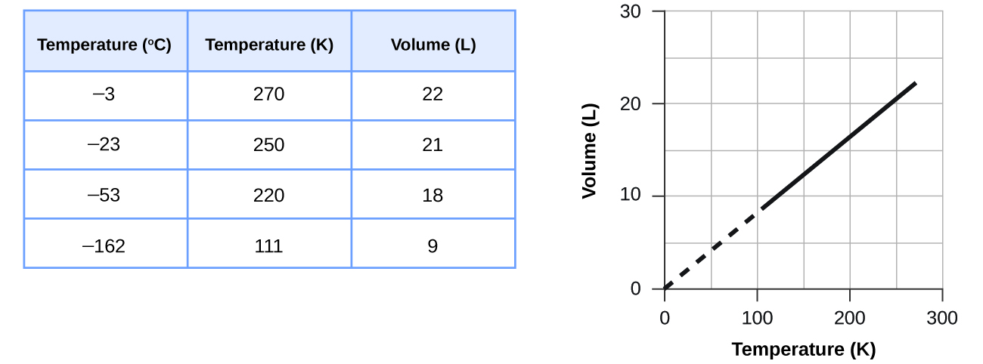
Volume and Temperature
The volume of a gas is directly proportional to its temperature in K.
At constant P and n
This is Charles's Law
The volume and temperature are linearly related for 1 mole of methane gas at a constant pressure of 1 atm. If the temperature is in kelvin, volume and temperature are directly proportional. The line stops at 111 K because methane liquefies at this temperature; when extrapolated, it intersects the graph’s origin, representing a temperature of absolute zero.

Slide 17
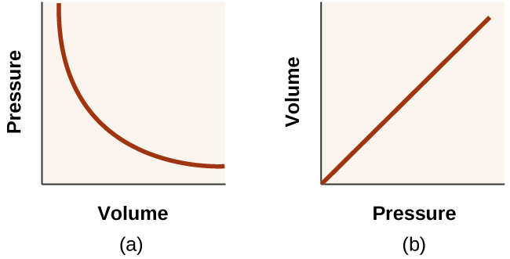
Volume and Pressure
The volume of a gas is inversely proportional to its pressure.
At constant T and n
This is Boyle's Law

Slide 18
Volume and Amount (Moles)
The volume of a gas is directly proportional to its amount (moles of gas).
At constant T and P
This is Avogadro’s Law

Slide 19
The Ideal Gas Law
These four equations can be combined into a single law consisting of all four properties.
The Ideal Gas Law: PV = nRT
The four constants (k’s) were combined into a new constant, R, called the ideal gas constant.

Slide 20
The Ideal Gas Law
PV = nRT
P is the pressure in atm
V is the volume in L
n is the moles of gas
T is the temperature in K
R is the ideal gas constant

Slide 21
PV = nRT
The ideal gas law accurately describes the properties of an ideal gas.
What is an ideal gas? What assumptions are being made?

Slide 22
Standard Temperature and Pressure
Sometimes it is important to define standard conditions.
Standard Temperature and Pressure (STP)
1 atm P
0 °C = 273 K
At STP, the volume of one mole of any gas can be calculated.

Slide 23
PV = nRT
Modified Version of Ideal Gas Law:
Moles kept constant
But other properties change

Slide 24
9.3: Stoichiometry of Gaseous Substances, Mixtures, and Reactions
Calculating the Density of a Gas
Calculating the Molar Mass of a Gas
Stoichiometry Calculations with Gas Phase Reactions
Pressure of a Mixture of Gases: Dalton’s Law

Slide 25
Calculating the Density of a Gas
Recall, the density of a substance
We can rearrange the following equation
Substitute into the density equation to obtain

Slide 26
Density of Gases
Recall, that Density is an intensive property
Does not depend on the amount of substance
But, the Density of a gas does depend upon
Pressure
Temperature
Molar mass

Slide 29
Gas Density
A balloon filled with air (the blue one) remains full overnight. A balloon filled with helium (the green one) partially deflates because the smaller, light helium atoms effuse through small holes in the rubber much more readily than the heavier molecules of nitrogen and oxygen found in air. (credit: modification of work by Mark Ott)

Slide 30
Gas Density

Slide 31
Calculating the Molar Mass of a Gas
Recall, the Molar Mass (MM) of a substance.
This expression can be rearranged.
And then substituted into the Ideal Gas Law.

Slide 32
Stoichiometry in Gaseous Reactions
Gases may appear as reactants or products in a chemical reaction.
The Ideal Gas Law and a Balanced Chemical Equation can be used to relate the P, V, T, n, and grams of a gas that takes part in a chemical reaction.

Slide 33
Stoichiometric factors can be used to relate the moles of one substance to the moles of any other substance in a balanced chemical equation.

Slide 34
Gases and Stoichiometry

Slide 35
Stoichiometry with Gas Volumes
The volume ratio of any two gases in a reaction at constant temperature and pressure is the same as the stoichiometric ratio (mole ratio) in the balanced chemical equation.
Recall that, V = kn (constant T, P). The volume of a gas is directly proportional to the moles of gas.

Slide 36
Electrolysis of Water

Slide 37
Dalton’s Law
The ideal gas law also applies to mixtures of gases if the gases don’t react with each other.
Dalton’s Law of Partial Pressure – The total pressure of a mixture of ideal gases is equal to the sum of the partial pressures of the component gases.
P_{T} = P_{A} + P_{B} + P_{C} ….

Slide 38
Dalton’s Law of Partial Pressure
P_{T} = P_{A} + P_{B} + P_{C} ….
For a mixture of gases A, B, C, …
P_{T} is the total pressure of the gas mixture
P_{A} is the partial pressure of gas A
P_{B} is the partial pressure of gas B
P_{C} is the partial pressure of gas C
The pressure exerted by each individual gas in a mixture is called its partial pressure.
The partial pressure is equal to the pressure that the gas would exert if it were by itself.

Slide 39
Partial Pressure and Mole Fraction
We can express the partial pressure of a gas in a mixture in terms of its mole fraction.
Consider a mixture of gases A and B.
The mole fraction of gas A (Χ_{A}) is the number of moles of A divided by the total number of moles of gas in the mixture.

Slide 40
Collecting a Gas Over Water
A common way to collect and quantify a gas produced in a chemical reaction is to capture the gas in an inverted bottle that had been filled with water.
The volume of water displaced can then be related back to the amount of gas produced.
As the gas travels through the water, it picks up water vapor, H₂O (g).
The collected gas mixture has a P_{T} equal to the atmospheric pressure.

Slide 41
Collecting a Gas Over Water

Slide 42
Wet Gases
We refer to the gas collected over water as a wet gas mixture.
Say for example that the gas being collected was H₂.
P_{T} is the atmospheric pressure.
P_{H2} is the partial pressure of the H₂ (g) collected.
P_{H2O} is the vapor pressure of water

Slide 43
Vapor Pressure
Vapor pressure of water - The pressure exerted by water vapor in equilibrium with liquid water in a closed container.
Intensive property – does not depend on the amount of water.
Temperature dependent.
More on Vapor pressure in Ch. 10…

