Slide 1
CHEMISTRY 2e
Chapter 2 ATOMS, MOLECULES, AND IONS
PowerPoint Image Slideshow

Slide 2
Chapter Outline
2.1 Early Ideas in Atomic Theory
2.2 Evolution of Atomic Theory
2.3 Atomic Structure and Symbolism
2.4 Chemical Formulas
2.5 The Periodic Table
2.6 Molecular and Ionic Compounds
2.7 Chemical Nomenclature

Slide 3
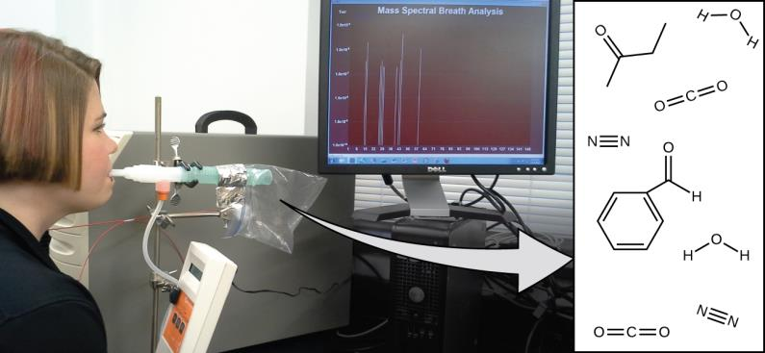
Figure 2.1
Analysis of molecules in an exhaled breath can provide valuable information, leading to early diagnosis of diseases or detection of environmental exposure to harmful substances. (credit: modification of work by Paul Flowers)

Slide 4
Learning Objectives
2.1 Early Ideas in Atomic Theory
State the postulates of Dalton’s atomic theory
Use postulates of Dalton’s atomic theory to explain the laws of definite and multiple proportions

Slide 5
Early Ideas in Atomic Theory
The concept of atoms was first proposed by the Greek philosophers Leucippus and Democritus in the fifth century BC.
atomos, a term derived from the Greek word for “indivisible”
Later, Aristotle and others believed that matter consisted of various combinations of the four “elements”—fire, earth, air, and water.
In 1807, English schoolteacher John Dalton proposed his atomic theory.

Slide 6
Dalton’s Atomic Theory
Dalton’s atomic theory can be summarized in five postulates.
Matter is composed of exceedingly small particles called atoms. An atom is the smallest unit of an element that can participate in a chemical change.
An element consists of only one type of atom, which has a mass that is characteristic of the element and is the same for all atoms of that element.
Atoms of one element differ in properties from atoms of all other elements.
A compound consists of atoms of two or more elements combined in a small, whole-number ratio. In a given compound, the number of atoms of each of its elements are always present in the same ratio.
Atoms are neither created nor destroyed during a chemical change, but instead rearrange to yield a different type(s) of matter.

Slide 7
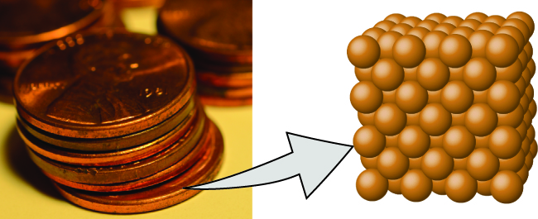
Figure 2.2
A pre-1982 copper penny (left) contains approximately 3 × 10²² copper atoms (several dozen are represented as brown spheres at the right), each of which has the same chemical properties. (credit: modification of work by “slgckgc”/Flickr)

Slide 8
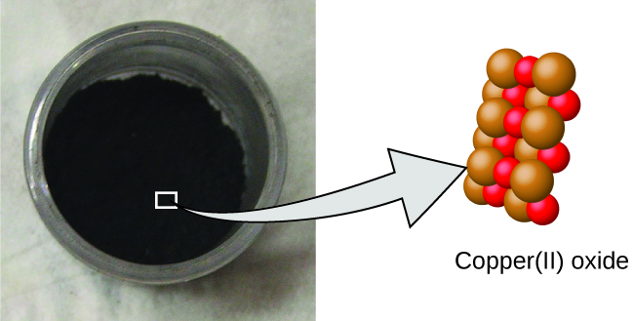
Figure 2.3
Copper(II) oxide, a powdery, black compound, results from the combination of two types of atoms—copper (brown spheres) and oxygen (red spheres)—in a 1:1 ratio. (credit: modification of work by “Chemicalinterest”/Wikimedia Commons)

Slide 9
Figure 2.4
When the elements copper (a shiny, red-brown solid, shown here as brown spheres) and oxygen (a clear and colorless gas, shown here as red spheres) react, their atoms rearrange to form a compound containing copper and oxygen (a powdery, black solid). (credit copper: modification of work by http://imagesof-elements.com/copper.php)

Slide 10
Law of Conservation of Matter
Dalton’s atomic theory provides a microscopic explanation of the many macroscopic properties of matter that you’ve learned about.
If atoms are neither created nor destroyed during a chemical change, then the total mass of matter present when matter changes from one type to another will remain constant (the law of conservation of matter).

Slide 11
Example 2.1

Slide 12
Example 2.1

Slide 13
Law of Definite Proportions
Law of definite proportions or the law of constant composition: All samples of a pure compound contain the same elements in the same proportion by mass.
Illustrated by experiments performed by French chemist Joseph Proust.

Slide 14
Table 2.1 Constant Composition of Isooctane
Sample | Carbon | Hydrogen | Mass Ratio
A | 14.82 g | 2.78 g
B | 22.33 g | 4.19 g
C | 19.40 g | 3.64 g

Slide 15
Law of Multiple Proportions
The law of multiple proportions states that when two elements react to form more than one compound, a fixed mass of one element will react with masses of the other element in a ratio of small, whole numbers.
Example: compounds containing chlorine and copper
A green solid contains 0.558 g Cl to 1 g Cu.
A brown solid contains 1.116 g Cl to 1 g Cu.

Slide 16
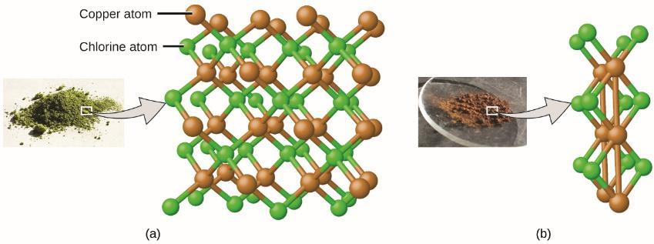
Figure 2.5
Compared to the copper chlorine compound in (a), where copper is represented by brown spheres and chlorine by green spheres, the copper chlorine compound in (b) has twice as many chlorine atoms per copper atom. (credit a: modification of work by “Benjah-bmm27”/Wikimedia Commons; credit b: modification of work by “Walkerma”/Wikimedia Commons)

Slide 17
Learning Objectives
2.2 Evolution of Atomic Theory
Outline milestones in the development of modern atomic theory
Summarize and interpret the results of the experiments of Thomson, Millikan, and Rutherford
Describe the three subatomic particles that compose atoms
Define isotopes and give examples for several elements

Slide 18
Evolution of Atomic Theory
What are atoms composed of?
Is there something smaller than an atom?
Here, we will discuss some of these key developments.

Slide 19
Discovery of the Electron: J.J. Thomson
J.J. Thomson experimented with cathode ray tubes.
Cathode ray tube:
A sealed glass tube from which almost all the air had been removed
Contained two metal electrodes
When a high voltage was applied across the electrodes, a visible beam called a cathode ray appeared between them.
Regardless of the metals used, this beam was always deflected toward the positive charge and away from the negative charge.
Thompson was able to calculate the charge-to-mass ratio of the cathode ray particles.

Slide 20
Thompson’s Results
The cathode ray particles were much lighter than atoms.
These particles are negatively charged.
These particles are indistinguishable, regardless of the source material.
This cathode ray particle is what we now call an electron—a negatively charged, subatomic particle with a mass more than one thousand times less than that of an atom.

Slide 21
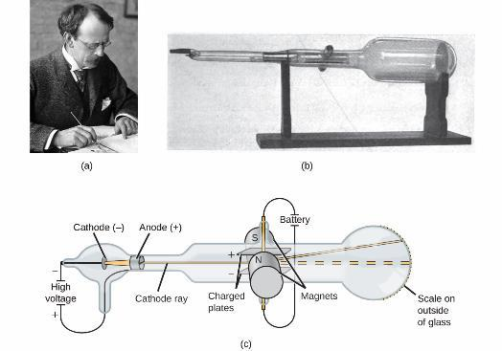
Figure 2.6
(a) J. J. Thomson produced a visible beam in a cathode ray tube. (b) This is an early cathode ray tube, invented in 1897 by Ferdinand Braun. (c) In the cathode ray, the beam (shown in yellow) comes from the cathode and is accelerated past the anode toward a fluorescent scale at the end of the tube. Simultaneous deflections by applied electric and magnetic fields permitted Thomson to calculate the mass-to-charge ratio of the particles composing the cathode ray. (credit a: modification of work by Nobel Foundation; credit b: modification of work by Eugen Nesper; credit c: modification of work by “Kurzon”/Wikimedia Commons)

Slide 22
Discovery of the Electron: Robert A Millikan
Robert A. Millikan’s Oil Drop Experiment (1909)
Millikan created microscopic oil droplets, which were electrically charged.
These drops could be slowed or reversed by an electric field.
Millikan was able to determine the charge on individual drops.

Slide 23
Figure 2.7
Millikan’s experiment measured the charge of individual oil drops. The tabulated data are examples of a few possible values.

Slide 24
Millikan’s Results
The charge of an oil drop was always a multiple of a specific charge, 1.6 × 10^{–19} C.
Millikan concluded that 1.6 × 10^{–19} C was the charge of a single electron.
Thompson already showed the charge to mass ratio of an electron to be 1.759 × 10¹¹ C/kg.

Slide 25
Figure 2.8
(a) Thomson suggested that atoms resembled plum pudding, an English dessert consisting of moist cake with embedded raisins (“plums”). (b) Nagaoka proposed that atoms resembled the planet Saturn, with a ring of electrons surrounding a positive “planet.” (credit a: modification of work by “Man vyi”/Wikimedia Commons; credit b: modification of work by “NASA”/Wikimedia Commons)

Slide 26
Discovery of the Nucleus: Ernest Rutherford
Ernest Rutherford’s Gold Foil Scattering Experiment
Aimed a beam of alpha particles (a particles) at a very thin piece of gold foil.
α particles are positively charged.
The scattering of these α particles was examined using a luminescent screen that would glow briefly when hit.

Slide 27
Figure 2.9
Geiger and Rutherford fired α particles at a piece of gold foil and detected where those particles went, as shown in this schematic diagram of their experiment. Most of the particles passed straight through the foil, but a few were deflected slightly and a very small number were significantly deflected.

Slide 28
Rutherford’s Results
The volume occupied by an atom must consist of a large amount of empty space.
A small, relatively heavy, positively charged body, the nucleus, must be at the center of each atom.
The nucleus contains most of the atom’s mass.
Negatively charged electrons surround the nucleus.
The proton, a positively charged, subatomic particle is located in the nucleus.

Slide 29
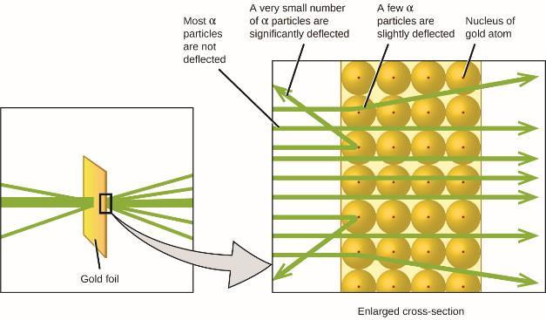
Figure 2.10
The α particles are deflected only when they collide with or pass close to the much heavier, positively charged gold nucleus. Because the nucleus is very small compared to the size of an atom, very few α particles are deflected. Most pass through the relatively large region occupied by electrons, which are too light to deflect the rapidly moving particles.

Slide 30
Other Important Discoveries of the 20th Century
Isotopes: Atoms of the same element that differ in mass
Frederick Soddy of England. Noble Prize in 1921.
Neutrons: Uncharged, subatomic particles with a mass approximately the same as that of protons
Discovered by James Chadwick in 1932.
Neutrons are also found in the nucleus.

Slide 31
Learning Objectives
2.3 Atomic Structure and Symbolism
Write and interpret symbols that depict the atomic number, mass number, and charge of an atom or ion
Define the atomic mass unit and average atomic mass
Calculate average atomic mass and isotopic abundance

Slide 32
Atomic Structure and Symbolism
The nucleus contains the majority of an atom’s mass.
Protons and neutrons are much heavier than electrons.
Electrons occupy almost all of an atom’s volume.
Diameter of an atom ~ 10^{–10} m
Diameter of a nucleus is 100,000 times smaller ~ 10^{–15} m

Slide 33
Figure 2.11
If an atom could be expanded to the size of a football stadium, the nucleus would be the size of a single blueberry. (credit middle: modification of work by “babyknight”/Wikimedia Commons; credit right: modification of work by Paxson Woelber)

Slide 34
Units
Atoms and subatomic particles are very small.
Example: A carbon atom weighs less than 2 × 10^{–23} g.
Electrons have a charge of less than 2 × 10^{–19} C.
Small units are needed.
Atomic mass unit (amu).
1 amu = 1.6605 x 10-24 g.
Mass of a carbon-12 atom = 12 amu
Fundamental unit of charge (e).
e = 1.602 × 10^{–19} C

Slide 35
Properties of Subatomic Particles
Proton
Mass = 1.0073 amu
Charge = +1
Neutron
Mass = 1.0087 amu (slightly heavier than a proton)
Charge = 0
Electron
Mass = 0.00055 amu
Charge = –1

Slide 36
Atomic Number (Z)
The number of protons in the nucleus of an atom is its atomic number (Z).
This is the defining trait of an element: Its value determines the identity of the atom.
For example, any atom that contains six protons is the element carbon and has the atomic number 6, regardless of how many neutrons or electrons it may have.

Slide 37
Neutral Atoms
A neutral atom must contain the same number of positive and negative charges.
The number of protons equals the number of electrons.
Therefore, the atomic number also indicates the number of electrons in a neutral atom.

Slide 38
Mass Number (A)
The total number of protons and neutrons in an atom is called its mass number (A).
The number of neutrons is therefore the difference between the mass number and the atomic number.
atomic number (Z) = number of protons
mass number (A) = number of protons + number of neutrons
A – Z = number of neutrons

Slide 39
Ions
When the number of protons and electrons are NOT equal, the atom is electrically charged and called an ion.
Charge of an atom = number of protons – number of electrons
Atoms (and molecules) acquire charge by losing or gaining electrons.

Slide 40
Cations and Anions
An atom that gains one or more electrons will exhibit a negative charge and is called an anion.
Example: A neutral oxygen atom (Z = 8) has eight electrons, and if it gains two electrons it will become an anion with a 2− charge (8 − 10 = 2−).
An atom that loses one or more electrons will exhibit a positive charge and is called an cation.
Example: A neutral sodium atom (Z = 11) has 11 electrons. If this atom loses one electron, it will become a cation with a 1+ charge (11 − 10 = 1+).

Slide 41
Figure 2.12
(a) Insufficient iodine in the diet can cause an enlargement of the thyroid gland called a goiter. (b) The addition of small amounts of iodine to salt, which prevents the formation of goiters, has helped eliminate this concern in the US where salt consumption is high. (credit a: modification of work by “Almazi”/Wikimedia Commons; credit b: modification of work by Mike Mozart)

Slide 42
Chemical Symbols
A chemical symbol is an abbreviation that we use to indicate an element or an atom of an element.
Example: The symbol for mercury is Hg.
Some symbols are derived from the common name of the element; others are abbreviations of the name in another language.
Most symbols have one or two letters, but three-letter symbols have been used to describe some elements that have atomic numbers greater than 112.
Only the first letter of a chemical symbol is capitalized.

Slide 43
Figure 2.13
The symbol Hg represents the element mercury regardless of the amount; it could represent one atom of mercury or a large amount of mercury.

Slide 44
Table 2.3 Some Common Elements and Their Symbols
Element | Symbol | Element | Symbol
aluminum | Al | iron | Fe (from ferrum)
bromine | Br | lead | Pb (from plumbum)
calcium | Ca | magnesium | Mg
carbon | C | mercury | Hg (from hydrargyrum)
chlorine | Cl | nitrogen | N
chromium | Cr | oxygen | O
cobalt | Co | potassium | K (from kalium)
copper | Cu (from cuprum) | silicon | Si
fluorine | F | silver | Ag (from argentum)
gold | Au (from aurum) | sodium | Na (from natrium)
helium | He | sulfur | S
hydrogen | H | tin | Sn (from stannum)
iodine | I | zinc | Zn

Slide 45
Isotopes
The symbol for a specific isotope of any element is written by placing the mass number as a superscript to the left of the element symbol.
The atomic number is sometimes written as a subscript to the left of the element symbol.
For example, magnesium exists as a mixture of three isotopes.
²⁴Mg, ²⁵Mg, and ²⁶Mg
All isotopes have 12 protons, but the number of neutrons are different.

Slide 46
Figure 2.14
The symbol for an atom indicates the element via its usual two-letter symbol, the mass number as a left superscript, the atomic number as a left subscript (sometimes omitted), and the charge as a right superscript.

Slide 47
Table 2.4 (Partial) Nuclear Compositions of Atoms of the Very Light Elements
Hydrogen exists as a mixture of three isotopes
Element | Symbol | Atomic Number | Number of Protons | Number of Neutrons | Mass (amu) | % Natural Abundance
hydrogen | (protium) | 1 | 1 | 0 | 1.0078 | 99.989
 | (deuterium) | 1 | 1 | 1 | 2.0141 | 0.0115
 | (tritium) | 1 | 1 | 2 | 3.01605 | trace

Slide 48
Atomic Mass
Each proton and each neutron has a mass of ~ 1 amu.
Each electron weighs far less.
Therefore the atomic mass of a single atom in amu is approximately equal to its mass number.
However, most elements exist naturally as a mixture of two or more isotopes.
The periodic table lists the weighted, average mass of all the isotopes present in a naturally occurring sample of that element.

Slide 49
Atomic Mass (continued)
For example, the element boron is composed of two isotopes:
19.9% ¹⁰B with a mass of 10.0129 amu
80.1% ¹¹B with a mass of 11.0093 amu

Slide 50
Mass Spectrometry (MS)
The occurrence and natural abundances of isotopes can be experimentally determined using an instrument called a mass spectrometer.
The sample is vaporized and exposed to a high-energy electron beam that causes the sample’s atoms (or molecules) to become electrically charged, typically by losing one or more electrons.
These cations are then separated by their mass and charge.

Slide 51
Figure 2.15
Analysis of zirconium in a mass spectrometer produces a mass spectrum with peaks showing the different isotopes of Zr.

Slide 52
Learning Objectives
2.4 Chemical Formulas
Symbolize the composition of molecules using molecular formulas and empirical formulas
Represent the bonding arrangement of atoms within molecules using structural formulas

Slide 53
Chemical Formulas
Molecular formula: A representation of a molecule or compound which consists of the following:
Chemical symbols to indicate the types of atoms.
Subscripts after the symbol to indicate the number of each type of atom in the molecule.
Subscripts are used only when more than one atom of a given type is present.
A structural formula shows the same information as a molecular formula but also shows how the atoms are connected.

Slide 54
Figure 2.16
A methane molecule can be represented as (a) a molecular formula, (b) a structural formula, (c) a ball-and-stick model, and (d) a space-filling model. Carbon and hydrogen atoms are represented by black and white spheres, respectively.

Slide 55
Elements That Exist as Molecules
Many elements consist of discrete, individual atoms.
Some elements exist as molecules.
Diatomic molecules: H₂, N₂, O₂, F₂, Cl₂, Br₂, I₂
The most common form of elemental sulfur exists as S₈.

Slide 56
Figure 2.17
A molecule of sulfur is composed of eight sulfur atoms and is therefore written as S₈. It can be represented as (a) a structural formula, (b) a ball-and-stick model, and (c) a space-filling model. Sulfur atoms are represented by yellow spheres.

Slide 57
Figure 2.18
The symbols H, 2H, H₂, and 2H₂ represent very different entities.

Slide 58
Empirical Formula
An empirical formula indicates the simplest whole-number ratio of the number of atoms (or ions) in the compound.
A molecular formula indicates the actual numbers of atoms of each element in a molecule of the compound.
Example: benzene
Molecular formula = C₆H₆ Empirical formula = CH
Example: acetic acid
Molecular formula = C₂H₄O₂ Empirical formula = CH₂O

Slide 59
Figure 2.19
(a) The white compound titanium dioxide provides effective protection from the sun. (b) A crystal of titanium dioxide, TiO₂, contains titanium and oxygen in a ratio of 1 to 2. The titanium atoms are gray and the oxygen atoms are red. (credit a: modification of work by “osseous”/Flickr)

Slide 60
Figure 2.20
Benzene, C₆H₆, is produced during oil refining and has many industrial uses. A benzene molecule can be represented as (a) a structural formula, (b) a ball-and-stick model, and (c) a space-filling model. (d) Benzene is a clear liquid. (credit d: modification of work by Sahar Atwa)

Slide 61
Figure 2.21
(a) Vinegar contains acetic acid, C₂H₄O₂, which has an empirical formula of CH₂O. It can be represented as (b) a structural formula and (c) as a ball-and-stick model. (credit a: modification of work by “HomeSpot HQ”/Flickr)

Slide 62
Figure 2.22
Chemist Lee Cronin has been named one of the UK’s 10 most inspirational scientists. The youngest chair at the University of Glasgow, Lee runs a large research group, collaborates with many scientists worldwide, has published over 250 papers in top scientific journals, and has given more than 150 invited talks. His research focuses on complex chemical systems and their potential to transform technology, but also branches into nanoscience, solar fuels, synthetic biology, and even artificial life and evolution. (credit: image courtesy of Lee Cronin)

Slide 63
Isomers
It may be possible for the same atoms to be arranged in different ways.
Isomers: Compounds with the same chemical formula but different molecular structures.
Example: Acetic acid and methyl formate both have the molecular formula C₂H₄O₂, but they have different structures and properties.

Slide 64
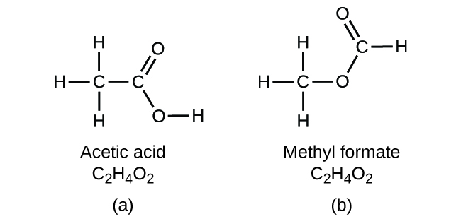
Figure 2.23
Molecules of (a) acetic acid and methyl formate (b) are structural isomers; they have the same formula (C₂H₄O₂) but different structures (and therefore different chemical properties).

Slide 65
Figure 2.24
Molecules of carvone are spatial isomers; they only differ in the relative orientations of the atoms in space. (credit bottom left: modification of work by “Miansari66”/Wikimedia Commons; credit bottom right: modification of work by Forest & Kim Starr)

Slide 66
Learning Objectives
2.5 The Periodic Table
State the periodic law and explain the organization of elements in the periodic table
Predict the general properties of elements based on their location within the periodic table
Identify metals, nonmetals, and metalloids by their properties and/or location on the periodic table

Slide 67
The Periodic Table
Dimitri Mendeleev in Russia (1869) and Lothar Meyer in Germany (1870) independently recognized that there was a periodic relationship among the properties of the elements known at that time.
For example:
Lithium (Li), sodium (Na), and potassium (K) are all shiny, conduct heat and electricity well, and have similar chemical properties.
Calcium (Ca), strontium (Sr), and barium (Ba) are also shiny, conduct heat and electricity well, but are less reactive than Li, Na, and K.

Slide 68
The First Periodic Table
Both Mendeleev and Meyer published tables with the elements arranged according to increasing atomic mass.
Mendeleev used his table to predict the existence of elements that would have the properties similar to aluminum and silicon, but were not yet known.
The discoveries of gallium (1875) and germanium (1886) provided great support for Mendeleev’s work.

Slide 69
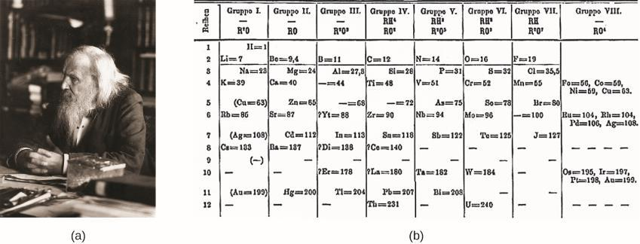
Figure 2.25
(a) Dimitri Mendeleev is widely credited with creating (b) the first periodic table of the elements. (credit a: modification of work by Serge Lachinov; credit b: modification of work by “Den fjättrade ankan”/Wikimedia Commons)

Slide 70
The Modern Periodic Table
By the twentieth century, it became apparent that the periodic relationship involved atomic numbers rather than atomic masses.
Periodic Law: The properties of the elements are periodic functions of their atomic numbers.
A modern periodic table arranges the elements in increasing order of their atomic numbers and groups atoms with similar properties in the same vertical column
Periods or series: horizontal rows
Groups: vertical columns (numbered 1–18)

Slide 71
Figure 2.26
Elements in the periodic table are organized according to their properties.

Slide 72
Classifications of Elements
Metals are shiny, malleable, good conductors of heat and electricity.
Nonmetals appear dull, poor conductors of heat and electricity.
Metalloids conduct heat and electricity moderately well, and possess some properties of metals and some properties of nonmetals.

Slide 73
Classifications of Elements (continued)
Main group elements (or representative elements)
Groups: 1, 2, 13–18
Transition metals
Groups: 3–13
Inner transition metals
Two rows at the bottom of the periodic table.
Lanthanides: top row
Actinides: bottom row

Slide 74
Classifications of Elements (continued)
Alkali metals: group 1 (except hydrogen)
Alkaline earth metals: group 2
Pnictogens: group 15
Chalcogens: group 16
Halogens: group 17
Noble Gases (or inert gases): group 18

Slide 75
Figure 2.27
The periodic table organizes elements with similar properties into groups.

Slide 76
Learning Objectives
2.6 Molecular and Ionic Compounds
Define ionic and molecular (covalent) compounds
Predict the type of compound formed from elements based on their location within the periodic table
Determine formulas for simple ionic compounds

Slide 77
Molecular and Ionic Compounds
In ordinary chemical reactions, the nucleus of each atom (and thus the identity of the element) remains unchanged.
Electrons participate in chemical reactions by being gained, lost, or shared.
The gain or lose of electrons, results in the formation of ions.

Slide 78
Figure 2.28
(a) A sodium atom (Na) has equal numbers of protons and electrons (11) and is uncharged. (b) A sodium cation (Na⁺) has lost an electron, so it has one more proton (11) than electrons (10), giving it an overall positive charge, signified by a superscripted plus sign.

Slide 79
Predicting Ion Charge
The periodic table can serve as a guide for predicting the ionic charge of main-group elements.
Many main-group metals lose enough electrons to leave them with the same number of electrons as an atom of the preceding noble gas.
Group 1: lose one electron, form a cation with a 1+ charge
Group 2: lose two electrons, form a cation with a 2+ charge
Many nonmetals gain enough electrons to give them the same number of electrons as an atom of the next noble gas.
Group 17: gain one electron, form an anion with a 1– charge.
Group 16: gain two electrons, form an anion with a 2– charge.

Slide 80
Predicting Ion Charge (continued)
Example: Ca (group 2)
Ca atom (20 protons, 20 electrons)
Loses 2 electrons
Now a Ca2+ ion (20 protons, 18 electrons)
Same number of electrons as the preceding noble gas, Ar.
Example: Br (group 17)
Br atom (35 protons, 35 electrons)
Gains 1 electron
Now a Br- ion (35 protons, 36 electrons)
Same number of electrons as the next noble gas, Kr.

Slide 81
Predicting Ion Charge (continued)
Moving from far left to far right in the periodic table:
Positive charges of cations are equal to the group number.
Moving from the far right to the far left in the periodic table:
Negative charges of anions are equal to the number of groups moved left from the noble gas.
This method is less reliable for transition metals.
Cu forms ions of 1+ and 2+ charge.
Fe forms ions of 2+ and 3+ charge.

Slide 82
Figure 2.29
Some elements exhibit a regular pattern of ionic charge when they form ions.

Slide 83
Polyatomic Ions
The ions that we have discussed so far are called monatomic ions, that is, they are ions formed from only one atom.
Polyatomic ions are electrically charged molecules (a group of bonded atoms with an overall charge).
Oxyanions are polyatomic ions that contain one or more oxygen atoms.

Slide 84
Table 2.5 (Partial) Common Polyatomic Ions
Name | Formula | Related Acid | Formula
ammonium | NH₄⁺ | nitrate | NO₃⁻
hydronium | H₃O⁺ | nitrate | NO₂⁻
peroxide | O₂²⁻ | sulfate | SO₄²⁻
hydroxide | OH⁻ | hydrogen sulfate | HSO₄⁻
acetate | CH₃COO⁻ | sulfite | SO₃²⁻
cyanide | CN⁻ | hydrogen sulfite | HSO₃⁻
azide | N₃⁻ | phosphate | PO₄³⁻
carbonate | CO₃²⁻ | hydrogen phosphate | HPO₄²⁻
bucarbonate | HCO₃⁻
dihydrogen phosphate | H₂PO₄⁻
perchlorate | ClO₄⁻
chlorate | ClO₃⁻
chlorite | ClO₂⁻
hypochlorite | ClO⁻
chromate | CrO₄²⁻
dichromate | Cr₂O₇²⁻
permanganate | MnO₄⁻

Slide 85
Naming Oxyanions
There is a system for naming oxyanions.
When a nonmetal forms two oxyanions:
–ate is the suffix used for the ion with the larger number of oxygen atoms
–ite is the suffix used for the ion with the smaller number of oxygen atoms
When a nonmetal forms more than two oxyanions, prefixes are used in addition to –ate and –ite.
per– (largest number of oxygens)
hypo – (smallest number of oxygens)

Slide 86
Types of Chemical Bonds
When electrons are transferred, ions form, and an ionic bond results.
Ionic bonds are electrostatic forces of attraction.
When electrons are shared and molecules form, a covalent bond results.
Compounds are classified as ionic or molecular (covalent) on the basis of the bonds present in them.

Slide 87
Ionic Compounds
Metals readily lose electrons—form cations.
Nonmetals readily gain electrons—form anions.
When a metal and nonmetal react, a transfer of electrons usually takes place.
Metals and nonmetals generally form ionic compounds.
A compound that contains ions and is held together by ionic bonds is called an ionic compound.

Slide 88
Ionic Compound Examples
Na and Cl
One Na atom gives up one electron forming a Na⁺ ion.
One Cl atom accepts that electron forming a Cl– ion.
The ionic compound, NaCl forms.
Ca and Cl
One Ca atom gives up two electrons forming a Ca²⁺ ion.
Two Cl atoms each accept one electron forming two Cl – ions.
The ionic compound, CaCl₂ forms.

Slide 89
Properties of Ionic Compounds
Typically solids with high melting and boiling points.
Nonconductive in solid form.
Conductive in molten form.

Slide 90
Figure 2.30
Sodium chloride melts at 801 °C and conducts electricity when molten. (credit: modification of work by Mark Blaser and Matt Evans)

Slide 91
Formulas of Ionic Compounds
Ionic compounds are electrically neutral overall.
The formula of an ionic compound must have a ratio of ions such that the numbers of positive and negative charges are equal.
These formulas are not molecular formulas.
Example: Al³⁺ and O^{2–} forms Al₂O₃
Two Al³⁺ ions gives six positive charges.
Three O^{2–} ions gives six negative charges.

Slide 92
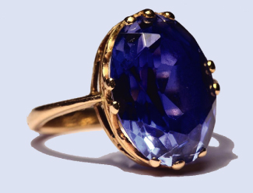
Figure 2.31
Although pure aluminum oxide is colorless, trace amounts of iron and titanium give blue sapphire its characteristic color. (credit: modification of work by Stanislav Doronenko)

Slide 93
Formulas of Ionic Compounds
Many ionic compounds contain polyatomic ions as the cation, the anion, or both.
Treat polyatomic ions as discrete units.
Parentheses in a formula are used to indicate a group of atoms that behave as a unit.
Example: Ca²⁺ and PO₄^{3–} forms Ca₃(PO₄)₂
Three Ca²⁺ ions gives six positive charges.
Two PO₄^{3–} ions gives six negative charges.

Slide 94
Molecular Compounds
Molecular compounds (covalent compounds) result when atoms share electrons.
Exist as discrete, neutral molecules.
Usually formed by a combination of nonmetals.
Often exist as gases, low-boiling liquids, and low-melting solids.

Slide 95
Learning Objectives
2.7 Chemical Nomenclature
Derive names for common types of inorganic compounds using a systematic approach

Slide 96
Chemical Nomenclature
Nomenclature: A collection of rules for naming things.
Compounds are identified by both their formula and name.
We will learn how to name the following types of inorganic compounds:
Ionic and molecular binary compounds: composed of two elements.
Ionic compounds containing polyatomic ions.
Acids

Slide 97
Naming Ionic Compounds
Name the cation first, followed by the name of the anion.
A monoatomic cation is just given the name of the element.
A monoatomic anion is given the name of the element with its ending replaced by the suffix –ide.
A polyatomic ion is just given the name of the ion.

Slide 98
Table 2.6 Names of Some Ionic Compounds
NaCl, sodium chloride | Na₂O, sodium oxide
KBr, potassium bromide | CdS, cadmium sulfide
CaI₂, calcium iodide | Mg₃N₂, magnesium nitride
CsF, cesium fluoride | Ca₃P₂, calcium phosphide
LiCl, lithium chloride | Al₄C₃, aluminum carbide

Slide 99
Table 2.7 Names of Some Polyatomic Ionic Compounds
KC₂H₃O₂, potassium acetate | CaSO₄, calcium sulfate
NH₄Cl, ammonium chloride | Al₂(CO₃)₃, aluminum carbonate
NaHCO₃, sodium bicarbonate | Mg₃(PO₄)₂, magnesium phosphate

Slide 100
Naming Ionic Compounds Containing a Metal Ion with a Variable Charge
Most of the transition metals and some main group metals can form two or more cations with different charges.
The charge of the metal ion is specified by a Roman numeral in parentheses after the name of the metal.

Slide 101
Table 2.9 Some Ionic Compounds with Variably Charged Metal Ions
Compound | Name
FeCl₂ | iron(II) chloride
FeCl₃ | iron(III) chloride
Hg₂O | mercury(I) oxide
HgO | mercury(II) oxide
SnF₂ | tin(II) fluoride
SnF₄ | tin(IV) fluoride

Slide 102
Table 2.10 Nomenclature Prefixes
Number | Prefix |  | Number | Prefix
1 (sometimes omitted) | mono- |  | 6 | hexa-
2 | di- |  | 7 | hepta-
3 | tri- |  | 8 | octa-
4 | tetra- |  | 9 | nona-
5 | penta- |  | 10 | deca-

Slide 103
Figure 2.32
(a) Erin Brockovich found that Cr(IV), used by PG&E, had contaminated the Hinckley, California, water supply. (b) The Cr(VI) ion is often present in water as the polyatomic ions chromate, CrO₄²⁻ (left), and dichromate, Cr₂O₇²⁻ (right).

Slide 104
Naming Ionic Hydrates
Hydrate: Compound, often ionic, that contains one or more water molecules bound within its crystals.
Hydrates may typically be dehydrated by heating to remove the bound water molecules, yielding the anhydrous compound.
To name hydrates:
Name the anhydrous compound (per usual rules)
Add the word hydrate with a Greek prefix denoting the number of water molecules
Formulas for hydrates are written by appending the formula for water to the formula for the anhydrous compound, including a stoichiometric coefficient denoting the number of water molecules, and separated by a vertically centered dot
Examples: copper(II) sulfate pentahydrate CuSO₄·5H₂O calcium chloride monohydrate CaCl₂·H₂O

Slide 105
Naming Binary Molecular (Covalent) Compounds
Molecular compounds are name using a different set of rules.
Covalent bonding allows for significant variation in the ratios of the atoms in a molecule.
The names for molecular compounds must explicitly identify these ratios.
The name of the more metallic element (the one farther to the left and/or bottom of the periodic table) is named first.
Followed by the name of the more nonmetallic element (the one farther to the right and/or top) with its ending changed to the suffix –ide.
The numbers of atoms of each element are designated by Greek prefixes.

Slide 106
Nomenclature Prefixes
When only one atom of the first element is present, the prefix mono- is usually not used.
When two vowels are adjacent, the a in the Greek prefix is usually dropped.

Slide 107
Table 2.11 Names of Some Molecular Compounds Composed of Two Elements
Compound | Name |  | Compound | Name
SO₂ | sulfur dioxide |  | BCl₃ | boron trichloride
SO₃ | sulfur trioxide |  | SF₆ | sulfur hexafluoride
NO₂ | nitrogen dioxide |  | PF₅ | phosphorus pentafluoride
N₂O₄ | dinitrogen tetroxide |  | P₄O₁₀ | tetraphosphorus decaoxide
N₂O₅ | dinitrogen pentoxide |  | P₄O₁₀ | iodine heptafluoride

Slide 108
Naming Acids
Some compounds containing hydrogen are members of an important class of substances known as acids.
Many acids release hydrogen ions, H⁺, when dissolved in water.
A mixture of an acid with water is given a special name to denote this property.

Slide 109
Naming Binary Acids
The word “hydrogen” is changed to the prefix hydro–.
The other nonmetallic element name is modified by adding the suffix –ic.
The word “acid” is added as a second word.

Slide 110
Table 2.12 Names of Some Simple Acids
Name of Gas | Name of Acid
HF(g), hydrogen fluoride | HF(aq), hydrofluoric acid
HCl(g), hydrogen chloride | HCl(aq), hydrochloric acid
HBr(g), hydrogen bromide | HBr(aq), hydrobromic acid
HI(g), hydrogen iodide | HI(aq), hydroiodic acid
H₂S(g), hydrogen sulfide | H₂S(aq), hydrosulfuric acid

Slide 111
Naming Oxyacids
Oxyacids: Compounds that contain hydrogen, oxygen, and at least one other element, and are bonded in such a way as to impart acidic properties to the compound.
Typical oxyacids consist of hydrogen combined with a polyatomic, oxygen-containing ion.
To name oxyacids:
Omit “hydrogen”
Start with the root name of the anion
Replace –ate with –ic, or –ite with –ous
Add “acid”

Slide 112
Table 2.13 Names of Common Oxyacids
Formula | Anion Name | Acid Name
HC₂H₃O₂ | acetate | acetic acid
HNO₃ | nitrate | nitric acid
HNO₂ | nitrite | nitrous acid
HClO₄ | perchlorate | perchloric acid
H₂CO₃ | carbonate | carbonic acid
H₂SO₄ | sulfate | sulfuric acid
H₂SO₃ | sulfite | sulfurous acid
H₃PO₄ | phosphate | phosphoric acid

Slide 113
Exercise 1

Slide 114
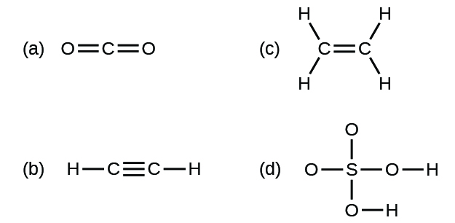
Exercise 29

Slide 115
Exercise 30

Slide 116
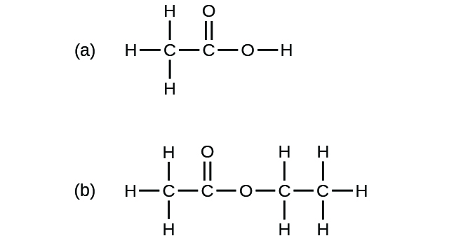
Exercise 33

Slide 117
BLANK PAGE
This OpenStax ancillary resource is © Rice University under a CC-BY 4.0 International license; it may be reproduced or modified but must be attributed to OpenStax, Rice University and any changes must be noted.

