Slide 1
CHEMISTRY 2e
Chapter 4 Stoichiometry of Chemical Reactions
PowerPoint Image Slideshow

Slide 2
Chapter Outline
4.1 Writing and Balancing Chemical Equations
4.2 Classifying Chemical Reactions
4.3 Reaction Stoichiometry
4.4 Reaction Yields
4.5 Quantitative Chemical Analysis

Slide 3
Figure 4.1
Many modern rocket fuels are solid mixtures of substances combined in carefully measured amounts and ignited to yield a thrust-generating chemical reaction. (credit: modification of work by NASA)

Slide 4
Learning Objectives
4.1 Writing and Balancing Chemical Equations
Derive chemical equations from narrative descriptions of chemical reactions.
Write and balance chemical equations in molecular, total ionic, and net ionic formats.

Slide 5
Writing and Balancing Chemical Equations
Preceding chapters introduced the use of element symbols to represent individual atoms, molecules, and compounds.
A balanced chemical equation uses symbolism to represent both the identities and the relative quantities of substances undergoing a chemical (or physical) change.

Slide 6
Figure 4.2
The reaction between methane and oxygen to yield carbon dioxide in water (shown at bottom) may be represented by a chemical equation using formulas (top).

Slide 7
Writing Chemical Equations
This example illustrates the fundamental aspects of any chemical equation:
The substances undergoing a reaction are called reactants, and their formulas are placed on the left side of the equation.
The substances generated by the reaction are called products, and their formulas are placed on the right side of the equation.
Plus signs (+) separate individual reactant and product formulas, and an arrow (⟶) separates the reactant and product (left and right) sides of the equation.
The relative numbers of reactant and product species are represented by coefficients (numbers placed immediately to the left of each formula). A coefficient of 1 is typically omitted.

Slide 8
Coefficients
It is common practice to use the smallest possible whole-number coefficients in a chemical equation.
These coefficients represent the relative numbers of reactants and products, and, therefore, they may be correctly interpreted as ratios.
Previous example: Methane and oxygen react to yield carbon dioxide and water in a 1:2:1:2 ratio.

Slide 9
Figure 4.3
Regardless of the absolute number of molecules involved, the ratios between numbers of molecules are the same as that given in the chemical equation.

Slide 10
Balancing Equations
The chemical equation described previously is balanced.
Equal numbers of atoms for each element are represented on the reactant and product sides.
The number of atoms for a given element is calculated by multiplying the coefficient of any formula containing that element by the element’s subscript in the formula.

Slide 11
Balancing Equations
If an element appears in more than one formula on a given side of the equation, the number of atoms represented in each must be computed and then added together.
For example, both product species in the example reaction, CO₂ and H₂O, contain the element oxygen.

Slide 12
Balancing Equations
The equation for the reaction between methane and oxygen to yield carbon dioxide and water is confirmed to be balanced as shown here:
CH₄ + 2O₂ ⟶ CO₂ + 2H₂O
Element | Reactants | Products | Balanced?
C | 1 × 1 = | 1 × 1 = 1 | 1 = 1, yes
H | 1 × 4 = 4 | 2 × 2 = 4 | 4 = 4, yes
O | 2 × 2 = 4 | (1 × 2) + (2 × 1) = 4 | 4 = 4, yes

Slide 13
Balancing Equations
An unbalanced chemical reaction can be balanced by a fairly simple approach known as balancing by inspection.
H₂O ⟶ H₂ + O₂ (unbalanced)
The numbers of H atoms are balanced, but the numbers of O atoms are not.
Element | Reactants | Products | Balanced?
H | 1 × 2 = 2 | 1 × 2 = 2 | 2 = 2, yes
O | 1 × 1 = 1 | 1 × 2 = 2 | 1 ≠ 2, no

Slide 14
Balancing Equations
To achieve balance, the coefficients of the equation must be changed as needed.
Subscripts define the identity of the substance, and so these cannot be changed without altering the qualitative meaning of the equation.

Slide 15
Balancing Equations
The O atom balance may be achieved by changing the coefficient for H2O to 2.
H₂O ⟶ H₂ + O₂ (unbalanced)
Element | Reactants | Products | Balanced?
H | 2 × 2 = 4 | 1 × 2 = 2 | 4 ≠ 2, no
O | 2 × 1 = 2 | 1 × 2 = 2 | 2 = 2, yes

Slide 16
Balancing Equations
The H atom balance was upset by this change, but it is easily reestablished by changing the coefficient for H₂ to 2.
2H₂O ⟶ 2H₂ + O₂ (balanced)
These coefficients yield equal numbers of both H and O atoms on the reactant and product sides; therefore, the equation is balanced!
Element | Reactants | Products | Balanced?
H | 2 × 2 = 4 | 2 × 2 = 4 | 4 = 4, yes
O | 2 × 1 = 2 | 1 × 2 = 2 | 2 = 2, yes

Slide 17
Balancing Equations
It is sometimes convenient to use fractions instead of integers as intermediate coefficients.
C₂H₆ + O₂ ⟶ 3H₂O + 2CO₂ (balanced)
When balance is achieved, all the equation’s coefficients may then be multiplied by a whole number to convert the fractional coefficients to integers.
Multiplying each coefficient by 2:
2C₂H₆ + 7O2 ⟶ 6H₂O + 4CO₂ (balanced)

Slide 18
Additional Information in Chemical Equations
The physical states of reactants and products are often indicated with a parenthetical abbreviation following the formulas.
(g) gas
(l) liquid
(s) solid
(aq) aqueous
2Na(s) + 2H₂O(l) ⟶ 2NaOH(aq) + H₂(g)
Special conditions necessary for a reaction are sometimes designated by writing a word or symbol above or below the equation’s arrow.
For example, a reaction carried out by heating may be indicated by the uppercase Greek letter delta (Δ) over the arrow.
CaCO3(s) ⟶ CaO(s) + CO2(g)

Slide 19
Equations for Ionic Reactions
Many chemical reactions take place in aqueous media.
When ions are involved, the chemical equations may be written with various levels of detail.
Molecular equation:
CaCl₂(aq) + 2AgNO₃ (aq) ⟶ Ca(NO₃)₂(aq) + 2AgCl(s)
Molecular equations don’t explicitly represent the ionic species that are present in solution.

Slide 20
Equations for Ionic Reactions
When ionic compounds dissolve in water, they may dissociate into their constituent ions
CaCl₂(aq) ⟶ Ca²⁺(aq) + 2Cl⁻(aq)
2AgNO₃(aq) ⟶ 2Ag⁺(aq) + 2NO₃⁻(aq)
Ca(NO₃)₂(aq) ⟶ Ca²⁺ (aq) + 2NO₃⁻(aq)
Unlike these three ionic compounds, AgCl does not dissolve in water to a significant extent.

Slide 21
Complete Ionic Equation
Ionic compounds dissolved in water are more realistically represented as dissociated ions.
Explicitly representing all dissolved ions results in a complete ionic equation:
Ca²⁺(aq) + 2Cl⁻(aq) + 2Ag⁺(aq) + 2NO₃⁻(aq) ⟶ Ca²⁺(aq) + 2NO₃⁻(aq) + 2AgCl(s)

Slide 22
Net Ionic Equation
Two chemical species are present in identical form on both sides of the arrow, Ca²⁺(aq) and NO₃⁻(aq).
These ions are spectator ions—ions whose presence is required to maintain charge neutrality and are neither chemically nor physically changed by the process.
Elimination of the spectator ions results in a net ionic equation:
Ag⁺(aq) + Cl⁻(aq) ⟶ AgCl(s)

Slide 23
Learning Objectives
4.2 Classifying Chemical Reactions
Define three common types of chemical reactions (precipitation, acid-base, and oxidation-reduction)
Classify chemical reactions as one of these three types given appropriate descriptions or chemical equations
Identify common acids and bases
Predict the solubility of common inorganic compounds by using solubility rules
Compute the oxidation states for elements in compounds

Slide 24
Classifying Chemical Reactions
A precipitation reaction is one in which dissolved substances react to form one (or more) solid products.
Also known as a double displacement, double replacement, or metathesis reaction
Many reactions of this type involve the exchange of ions between ionic compounds in aqueous solution.
Precipitation reactions are common in nature and in industry.

Slide 25
Solubility and Precipitation Reactions
Solubility: the maximum concentration of a substance that can be achieved under specified conditions
Substances that have a relatively large solubility are said to be soluble.
A substance will precipitate when solution conditions are such that its concentration exceeds its solubility.
Substances that have a relatively low solubility are said to be insoluble, and these are the substances that readily precipitate from solution.

Slide 26
Solubility of Common Ionic Compounds in Water
Soluble compounds contain: | Insoluble exceptions:
group 1 metal cations and the ammonium ion the halide ions the acetate, bicarbonate, nitrate, and chlorate ions the sulfate ion | the halides of Ag⁺, Hg₂²⁺, Pb²⁺ Sulfates of Ag⁺, Ba²⁺, Ca²⁺, Hg₂²⁺, Pb²⁺ , Sr²⁺
Insoluble compounds contain: | Soluble exceptions:
carbonate, chromate, phosphate, and sulfide ions hydroxide ion | compounds of these ions with group 1 metal cations or ammonium ion. hydroxides of group 1 metal cations and Ba²⁺

Slide 27
Precipitation Reaction Example
Molecular equation:
2KI(aq) + Pb(NO₃)₂(aq) ⟶ PbI₂(s) + 2KNO₃(aq)
PbI₂ precipitates from solution, which is consistent with the solubility rules.
Net ionic equation:
Pb²⁺(aq) + 2I–(aq) ⟶ PbI₂(s)

Slide 28
Figure 4.4
A precipitate of PbI₂ forms when solutions containing Pb²⁺ and I⁻ are mixed. (credit: Der Kreole/Wikimedia Commons)

Slide 29
Precipitate Reaction Example
Molecular Equation:
NaCl(aq) + AgNO₃(aq) ⟶ AgCl(s) + NaNO₃(aq)
AgCl precipitates from solution, which is consistent with the solubility rules.
Net ionic equation:
Ag⁺(aq) + Cl⁻(aq) ⟶ AgCl(s)

Slide 30
Acid-Base Reactions
An acid-base reaction is one in which a hydrogen ion, H⁺, is transferred from one chemical species to another.
An acid is a substance that will dissolve in water to yield hydronium ions, H₃O⁺.
Example: HCl is a strong acid
HCl(aq) + H₂O(aq) ⟶ Cl⁻(aq) + H₃O⁺(aq)
This is an acid-base reaction: H⁺ ions are transferred from HCl molecules to H₂O molecules.

Slide 31
Figure 4.5
When hydrogen chloride gas dissolves in water, (a) it reacts as an acid, transferring protons to water molecules to yield (b) hydronium ions (and solvated chloride ions).

Slide 32
Strong Acids
Virtually every HCl molecule that dissolves in water will undergo this reaction.
Acids that completely react in this fashion are called strong acids.

Slide 33
Table 4.2 Common Strong Acids
Compound Formula | Name in Aqueous Solution
HBr | hydrobromic acid
HCl | hydrochloric acid
HI | hydroiodic acid
HNO₃ | nitric acid
HClO₄ | perchloric acid
H₂SO₄ | sulfuric acid

Slide 34
Weak Acids
A far greater number of compounds behave as weak acids and only partially react with water.
A large majority of dissolved molecules remain in their original form and only a relatively small amount of hydronium ions are generated.

Slide 35
Weak Acids
Example: acetic acid
CH₃CO₂H(aq) + H₂O(l) ⇌ CH₃CO₂⁻(aq) + H₃O⁺(aq)
Only about 1% of acetic acid molecules are present in the ionized form, CH₃CO₂⁻.
The use of a double-arrow in the equation denotes the partial reaction aspect of this process.
This is also an acid-base reaction.

Slide 36
Figure 4.6
(a) Fruits such as oranges, lemons, and grapefruit contain the weak acid citric acid. (b) Vinegars contain the weak acid acetic acid. The hydrogen atoms that may be transferred during an acid-base reaction are highlighted in the inset molecular structures. (credit a: modification of work by Scott Bauer; credit b: modification of work by Brücke-Osteuropa/Wikimedia Commons)

Slide 37
Bases
A base is a substance that will dissolve in water to yield hydroxide ions, OH−.
The most common bases are ionic compounds composed of alkali or alkaline earth metal cations (groups 1 and 2) combined with the hydroxide ion.
Examples: NaOH, KOH, Ca(OH)₂, Ba(OH)₂
These bases, along with other hydroxides, completely dissociate in water and are considered strong bases.

Slide 38
Strong Bases
NaOH(s) ⟶ Na⁺(aq) + OH⁻(aq)
The dissociation process is essentially complete when NaOH is dissolved in water.
This process is a dissociation (physical process), not an acid-base reaction.

Slide 39
Weak Bases
Some compounds produce hydroxide ions when dissolved by chemically reacting with water molecules.
In all cases, these compounds react only partially and are classified as weak bases.
Example: ammonia, NH3
NH₃(aq) + H₂O(l) ⇌ NH₄⁺(aq) + OH⁻(aq)
This is an acid-base reaction: H⁺ is transferred from water molecules to ammonia molecules.

Slide 40
Figure 4.7
Ammonia is a weak base used in a variety of applications. (a) Pure ammonia is commonly applied as an agricultural fertilizer. (b) Dilute solutions of ammonia are effective household cleansers. (credit a: modification of work by National Resources Conservation Service; credit b: modification of work by pat00139)

Slide 41
Neutralization Reactions
A neutralization reaction is a specific type of acid-base reaction in which the reactants are an acid and a base, the products are often a salt and water, and neither reactant is the water itself:
Acid + base ⟶ salt + water
Example:
Mg(OH)₂(s) + 2HCl(aq) ⟶ MgCl₂(aq) + 2H₂O(l)
MgCl₂ is a salt.

Slide 42
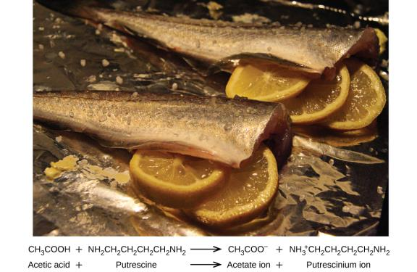
Figure 4.8
A neutralization reaction takes place between citric acid in lemons or acetic acid in vinegar, and the bases in the flesh of fish.

Slide 43
Oxidation-Reduction (Redox) Reactions
Some redox reactions involve the transfer of electrons between reactant species to yield ionic products:
2Na(s) + Cl₂(g) ⟶ 2NaCl(s)
It is helpful to split the overall reaction into individual equations called half-reactions.
2Na(s) ⟶ 2Na⁺(s) + 2e–
Cl₂(g) + 2e– ⟶ 2Cl–(s)

Slide 44
Oxidation-Reduction (Redox) Reactions
The Na atoms lose electrons.
The Cl atoms gain electrons.
For redox reactions of this sort:
Oxidation = loss of electrons
Reduction = gain of electrons
Na is oxidized
Cl₂ is reduced

Slide 45
Reducing and Oxidizing Agents
Na functions as a reducing agent (reductant), because it provides electrons for (or reduces) chlorine.
Cl₂ functions as an oxidizing agent (oxidant), because it effectively removes electrons from (oxidizes) sodium.

Slide 46
Oxidation-Reduction (Redox) Reactions
Some redox processes do not involve the transfer of electrons:
H₂(g) + Cl₂(g) ⟶ 2HCl(g)
The product of this reaction is a covalent compound, so transfer of electrons in the explicit sense is not involved.
The oxidation number (or oxidation state) of an element in a compound is the charge its atoms would possess if the compound was ionic.

Slide 47
Rules for Assigning Oxidation Numbers
The oxidation number of an atom in an elemental substance is zero.
The oxidation number of a monatomic ion is equal to the ion’s charge.

Slide 48
Rules for Assigning Oxidation Numbers
Oxidation numbers for common nonmetals are usually assigned as follows:
Hydrogen:
+1 when combined with nonmetals
−1 when combined with metals
Oxygen:
−2 in most compounds
Sometimes −1 (so-called peroxides, O₂²⁻)
Very rarely − ½ (so-called superoxides, O₂⁻)
Positive values when combined with F (values vary)
Halogens:
−1 for F always
−1 for other halogens except when combined with oxygen or other halogens (positive oxidation numbers in these cases, varying values)

Slide 49
Rules for Assigning Oxidation Numbers
The sum of the oxidation numbers for all atoms in a molecule or polyatomic ion equals the charge on the molecule or ion.

Slide 50
Example 4.5
Follow the guidelines in this section of the text to assign oxidation numbers to all the elements in the following species:
(a) H₂S
According to guideline 1, the oxidation number for H is +1.
Using this oxidation number and the compound’s formula, guideline 4 may then be used to calculate the oxidation number for sulfur (x):
charge on H₂S = 0 = (2 × 1) + 1x
x = −2

Slide 51
Example 4.5
Follow the guidelines in this section of the text to assign oxidation numbers to all the elements in the following species:
(b) SO₃²⁻
Guideline 3 suggests the oxidation number for oxygen is −2.
Using this oxidation number and the ion’s formula, guideline 4 may then be used to calculate the oxidation number for sulfur (x):
charge on SO₃²⁻ = −2 = (3 × −2) + 1x
x = +4

Slide 52
Example 4.5
Follow the guidelines in this section of the text to assign oxidation numbers to all the elements in the following species:
(c) Na₂SO₄
For ionic compounds, it’s convenient to assign oxidation numbers for the cation and anion separately.
According to guideline 2, the oxidation number for sodium is +1.
Assuming the usual oxidation number for oxygen (−2 per guideline 3), the oxidation number for sulfur (x) is calculated as directed by guideline 4:
charge on SO₄²⁻ = −2 = (4 × −2) + 1x
x = +6

Slide 53
Oxidation-Reduction (Redox) Reactions
Using the oxidation number concept, an all-inclusive definition of a redox reaction has been established.
Oxidation-reduction (redox) reactions are those in which one or more elements involved undergo a change in oxidation number.
Oxidation = increase in oxidation number
Reduction = decrease in oxidation number

Slide 54
Types of Redox Reactions
Combustion reactions in which the reductant (also called a fuel) and the oxidant (often, but not necessarily, molecular oxygen) react vigorously and produce significant amounts of heat, and often light, in the form of a flame.
Example: solid rocket fuel reaction
10Al(s) + 6NH₄ClO₄(s) ⟶ 4Al₂O₃(s) + 2AlCl₃(s) + 12H₂O(g) + 3N₂(g)

Slide 55
Types of Redox Reactions (
Single-displacement (replacement) reactions are redox reactions in which an ion in solution is displaced (or replaced) via the oxidation of a metallic element.
Example:
Cu(s) + 2AgNO₃(aq) ⟶ Cu(NO₃)₂(aq) + 2Ag(s)

Slide 56
Figure 4.9
(a) A copper wire is shown next to a solution containing silver(I) ions. (b) Displacement of dissolved silver ions by copper ions results in (c) accumulation of gray-colored silver metal on the wire and development of a blue color in the solution, due to dissolved copper ions. (credit: modification of work by Mark Ott)

Slide 57
Balancing Redox Reactions via the Half-Reaction Method
Redox reactions that take place in aqueous media often involve water, hydronium ions, and hydroxide ions as reactants or products.
Although these species are not oxidized or reduced, they do participate in the chemical change in other ways.
These reactions are difficult to balance by inspection.
One very useful approach to balance these types of redox reactions is to use the half-reaction method.

Slide 58
Steps for Balancing Redox Reactions
Write the two individual half-reactions: the oxidation and the reduction.
Balance all elements except oxygen and hydrogen.
Balance oxygen atoms by adding H₂O molecules.
Balance hydrogen atoms by adding H⁺ ions.
Balance charge by adding electrons.

Slide 59
Steps for Balancing Redox Reactions
If necessary, multiply each half-reaction’s coefficients by the smallest possible integers to yield equal numbers of electrons in each.
Add the balanced half-reactions together and simplify by removing species that appear on both sides of the equation
For reactions occurring in basic media (excess hydroxide ions), carry out these additional steps:
Add OH⁻ ions to both sides of the equation in numbers equal to the number of H⁺ ions.
On the side of the equation containing both H⁺ and OH⁻ ions, combine these ions to yield water molecules.
Simplify the equation by removing any redundant water molecules.
Finally, check to see that the number of atoms and the total charge are balanced.

Slide 60
Example 4.7
Write a balanced equation for the reaction between the dichromate ion and iron(II) to yield iron(III) and chromium(III) in acidic solution.
Cr₂O₇²⁻ + Fe²⁺ ⟶ Cr³⁺ + Fe³⁺
Step 1: Write the two half-reactions.
Each half-reaction will contain one reactant and one product with one element in common.
Fe²⁺ ⟶ Fe³⁺
Cr₂O₇²⁻ ⟶ Cr³⁺

Slide 61
Example 4.7
Step 2: Balance all elements except oxygen and hydrogen. The iron half-reaction is already balanced, but the chromium half-reaction shows two Cr atoms on the left and one Cr atom on the right. Changing the coefficient on the right side of the equation to 2 achieves balance with regard to Cr atoms.
Fe²⁺ ⟶ Fe³⁺
Cr₂O₇²⁻ ⟶ 2Cr³⁺
Step 3: Balance oxygen atoms by adding H₂O molecules. The iron half-reaction does not contain O atoms. The chromium half-reaction shows seven O atoms on the left and none on the right, so seven water molecules are added to the right side.
Fe²⁺ ⟶ Fe³⁺
Cr₂O₇²⁻ ⟶ 2Cr³⁺ + 7H₂O

Slide 62
Example 4.7
Step 4: Balance hydrogen atoms by adding H⁺ ions. The iron half-reaction does not contain H atoms. The chromium half-reaction shows 14 H atoms on the right and none on the left, so 14 H⁺ ions are added to the left side.
Fe²⁺ ⟶ Fe³⁺
Cr₂O₇²⁻ + 14H⁺ ⟶ 2Cr³⁺ + 7H₂O

Slide 63
Example 4.7
Step 5: Balance charge by adding electrons. The iron half-reaction shows a total charge of 2+ on the left side (1 Fe²⁺ ion) and 3+ on the right side (1 Fe³⁺ ion). Adding one electron to the right side brings that side’s total charge to (3+) + (1−) = 2+, and charge balance is achieved.
The chromium half-reaction shows a total charge of
(1 × 2−) + (14 × 1+) = 12+ on the left side (1 Cr₂O₇²⁻ ion and 14 H⁺ ions). The total charge on the right side is (2 × 3+) = 6+ (2 Cr³⁺ ions). Adding six electrons to the left side will bring that side’s total charge to (12 + 6−) = 6+, and charge balance is achieved.
Fe²⁺ ⟶ Fe³⁺ + e–
Cr₂O₇²⁻ + 14H⁺ + 6e– ⟶ 2Cr³⁺ + 7H₂O

Slide 64
Example 4.7
Step 6: Multiply the two half-reactions so the number of electrons in one reaction equals the number of electrons in the other reaction. To be consistent with mass conservation, and the idea that redox reactions involve the transfer (not creation or destruction) of electrons, the iron half-reaction’s coefficient must be multiplied by 6.
6Fe²⁺ ⟶ 6Fe³⁺ + 6e⁻
Cr₂O₇²⁻ + 14H⁺ + 6e⁻ ⟶ 2Cr³⁺ + 7H₂O

Slide 65
Example 4.7
Step 7: Add the balanced half-reactions and cancel species that appear on both sides of the equation.
6Fe²⁺ + Cr₂O₇²⁻ + 14H⁺ + 6e⁻ ⟶ 6Fe³⁺ + 6e⁻ + 2Cr³⁺ + 7H₂O
Only the six electrons are redundant species. Removing them from each side of the equation yields the simplified, balanced equation here:
6Fe²⁺ + Cr₂O₇²⁻ + 14H⁺ ⟶ 6Fe³⁺ + 2Cr³⁺ + 7H₂O

Slide 66
Example 4.7
6Fe²⁺ + Cr₂O₇²⁻ + 14H⁺ ⟶ 6Fe³⁺ + 2Cr³⁺ + 7H₂O
A final check of atom and charge balance confirms the equation is balanced.
 | Reactants | Products
Fe | 6 | 6
Cr | 2 | 2
O | 7 | 7
H | 14 | 14
charge | 24+ | 24+

Slide 67
Learning Objectives
4.3 Reaction Stoichiometry
Explain the concept of stoichiometry as it pertains to chemical reactions
Use balanced chemical equations to derive stoichiometric factors relating amounts of reactants and products
Perform stoichiometric calculations involving mass, moles, and solution molarity

Slide 68
Reaction Stoichiometry
A balanced chemical equation provides a great deal of information in a very succinct format.
Chemical formulas provide the identities of the reactants and products involved in the chemical change.
Coefficients provide the relative numbers of these chemical species.
The quantitative relationships between the amounts of reactants and products are known as the reaction’s stoichiometry.

Slide 69
Stoichiometry
The general approach to using stoichiometric relationships is similar in concept to food preparation.
Example: A recipe for making eight pancakes calls for 1 cup of pancake mix, ¾ cup of milk, and one egg.
This recipe can be written as an equation:
1 cup mix + ¾ cup milk + 1 egg ⟶ 8 pancakes

Slide 70
Stoichiometry
1 cup of mix + ¾ cup of milk + 1 egg ⟶ 8 pancakes
If two dozen pancakes are needed, the amount of ingredients must be increased proportionally according to the amounts given in the recipe.

Slide 71
Stoichiometry
Balanced chemical equations are used in a similar fashion as recipes.
From a balanced chemical equation we can determine:
The amount of one reactant required to react with a given amount of another reactant.
The amount of reactant needed to yield a given amount of product.
The coefficients in the balanced equation are used to derive stoichiometric factors that permit computation of the desired quantity.

Slide 72
Stoichiometric Factors
N₂(g) + 3H₂(g) ⟶ 2NH₃(g)
This equation shows that ammonia molecules are produced from hydrogen molecules in a 2:3 ratio.
Stoichiometric factors may be derived using any amount (number) unit:

Slide 73
Example 4.8
How many moles of I₂ are required to react with 0.429 mol of Al according to the following equation?
2Al + 3I₂ ⟶ 2AlI₃

Slide 74
Figure 4.10
Aluminum and iodine react to produce aluminum iodide. The heat of the reaction vaporizes some of the solid iodine as a purple vapor. (credit: modification of work by Mark Ott)

Slide 75
Example 4.8

Slide 76
Example 4.9

Slide 77
Example 4.10
What mass of sodium hydroxide, NaOH, would be required to produce 16 g of the antacid milk of magnesia [magnesium hydroxide, Mg(OH)₂] by the following reaction?
MgCl₂(aq) + 2NaOH(aq) ⟶ Mg(OH)₂(s) + 2NaCl(aq)

Slide 78
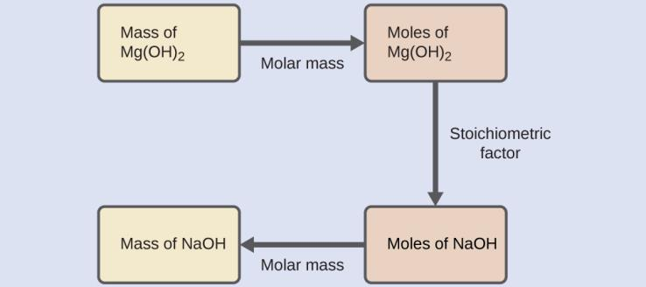
Example 4.10

Slide 79
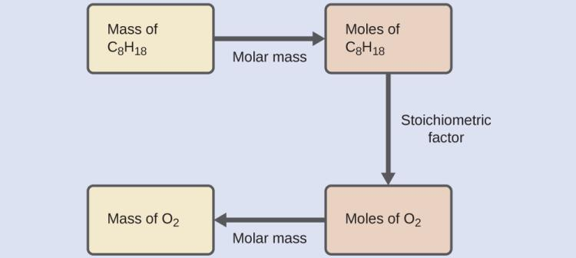
Example 4.11

Slide 80
Stoichiometry
Examples 4.8 and 4.10 illustrate just a few instances of reaction stoichiometry calculations.
Numerous variations on the beginning and ending computational steps are possible depending on what particular quantities are provided and sought (volumes, solution concentrations, and so forth).
All these calculations share a common essential component: the use of stoichiometric factors derived from balanced chemical equations.

Slide 81
Figure 4.11
The flowchart depicts the various computational steps involved in most reaction stoichiometry calculations.

Slide 82
Figure 4.12
Airbags deploy upon impact to minimize serious injuries to passengers. (credit: Jon Seidman)

Slide 83
Learning Objectives
4.4 Reaction Yields
Explain the concepts of theoretical yield and limiting reactants/reagents.
Derive the theoretical yield for a reaction under specified conditions.
Calculate the percent yield for a reaction.

Slide 84
Reaction Yields
The relative amounts of reactants and products represented in a balanced chemical equation are often referred to as stoichiometric amounts.
All the exercises in the preceding module involved stoichiometric amounts of reactants.
In more realistic situations, reactants are not present in stoichiometric amounts.

Slide 85
Limiting Reactant
Consider making grilled cheese sandwiches.
1 slice of cheese + 2 slices of bread ⟶ 1 sandwich
Provided with 28 slices of bread and 11 slices of cheese, one may prepare 11 sandwiches per the provided recipe.
All the provided cheese would be used and six slices of bread would be left over.

Slide 86
Limiting Reactant
The number of sandwiches prepared has been limited by the number of cheese slices.
Cheese is the limiting reactant.
The limiting reactant will always be entirely consumed, thus limiting the amount of product that may be generated.
The bread slices have been provided in excess.
Bread is the excess reactant.

Slide 87
Figure 4.13
Sandwich making can illustrate the concepts of limiting and excess reactants.

Slide 88
Limiting Reactant
Now consider a chemical process.
H₂(g) + Cl₂(g) ⟶ 2HCl(g)
Imagine combining 3 moles of H₂ and 2 moles of Cl₂.
One approach for determining the limiting reactant involves comparing the amount of product expected for the complete reaction of each reactant.
The reactant yielding the lesser amount of product is the limiting reactant.

Slide 89
Limiting Reactant
The Cl₂ will be consumed once 4 moles of HCl are produced.
Unreacted H₂ will remain once this reaction is complete.
Cl₂ is the limiting reactant and H₂ is the excess reactant.

Slide 90
Figure 4.14
When H₂ and Cl₂ are combined in nonstoichiometric amounts, one of these reactants will limit the amount of HCl that can be produced. This illustration shows a reaction in which hydrogen is present in excess and chlorine is the limiting reactant.

Slide 91
Theoretical and Actual Yields
The amount of product that may be produced by a reaction, as calculated per the stoichiometry of an appropriate balanced chemical equation, is called the theoretical yield of the reaction.
The amount of product obtained is called the actual yield and it is often less than the theoretical yield for a number several reasons.
Competing side reactions
Incomplete reaction
Difficult recovery of product

Slide 92
Percent Yield
The extent to which a reaction’s theoretical yield is achieved is commonly expressed as its percent yield:
When calculating percent yield, both yields must be expressed using the same units so these units will cancel.

Slide 93
Example 4.13
Upon reaction of 1.274 g of copper sulfate with excess zinc metal, 0.392 g copper metal was obtained according to the equation:
CuSO₄(aq) + Zn(s) ⟶ Cu(s) + ZnSO₄(aq)
What is the percent yield?

Slide 94
Example 4.13
First determine the theoretical yield.

Slide 95
Example 4.13
Next calculate the percent yield.

Slide 96
Figure 4.15
(a) Ibuprofen is a popular nonprescription pain medication commonly sold as 200 mg tablets. (b) The BHC process for synthesizing ibuprofen requires only three steps and exhibits an impressive atom economy. (credit a: modification of work by Derrick Coetzee)

Slide 97
Learning Objectives
4.5 Quantitative Chemical Analysis
Describe the fundamental aspects of titrations and gravimetric analysis.
Perform stoichiometric calculations using typical titration and gravimetric data.

Slide 98
Quantitative Chemical Analysis
Quantitative Analysis: The determination of the amount or concentration of a substance in a sample.
We will discuss two main types of quantitative analysis:
Titration
Gravimetric Analysis

Slide 99
Titration
Titrations involve two solutions:
Titrant: Solution containing a known concentration of one reactant.
Analyte: Solution containing a reactant of unknown amount or concentration
Measuring the volume of titrant solution required for complete reaction with the analyte (the equivalence point of the titration) allows calculation of the analyte concentration.

Slide 100
Titration
Indicators are added to the analyte solution to impart a change in color at or very near the equivalence point of the titration.
The volume of titrant actually measured is called the end point.
The difference between the equivalence and end points should be negligible.

Slide 101
Figure 4.16
(a) A student fills a buret in preparation for a titration analysis. (b) A typical buret permits volume measurements to the nearest 0.01 mL. (credit a: modification of work by Mark Blaser and Matt Evans; credit b: modification of work by Mark Blaser and Matt Evans)

Slide 102
Example 4.14
The end point in a titration of a 50.00-mL sample of aqueous HCl was reached by addition of 35.23 mL of 0.250 M NaOH titrant. The titration reaction is:
HCl(aq) + NaOH(aq) ⟶ NaCl(aq) + H₂O(l)
What is the molarity of the HCl?

Slide 103
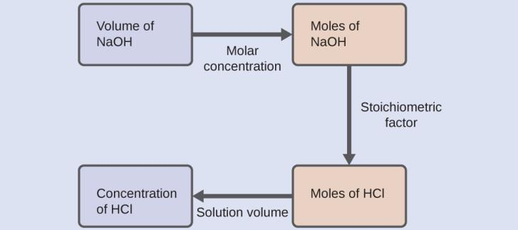
Example 4.14

Slide 104
Example 4.14

Slide 105
Gravimetric Analysis
Gravimetric analysis: A type of analysis in which a sample is subjected to some treatment that causes a change in the physical state of the analyte that permits its separation from the other components of the sample.
Mass measurements of the sample, the isolated analyte, or some other component of the system, used along with the known stoichiometry of the compounds involved, permit calculation of the analyte concentration.
Commonly, the analyte is separated by subjecting it to a precipitation reaction.

Slide 106
Figure 4.17
Precipitate may be removed from a reaction mixture by filtration.

Slide 107
Example 4.15
A 0.4550-g solid mixture containing MgSO₄ is dissolved in water and treated with an excess of Ba(NO₃)₂, resulting in the precipitation of 0.6168 g of BaSO₄.
MgSO₄(aq) + Ba(NO₃)₂(aq) ⟶ BaSO₄(s) + Mg(NO₃)₂(aq)
What is the concentration (mass percent) of MgSO4 in the mixture?

Slide 108
Example 4.15

Slide 109
Example 4.15

Slide 110
Combustion Analysis
The elemental composition of hydrocarbons and related compounds may be determined via a gravimetric method known as combustion analysis.
A weighed sample of the compound is heated to a high temperature under a stream of oxygen gas, resulting in its complete combustion to yield gaseous products of known identities.

Slide 111
Combustion Analysis
The complete combustion of hydrocarbons, for example, will yield carbon dioxide and water vapor as the only products.
The gaseous combustion products are swept through separate, preweighed collection devices containing compounds that selectively absorb each product.
The mass of the absorbed product can then be used in an appropriate stoichiometric calculation to derive the moles and mass of the relevant element.

Slide 112
Figure 4.18
This schematic diagram illustrates the basic components of a combustion analysis device for determining the carbon and hydrogen content of a sample.

Slide 113
Example 4.16
Polyethylene is a hydrocarbon polymer used to produce food-storage bags and many other flexible plastic items. A combustion analysis of a 0.00126-g sample of polyethylene yields 0.00394 g of CO₂ and 0.00161 g of H₂O.
C_{x}H_{y}(s) + excess O₂(g) ⟶ xCO₂(g) + H₂O(g)
What is the empirical formula of polyethylene?

Slide 114
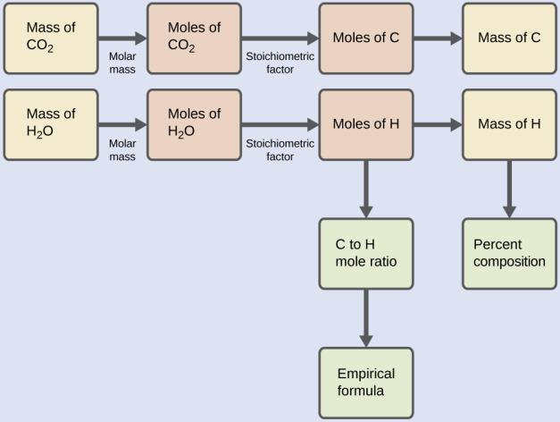
Example 4.16

Slide 115
Example 4.16
The empirical formula for the compound is then derived by identifying the smallest whole-number multiples for these mole amounts. The H-to-C mole ratio is
and the empirical formula for polyethylene is CH₂.

Slide 116
Exercise 42f

Slide 117
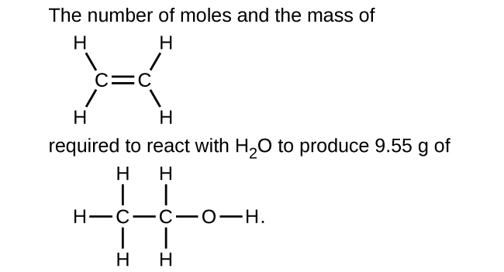
Exercise 44f

Slide 118
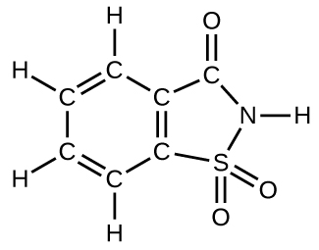
Exercise 75

Slide 119
Exercise 92

Slide 120
BLANK PAGE
This OpenStax ancillary resource is © Rice University under a CC-BY 4.0 International license; it may be reproduced or modified but must be attributed to OpenStax, Rice University and any changes must be noted.

