Slide 1
CHEMISTRY 2e
Chapter 6 Electronic Structure and Periodic Properties
of Elements
PowerPoint Image Slideshow

Slide 2
Chapter Outline
6.1 Electromagnetic Energy
6.2 The Bohr Model
6.3 Development of Quantum Theory
6.4 Electronic Structure of Atoms (Electron Configurations)
6.5 Periodic Variations in Element Properties

Slide 3
Figure 6.1
The Crab Nebula consists of remnants of a supernova (the explosion of a star). NASA’s Hubble Space Telescope produced this composite image. Measurements of the emitted light wavelengths enabled astronomers to identify the elements in the nebula, determining that it contains specific ions including S⁺ (green filaments) and O²⁺ (red filaments). (credit: modification of work by NASA and ESA)

Slide 4
Learning Objectives
6.1 Electromagnetic Energy
Explain the basic behavior of waves, including travelling waves and standing waves
Describe the wave nature of light
Use appropriate equations to calculate related light-wave properties such as frequency, wavelength, and energy
Distinguish between line and continuous emission spectra
Describe the particle nature of light

Slide 5
Electromagnetic Energy
The nature of light has been a subject of inquiry since antiquity.
In the seventeenth century, Isaac Newton:
White light consists of the individual colors of the rainbow combined together.
Light was composed of streams of extremely tiny particles travelling at high speeds according to Newton's laws of motion.

Slide 6
Light
Early in the nineteenth century, Thomas Young:
Light passing through narrow, closely spaced slits produced interference patterns
Could not be explained in terms of Newtonian particles but could be easily explained in terms of waves
James Clerk Maxwell:
Light was the visible part of a vast spectrum of electromagnetic waves.
Particles and waves are connected on a fundamental level called wave-particle duality.

Slide 7
Waves
A wave is an oscillation or periodic movement that can transport energy from one point in space to another.
Examples of waves:
Shaking the end of a rope
Dropping a pebble into a pond
The expansion of air that accompanies a lightning strike
In each of these cases, kinetic energy is transferred through matter (the rope, water, or air) while the matter remains essentially in place.

Slide 8
Speed of Light
Waves are not restricted to travel through only matter.
Electromagnetic waves consist of an electric field oscillating in step with a perpendicular magnetic field, both of which are perpendicular to the direction of travel.
Electromagnetic waves can travel through a vacuum at a constant speed.
This speed is known as the speed of light (c).
c = 2.998 × 10⁸ m/s

Slide 9
Wave Properties
All waves are characterized by the following:
Wavelength (λ)
Distance between two consecutive peaks or troughs in a wave
Frequency (ν)
Number of successive wavelengths that pass a given point in a unit time
Amplitude
One-half the distance between the peaks and troughs

Slide 10
Frequency
The unit for frequency, expressed as cycles per second (s⁻¹), is the hertz (Hz).
Common multiples of the hertz are often used.
Megahertz, (1 MHz = 1 × 10⁶ Hz)
Gigahertz (1 GHz = 1 × 10⁹ Hz)

Slide 11
Wavelength, Frequency, and Speed
The product of a wave's wavelength (λ) and its frequency (ν), λν, is the speed of the wave.
Thus, for electromagnetic radiation in a vacuum:
c = 2.998 × 10⁸ m/s = λν
Wavelength and frequency are inversely proportional:
As the wavelength increases, the frequency decreases and vice versa.

Slide 12
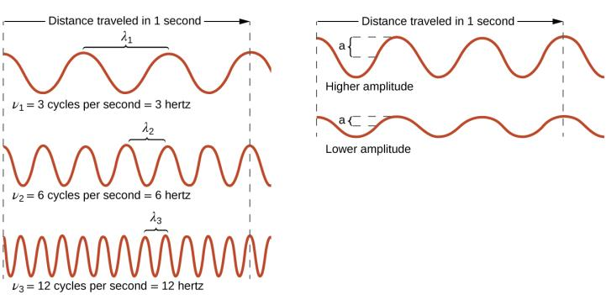
Figure 6.2
One-dimensional sinusoidal waves show the relationship among wavelength, frequency, and speed. The wave with the shortest wavelength has the highest frequency. Amplitude is one-half the height of the wave from peak to trough.

Slide 13
Electromagnetic Spectrum
The electromagnetic spectrum is the range of all types of electromagnetic radiation.
Visible light makes up only a small portion of the electromagnetic spectrum.
Each of the various colors of visible light has specific frequencies and wavelengths associated with them.

Slide 14
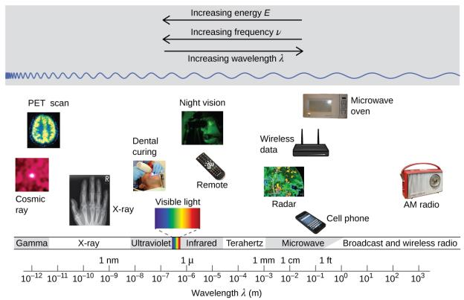
Figure 6.3
Portions of the electromagnetic spectrum are shown in order of decreasing frequency and increasing wavelength. (credit “Cosmic ray": modification of work by NASA; credit “PET scan": modification of work by the National Institute of Health; credit “X-ray": modification of work by Dr. Jochen Lengerke; credit “Dental curing": modification of work by the Department of the Navy; credit “Night vision": modification of work by the Department of the Army; credit “Remote": modification of work by Emilian Robert Vicol; credit “Cell phone": modification of work by Brett Jordan; credit “Microwave oven": modification of work by Billy Mabray; credit “Ultrasound": modification of work by Jane Whitney; credit “AM radio": modification of work by Dave Clausen)

Slide 15
Example 6.1
A sodium streetlight gives off yellow light that has a wavelength of 589 nm (1 nm = 1 × 10⁻⁹ m). What is the frequency of this light?
We can rearrange the equation c = λν to solve for the frequency:

Slide 16
Example 6.1
Since c is expressed in meters per second, we must also convert 589 nm to meters.

Slide 17
Figure 6.4
Radio and cell towers are typically used to transmit long-wavelength electromagnetic radiation. Increasingly, cell towers are designed to blend in with the landscape, as with the Tucson, Arizona, cell tower (right) disguised as a palm tree. (credit left: modification of work by Sir Mildred Pierce; credit middle: modification of work by M.O. Stevens)

Slide 18
Figure 6.5
This schematic depicts how amplitude modulation (AM) and frequency modulation (FM) can be used to transmit a radio wave.

Slide 19
Interference Patterns
Interference patterns arise when light passes through narrow slits closely spaced about a wavelength apart.
The dark regions correspond to regions where the peaks for the wave from one slit happen to coincide with the troughs for the wave from the other slit (destructive interference).
The brightest regions correspond to the regions where the peaks for the two waves (or their two troughs) happen to coincide (constructive interference).
Such interference patterns cannot be explained by particles moving according to the laws of classical mechanics.

Slide 20
Figure 6.6
Interference fringe patterns are shown for light passing through two closely spaced, narrow slits. The spacing of the fringes depends on the wavelength, with the fringes being more closely spaced for the shorter-wavelength blue light. (credit: PASCO)

Slide 21
Standing Waves
Not all waves are travelling waves.
Standing waves (also known as stationary waves) remain constrained within some region of space.
Standing waves play an important role in our understanding of the electronic structure of atoms and molecules.
A vibrating string that is held fixed at its two end points is an example of a one-dimensional standing wave.

Slide 22
Figure 6.7
A vibrating string shows some one-dimensional standing waves. Since the two end points of the string are held fixed, only waves having an integer number of half-wavelengths can form. The points on the string between the end points that are not moving are called the nodes.

Slide 23
Standing Waves
Only those waves having an integer number, n, of half-wavelengths between the end points can form.
A system with fixed end points restricts the number and type of possible waveforms.
This is an example of b.
Only discrete values from a more general set of continuous values are observed.

Slide 24
Standing Waves
Harmonic waves (those waves displaying more than one-half wavelength) all have one or more points between the two end points that are not in motion.
These special points are nodes.

Slide 25
Two-Dimensional Standing Waves
Vibrational patterns on a flat surface are examples of two-dimensional standing waves.
The nodes can be made visible by sprinkling the drum surface with a powder that collects on the areas of the surface that have minimal displacement.
For one-dimensional standing waves, the nodes were points on the line.
For two-dimensional standing waves, the nodes are lines on the surface.

Slide 26
Figure 6.8
Two-dimensional standing waves can be visualized on a vibrating surface. The surface has been sprinkled with a powder that collects near the nodal lines. There are two types of nodes visible: radial nodes (circles) and angular nodes (radii).

Slide 27
Blackbody Radiation and the Ultraviolet Catastrophe
Sunlight consists of a range of broadly distributed wavelengths that form a continuous spectrum.
A blackbody is a convenient, ideal emitter that approximates the behavior of many materials when heated.
A good approximation of a blackbody that can be used to observe blackbody radiation:
A metal oven that can be heated to very high temperatures.

Slide 28
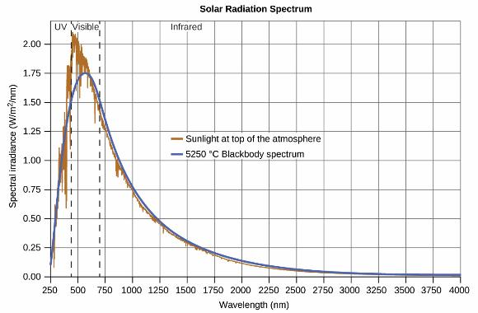
Figure 6.9
The spectral distribution (light intensity vs. wavelength) of sunlight reaches the Earth’s atmosphere as UV light, visible light, and IR light. The unabsorbed sunlight at the top of the atmosphere has a distribution that approximately matches the theoretical distribution of a blackbody at 5250 ^{º}C, represented by the blue curve. (credit: modification of work by American Society for Testing and Materials (ASTM) Terrestrial Reference Spectra for Photovoltaic Performance Evaluation)

Slide 29
Blackbody Radiation and the Ultraviolet Catastrophe
The maxima in the blackbody curves, λ_{max}, shift to shorter wavelengths as the temperature increases.
Theoretical expressions as functions of temperature fit the observed experimental blackbody curves well at longer wavelengths.
But there were significant discrepancies at shorter wavelengths.
This became known as the “ultraviolet catastrophe”.

Slide 30
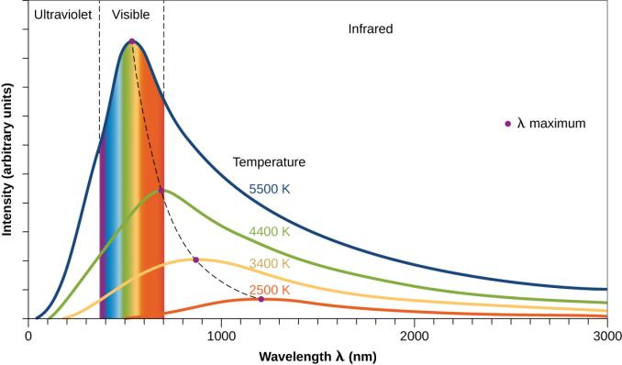
Figure 6.10
Blackbody spectral distribution curves are shown for some representative temperatures.

Slide 31
Blackbody Radiation and the Ultraviolet Catastrophe
Around 1900, Max Planck derived a theoretical expression for blackbody radiation that fit the experimental observations exactly (within experimental error).
Planck developed his theoretical treatment on the premise that the atoms composing the oven vibrated.
The atoms vibrated at increasing frequencies (or decreasing wavelengths), as the temperature increased.

Slide 32
Planck’s Constant
Planck had to assume that the vibrating atoms required quantized energies, which he was unable to explain.
E = nhν n = 1, 2, 3, . . .
The quantity h is a constant now known as Planck's constant.
h = 6.626 × 10⁻³⁴ J · s

Slide 33
The Photoelectric Effect
The next paradox in the classical theory to be resolved concerned the photoelectric effect.
It had been observed that electrons could be ejected from the surface of a metal.
The light had to have a frequency greater than some threshold frequency.
Surprisingly, the kinetic energy of the ejected electrons did not depend on the brightness of the light, but increased with increasing frequency of the light.

Slide 34
The Photoelectric Effect
According to classical wave theory, a wave's energy depends on its intensity (which depends on its amplitude), not its frequency.
Albert Einstein was able to resolve the paradox by incorporating Planck's quantization findings into the particle view of light (Nobel prize).
Light striking the metal surface should not be viewed as a wave, but instead as a stream of particles (later called photons).

Slide 35
The Photoelectric Effect
The energy of the photons depended on their frequency.
According to Planck's formula:

Slide 36
The Photoelectric Effect
Electrons were ejected when hit by photons having sufficient energy (a frequency greater than the threshold).
The greater the frequency, the greater the kinetic energy imparted to the escaping electrons by the collisions.
Somehow, at a deep fundamental level still not fully understood, light is both wavelike and particle-like. This is known as wave-particle duality.

Slide 37
Figure 6.11
Photons with low frequencies do not have enough energy to cause electrons to be ejected via the photoelectric effect. For any frequency of light above the threshold frequency, the kinetic energy of ejected electron will increase linearly with the energy of the incoming photon.

Slide 38
Example 6.2
When we see light from a neon sign, we are observing radiation from excited neon atoms. If this radiation has a wavelength of 640 nm, what is the energy of the photon being emitted?
We use the form of Planck's equation that includes the wavelength, λ, and convert units of nanometers to meters so that the units of λ and c are the same.

Slide 39
Line Spectra
Scientists in the late nineteenth century struggled with understanding the light emitted from atoms and molecules.
When solids, liquids, or condensed gases are heated sufficiently, they radiate some of the excess energy as light.
Photons produced in this manner have a range of energies, and thereby produce a continuous spectrum in which an unbroken series of wavelengths is present.

Slide 40
Line Spectra
In contrast to continuous spectra, light can also occur as discrete or line spectra having very narrow line widths interspersed throughout the spectral regions.
Exciting a gas at low partial pressure using an electrical current, or heating it, will produce line spectra.
Each element displays its own characteristic set of lines.

Slide 41
Figure 6.12
Neon signs operate by exciting a gas at low partial pressure using an electrical current. This sign show the elaborate artistic effects that can be achieved. (credit: Dave Shaver)

Slide 42
Line Spectra
Each emission line consists of a single wavelength of light.
This implies that the light emitted by a gas consists of a set of discrete energies.
The origin of discrete spectra in atoms and molecules was extremely puzzling to scientists.
According to classical electromagnetic theory, only continuous spectra should be observed.

Slide 43
Figure 6.13
Compare the two types of emission spectra: continuous spectrum of white light (top) and the line spectra of the light from excited sodium, hydrogen, calcium, and mercury atoms.

Slide 44
Line Spectra
In 1885, Johann Balmer was able to derive an empirical equation.
The equation related the four visible wavelengths of light emitted by hydrogen atoms to whole integers.
Other discrete lines for the hydrogen atom were found in the UV and IR regions.

Slide 45
Line Spectra
Johannes Rydberg generalized Balmer's work.
He developed an empirical formula that predicted all of hydrogen's emission lines.
n₁ and n₂ are integers
n₁ < n₂
R∞ is the Rydberg constant (1.097 × 10⁷ m⁻¹)

Slide 46
Learning Objectives
6.2 The Bohr Model
Describe the Bohr model of the hydrogen atom
Use the Rydberg equation to calculate energies of light emitted or absorbed by hydrogen atoms

Slide 47
The Bohr Model
The emission spectra for hydrogen was eventually explained by Niels Bohr in 1913.
Bohr’s work convinced scientists to abandon classical physics and spurred the development of modern quantum mechanics.

Slide 48
Atomic Model Prior to Bohr
Atoms consisted of tiny dense nuclei surrounded by lighter and even tinier electrons continually moving about the nucleus.
This classical mechanical description of the atom is incomplete, since an electron moving in an elliptical orbit would be accelerating.
According to classical electromagnetism, the electron should continuously emit electromagnetic radiation.

Slide 49
Atomic Model Prior to Bohr
This loss in orbital energy should result in the electron’s orbit getting continually smaller until it spirals into the nucleus.
Niels Bohr attempted to resolve the atomic paradox by ignoring classical electromagnetism’s prediction that the orbiting electron in hydrogen would continuously emit light.

Slide 50
Bohr Model
Bohr incorporated the following into the classical mechanics description of the atom.
Planck’s ideas of quantization.
Einstein’s finding that light consists of photons whose energy is proportional to their frequency.
Bohr assumed that the electron orbiting the nucleus would not normally emit any radiation.
Rather the electron emits or absorbs a photon if it moved to a different orbit.

Slide 51
Bohr Model
The energy absorbed or emitted would reflect differences in the orbital energies according to this equation:
E_{i} and E_{f} are the initial and final orbital energies.
Bohr assumed only discrete values for the energy difference (ΔE) were possible.

Slide 52
Bohr Model
Bohr’s expression for the quantized energies:
k is a constant comprising fundamental constants such as the electron mass and charge and Planck’s constant.

Slide 53
Bohr Model
Inserting the expression for the orbit energies into the equation for ΔE gives
or
Which is identical to the Rydberg equation for .

Slide 54
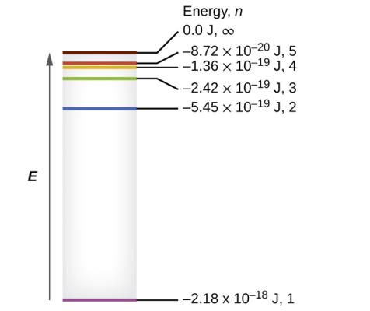
Figure 6.14
Quantum numbers and energy levels in a hydrogen atom. The more negative the calculated value, the lower the energy.

Slide 55
Bohr Model
One of the fundamental laws of physics is that matter is most stable when it has the lowest possible energy.
When the electron is in this lowest energy orbit (n = 1), the atom is said to be in its ground state.
If the atom receives energy from an outside source, it is possible for the electron to move to an orbit with a higher n value (excited state), which has a higher energy.

Slide 56
Bohr Model
When the atom absorbs energy as a photon, the electron moves from an orbit with a lower n to a higher n.
When an electron falls from an orbit with a higher n to a lower n, the atoms emits energy as a photon.
Since ΔE can only be discrete values, the photon absorbed or emitted can only have a wavelength with a discrete value (not continuous).
This explained the line spectra for the hydrogen atom.

Slide 57
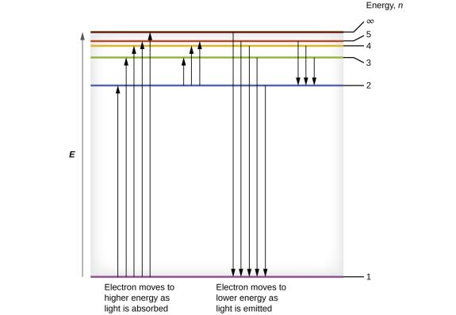
Figure 6.15
The horizontal lines show the relative energy of orbits in the Bohr model of the hydrogen atom, and the vertical arrows depict the energy of photons absorbed (left) or emitted (right) as electrons move between these orbits.

Slide 58
Example 6.5
What is the energy (in joules) and the wavelength (in meters) of the line in the spectrum of hydrogen that represents the movement of an electron from Bohr orbit with n = 4 to the orbit with n = 6? In what part of the electromagnetic spectrum do we find this radiation?
In this case, the electron starts out with n = 4, so n₁ = 4. It comes to rest in the n = 6 orbit, so n₂ = 6. The difference in energy between the two states is given by this expression where k = 2.179 × 10^{–18} J:

Slide 59
Example 6.5
This energy difference is positive, indicating a photon enters the system (is absorbed) to excite the electron from the n = 4 orbit up to the n = 6 orbit. The wavelength of a photon with this energy is found by the expression:

Slide 60
Example 6.5
Rearrangement gives:
This wavelength is found in the infrared portion of the electromagnetic spectrum.

Slide 61
Limitations of the Bohr Model
Bohr was unable to extend his theory to the next simplest atom, He, which only has two electrons.
It is does not account for electron–electron interactions in atoms with more than one electron.
Bohr’s model was severely flawed, since it was still based on the classical mechanics notion of precise orbits.

Slide 62
The Bohr Model
The Bohr model does introduce several important features of all models used to describe the distribution of electrons in an atom.
The energies of electrons (energy levels) in an atom are quantized, described by quantum numbers: integer numbers having only specific allowed values and used to characterize the arrangement of electrons in an atom.
An electron’s energy increases with increasing distance from the nucleus.
The discrete energies (lines) in the spectra of the elements result from quantized electronic energies.

Slide 63
Moving Forward
Bohr won a Nobel Prize in Physics for his contributions.
It became clear to most physicists at that time that the classical theories that worked so well in the macroscopic world were fundamentally flawed and could not be extended down into the microscopic domain of atoms and molecules.
A proper model of quantum mechanics was later developed to supersede classical mechanics.

Slide 64
Learning Objectives
6.3 Development of Quantum Theory
Extend the concept of wave–particle duality that was observed in electromagnetic radiation to matter as well
Understand the general idea of the quantum mechanical description of electrons in an atom, and that it uses the notion of three-dimensional wave functions, or orbitals, that define the distribution of probability to find an electron in a particular part of space
List and describe traits of the four quantum numbers that form the basis for completely specifying the state of an electron in an atom

Slide 65
Development of Quantum Theory
Particles and waves are very different phenomena in the macroscopic realm.
By the 1920s it became increasingly clear that very small pieces of matter follow a different set of rules from those we observe for large objects.
The unquestionable separation of waves and particles was no longer the case for the microscopic world.

Slide 66
Figure 6.16
An interference pattern on the water surface is formed by interacting waves. The waves are caused by reflection of water from the rocks. (credit: modification of work by Sukanto Debnath)

Slide 67
Louis de Broglie
If electromagnetic radiation can have particle-like character, can electrons and other submicroscopic particles exhibit wavelike character?
In 1925 Louis de Broglie extended the wave–particle duality of light that Einstein used to resolve the photoelectric-effect paradox to material particles.

Slide 68
De Broglie Wavelength
h = Planck’s constant
m = particle mass
v = particle velocity
p = particle momentum
λ = de Broglie wavelength
The de Broglie wavelength is a characteristic of particles, not electromagnetic radiation.

Slide 69
De Broglie Wavelength
Bohr had postulated the electron as being a particle orbiting the nucleus in quantized orbits.
De Broglie argued that Bohr’s assumption of quantization can be explained if the electron is considered a circular standing wave.
Only an integer number of wavelengths can fit exactly within the orbit.

Slide 70
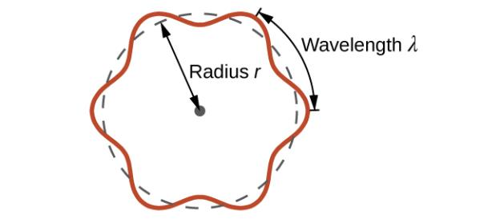
Figure 6.17
If an electron is viewed as a wave circling around the nucleus, an integer number of wavelengths must fit into the orbit for this standing wave behavior to be possible.

Slide 71
De Broglie Wavelength
For a circular orbit of radius r, the circumference is 2πr, and so de Broglie’s condition is:

Slide 72
Wave Nature of Electrons
C. J. Davisson and L. H. Germer, demonstrated experimentally that electrons can exhibit wavelike behavior.
They showed that electrons travelling through a regular atomic pattern in a crystal produced an interference pattern.
The interference pattern is strikingly similar to the interference patterns for light.

Slide 73
Figure 6.18
(a) The interference pattern for electrons passing through very closely spaced slits demonstrates that quantum particles such as electrons can exhibit wavelike behavior. (b) The experimental results illustrated here demonstrate the wave–particle duality in electrons.

Slide 74
Wave–Particle Duality
Thus, it appears that while electrons are small localized particles, their motion does not follow the equations of motion implied by classical mechanics.
Instead some type of wave equation governs a probability distribution for an electron’s motion.
Thus the wave–particle duality first observed with photons is actually a fundamental behavior intrinsic to all quantum particles.

Slide 75
Heisenberg Uncertainty Principle
Werner Heisenberg determined that there is a fundamental limit to how accurately one can measure both a particle’s position and its momentum simultaneously.
The more accurately we measure the momentum of a particle, the less accurately we can determine its position at that time, and vice versa.
Heisenberg Uncertainty Principle: It is fundamentally impossible to determine simultaneously and exactly both the momentum and the position of a particle.

Slide 76
Heisenberg Uncertainty Principle
Δx = uncertainty in the position of the particle
Δp_{x} = uncertainty in the momentum of the particle in the x direction.

Slide 77
The Quantum-Mechanical Model of an Atom
Erwin Schrödinger extended de Broglie’s work by incorporating the de Broglie relation into a wave equation.
Today this equation is know as the Schrödinger equation.
Schrödinger properly thought of the electron in terms of a three-dimensional stationary wave, or wavefunction, represented by the Greek letter psi, ψ.

Slide 78
The Quantum-Mechanical Model of an Atom
A few years later, Max Born:
Electrons are still particles, and so the waves represented by ψ are not physical waves but, instead, are complex probability amplitudes.
The square of the magnitude of a wavefunction ∣ψ∣² describes the probability of the quantum particle being present near a certain location in space.
Wavefunctions can be used to determine the distribution of the electron’s density with respect to the nucleus in an atom.

Slide 79
The Schrödinger Equation
In the most general form, the Schrödinger equation can be written as:
Ĥ is the Hamiltonian operator, a set of mathematical operations representing the total energy of the quantum particle.
ψ is the wavefunction of the particle.
E is the total energy of the particle.

Slide 80
Quantum Mechanics
Schrödinger’s work, as well as that of Heisenberg and many other scientists following in their footsteps, is generally referred to as quantum mechanics.

Slide 81
Understanding Quantum Theory of Electrons in Atoms
Electrons in atoms can exist only in discrete energy levels but not between them.
The energy of an electron in an atom is quantized.
The energy can be equal only to certain specific values and can jump from one energy level to another but not transition smoothly or stay between these levels.

Slide 82
Principle Quantum Number
The energy levels are labeled with an n value, where n = 1, 2, 3, ….
Generally speaking, the energy of an electron in an atom is greater for larger values of n.
n is referred to as the principal quantum number or shell number.
The principal quantum number defines the location of the energy level and is similar in concept to the Bohr model.

Slide 83
Figure 6.19
Different shells are numbered by principle quantum numbers.

Slide 84
Atomic Orbitals
The principal quantum number is one of three quantum numbers used to characterize an orbital.
An atomic orbital is a general region in an atom that an electron is most probable to reside.
An atomic orbital is distinct from an orbit.
The quantum mechanical model specifies the probability of finding an electron in a three-dimensional space around the nucleus.

Slide 85
Angular Momentum Quantum Number
The angular momentum quantum number (ℓ) is an integer that defines the shape of the orbital.
ℓ takes on the values, ℓ = 0, 1, 2, …, n – 1.
For an orbital with n = 1; ℓ = 0
For an orbital with n = 2; ℓ = 0 and 1
Orbitals with the same value of ℓ form a subshell.

Slide 86
Angular Momentum Quantum Number
Instead of using numbers, the angular momentum quantum number is often designated by letters.
For ℓ = 0: s orbital
For ℓ = 1: p orbital
For ℓ = 2: d orbital
For ℓ = 3: f orbital

Slide 87
Radial Nodes
There are certain distances from the nucleus at which the probability density of finding an electron located in a particular orbital is zero.
The value of the wavefunction ψ is zero at this distance for this orbital.
Such a value of radius r is called a radial node.

Slide 88
Radial Nodes
The number of radial nodes in an orbital is n – ℓ – 1.
For a 1s orbital (n = 1, ℓ = 0)
The number of nodes = 1 – 0 – 1 = 0
For a 2s orbital (n = 2, ℓ = 0)
The number of nodes = 2 – 0 – 1 = 1
For a 3s orbital (n = 3, ℓ = 0)
The number of nodes = 3 – 0 – 1 = 2

Slide 89
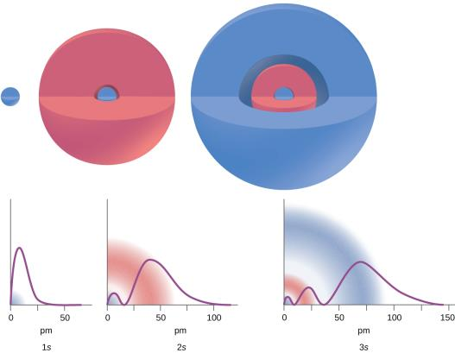
Figure 6.21
The graphs show the probability (y axis) of finding an electron for the 1s, 2s, 3s orbitals as a function of distance from the nucleus.

Slide 90
Orbital Shapes
The s subshell has a spherical shape.
The p subshell has a dumbbell shape.
The d and f orbitals are more complex.
These shapes represent the three-dimensional regions where the electron is likely to be found.

Slide 91
Figure 6.22
Shapes of s, p, d, and f orbitals.

Slide 92
Magnetic Quantum Number
If an orbital has an angular momentum (ℓ ≠ 0), then this orbital can point in different directions.
The magnetic quantum number, m_{l}, specifies the orientation of the orbital in space.

Slide 93
Magnetic Quantum Number
The value of mℓ depends on the value of ℓ.
mℓ = –ℓ … –1, 0, +1, … + ℓ
There are 2ℓ + 1 orbitals with the same ℓ value.
One s-orbital for ℓ = 0
Three p-orbitals for ℓ = 1
Five d-orbitals for ℓ = 2
Seven f-orbitals for ℓ = 3

Slide 94
Orbital Relative Energies
When referring to an orbital, usually both the n value and the letter designation for ℓ are reported.
Examples: 2s, 3p
In the case of a hydrogen atom, energies of all the orbitals with the same n are the same.
This is called a degeneracy, and the energy levels with the same principal quantum number, n, are called degenerate energy levels.

Slide 95
Orbital Relative Energies
However, in atoms with more than one electron, this degeneracy is eliminated by electron–electron interactions.
Orbitals that belong to different subshells have different energies.
Orbitals within the same subshell are still degenerate and have the same energy.

Slide 96
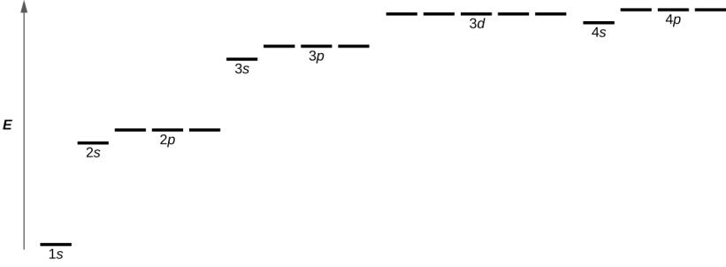
Figure 6.22
The chart shows the energies of electron orbitals in a multi-electron atom.

Slide 97
Spin Quantum Number
The first three quantum numbers, n, l, and m_{l}, define the region of space where an electron is most likely to be located.
The electron spin is a different kind of property.
Electron spin describes an intrinsic electron “rotation” or “spinning”.
An electron can only “spin” in one of two quantized states.

Slide 98
Spin Quantum Number
The spin quantum number, m_{s}, describes the two possible states.
m_{s} = +½ or –½
Any electron, regardless of the atomic orbital it is located in, can only have one of those two values of the spin quantum number.

Slide 99
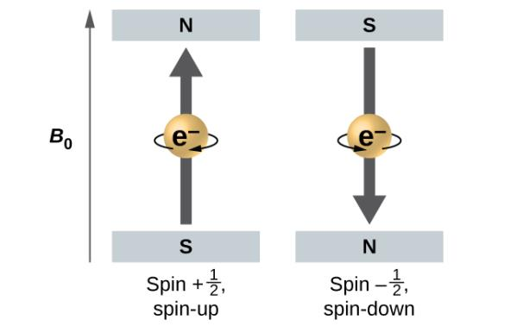
Figure 6.23
Electrons with spin values ±1/2 in an external magnetic field.

Slide 100
The Pauli Exclusion Principle
An electron in an atom is completely described by four quantum numbers: n, l, m_{l}, and m_{s}.
Wolfgang Pauli, an Austrian physicist, formulated a general principle.
The Pauli Exclusion Principle: No two electrons in the same atom can have exactly the same set of all four quantum numbers.

Slide 101
The Pauli Exclusion Principle
Electrons can share the same orbital (the same set of quantum numbers n, l, and m_{l}).
But only if they have different m_{s} numbers.
Since the spin quantum number can only have two values (± ½), no more than two electrons can occupy the same orbital.
If two electrons are located in the same orbital, they must have opposite spins.

Slide 102
Table 6.1 Quantum Numbers, Their Properties, and Significance
Name | Symbol | Allowed Values | Physical Meaning
principal quantum number | n | 1, 2, 3, 4, …. | shell, the general region for the value of energy for an electron in the orbital
angular momentum quantum number | ℓ | 0 ≤ ℓ ≤ n –1 | subshell, the shape of the orbital
magnetic quantum number | m_{l} | –ℓ ≤ m_{l} ≤ ℓ | orientation of the orbital
spin quantum number | m_{s} | +½ , –½ | direction of the intrinsic quantum “spinning” of the electron

Slide 103
Learning Objectives
6.4 Electronic Structure of Atoms (Electron Configurations)
Derive the predicted ground-state electron configurations of atoms
Identify and explain exceptions to predicted electron configurations for atoms and ions
Relate electron configurations to element classifications in the periodic table

Slide 104
Electronic Structure of Atoms (Electron Configurations)
The energy of atomic orbitals increases as the principal quantum number, n, increases.
As the principal quantum number, n, increases, the size of the orbital increases and the electrons spend more time farther from the nucleus.
Thus, the attraction to the nucleus is weaker and the energy associated with the orbital is higher (less stabilized).

Slide 105
Orbital Energies and Atomic Structure
In any atom with two or more electrons, the repulsion between the electrons makes energies of subshells with different values of l differ.
The energy of the orbitals increases within a shell in the order s < p < d < f.
Electrons in atoms tend to fill low-energy orbitals first.

Slide 106
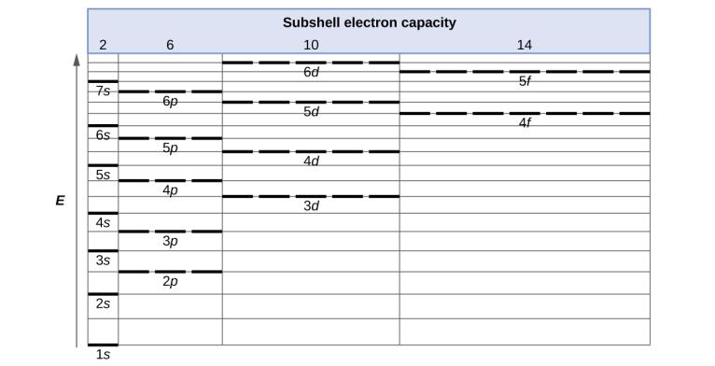
Figure 6.25
Generalized energy-level diagram for atomic orbitals in an atom with two or more electrons (not to scale).

Slide 107
Electron Configuration
The arrangement of electrons in the orbitals of an atom is called the electron configuration of the atom.
An electron configuration consists of symbols that contain three pieces of information:
The principal quantum shell, n.
The letter that designates the orbital type (l).
A superscript number that designates the number of electrons in that particular subshell.

Slide 108
Figure 6.26
The diagram of an electron configuration specifies the subshell (n and l value, with letter symbol) and superscript number of electrons.

Slide 109
The Aufbau Principle
To determine the electron configuration for an atom we add a number of electrons equal to its atomic number.
Beginning with hydrogen, and continuing across the periods of the periodic table, we add one electron to the subshell of lowest available energy.
This procedure is called the Aufbau principle, from the German word Aufbau (“to build up”).
When writing electron configurations and orbital diagrams keep in mind the Pauli Exclusion principle.

Slide 110
Figure 6.26
This diagram depicts the energy order for atomic orbitals and is useful for deriving ground-state electron configurations.

Slide 111
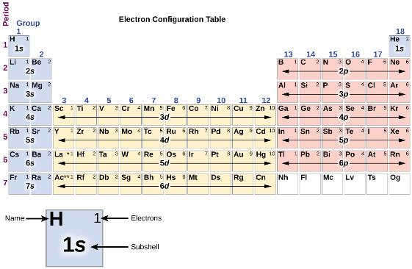
Figure 6.27
This periodic table shows the electron configuration for the valence subshells of atoms. By “building up” from hydrogen, this table can be used to determine the electron configuration for atoms of most elements in the periodic table (electron configurations of the lanthanides and actinides are not accurately predicted by this simple approach, see Figure 6.29).

Slide 112
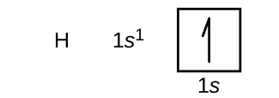
Electron Configurations and Orbital Diagrams
Orbital diagrams are pictorial representations of the electron configuration, showing the individual orbitals and the pairing arrangement of electrons.
An upward arrow represents and electron with m_{s} = + ½.
A downward arrow represents and electron with m_{s} = - ½.

Slide 113
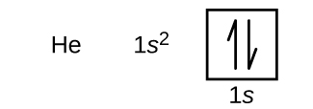
Electron Configurations and Orbital Diagrams

Slide 114
Electron Configurations and Orbital Diagrams
Hund’s rule: the lowest-energy configuration for an atom with electrons within a set of degenerate orbitals is that having the maximum number of unpaired electrons.

Slide 115
Electron Configurations and Orbital Diagrams

Slide 116
Valence and Core Electrons
The electrons occupying the orbital(s) in the outermost shell (highest value of n) are called valence electrons.
The electrons occupying the inner shell orbitals are called core electrons.
The core electrons represent noble gas electron configurations.
Electron configurations can be expressed in an abbreviated format by writing the noble gas that matches the core electron configuration, along with the valence electrons.

Slide 117
Figure 6.28
A core-abbreviated electron configuration (right) replaces the core electrons with the noble gas symbol whose configuration matches the core electron configuration of the other element.

Slide 118
Abbreviated Electron Configurations
Abbreviated electron configurations emphasize the similarity of the configurations of elements in the same group.
Group 1:
Li: [He]2s¹
Na: [Ne]3s¹
K: [Ar]4s¹
Group 2:
Be: [He]2s²
Mg: [Ne]3s²
Ca: [Ar]4s²

Slide 119
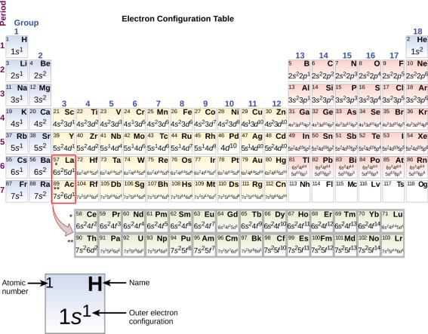
Figure 6.29
This version of the periodic table shows the outer-shell electron configuration of each element. Note that down each group, the configuration is often similar.

Slide 120
Electron Configurations
Beginning with the transition metal scandium (atomic number 21), additional electrons are added successively to the 3d subshell.
d subshells are filled to capacity with 10 electrons.
For l = 2 [d orbitals], there are 2l + 1 = 5 values of m_{l}.
Five d orbitals have a combined capacity of 10 electrons.
After the 3d subshell is filled, electrons are next added to the 4p subshell.

Slide 121
Electron Configurations
For the two periods of inner transition metals, lanthanum (La) through lutetium (Lu) and actinium (Ac) through lawrencium (Lr).
Electrons are added to an f subshell.
For l = 3 [f orbitals], there are 2l + 1 = 7 values of m_{l}.
Seven f orbitals have a combined capacity of 14 electrons.

Slide 122
Electron Configuration Exceptions
There are some exceptions to the order of filling subshells.
Examples: Cu and Cr
There is stability associated with a half-filled or fully filled d subshell.
An electron shifts from the 4s into the 3d subshell to achieve this stability.
Cu:
Expect: [Ar]4s²3d⁹
Actual: [Ar]4s¹3d¹⁰
Cr
Expect: [Ar]4s²3d⁴
Actual: [Ar]4s¹3d⁵

Slide 123
Example 6.10

Slide 124
Electron Configurations and the Periodic Table
The periodic table arranges atoms so that elements with the same chemical and physical properties are in the same group.
Elements in the same group have similar valence electron configurations.
Valence electrons play the most important role in chemical reactions.
This describes why elements in the same group have similar chemical reactivity.

Slide 125
Electron Configurations and the Periodic Table
Main group elements or representative elements are those in which the last electron added enters an s or a p orbital in the outermost shell.
The valence electrons for main group elements are those with the highest n level.
Example: Gallium (Ga): [Ar]4s²3d¹⁰4p¹
Ga has three valence electrons (4s² and 4p¹).
The completely filled 3d orbitals count as core, not valence electrons.

Slide 126
Electron Configurations and the Periodic Table
Transition elements or transition metals are metallic elements in which the last electron added enters a d orbital.
The valence electrons (those added after the last noble gas configuration) in these elements include the ns and (n – 1)d electrons.
Example: Vanadium (V): [Ar]4s²3d³
V has five valence electrons (4s² and 3d³).

Slide 127
Electron Configurations and the Periodic Table
Inner transition elements are metallic elements in which the last electron added occupies an f orbital.
The valence electrons (those added after the last noble gas configuration) in these elements include the ns, (n – 2)f, and if present the (n – 1)d subshells.
Example: Promethium (Pm): [Ar]6s²4f⁵
Pm has seven valence electrons (6s² and 4f⁵).

Slide 128
Electron Configurations of Ions
Recall, ions are formed when atoms gain or lose electrons.
A cation (positively charged ion) forms when one or more electrons are removed from an atom.
For main group elements, the electrons that were added last are the first electrons removed.
For transition metals and inner transition metals, the highest ns electrons are lost first, and then the (n – 1)d or (n – 2)f electrons are removed.

Slide 129
Electron Configurations of Ions
An anion (negatively charged ion) forms when one or more electrons are added to a parent atom.
The electrons are added in the order predicted by the Aufbau principle.

Slide 130
Example 6.11
Predicting Electron Configurations of Ions
What is the electron configuration of:
(a) Na⁺
(b) P^{3–}
(c) Al²⁺
(d) Fe²⁺
(e) Sm³⁺
First, write out the electron configuration for the parent atom, and then add or remove the appropriate number of electrons from the correct orbital(s).

Slide 131
Example 6.11
Na: 1s²2s²2p⁶3s¹. Sodium loses one electron.
Na⁺: 1s²2s²2p⁶
P: 1s²2s²2p⁶3s²3p³. Phosphorus gains three electrons.
P³⁻: 1s²2s²2p⁶3s²3p⁶
Al: 1s²2s²2p⁶3s²3p¹. Aluminum loses two electrons.
Al²⁺: 1s²2s²2p⁶3s¹
Fe: 1s²2s²2p⁶3s²3p⁶4s²3d⁶. Iron loses two electrons and, since it is a transition metal, they are removed from the 4s orbital.
Fe²⁺: 1s²2s²2p⁶3s²3p⁶3d⁶
Sm: 1s²2s²2p⁶3s²3p⁶4s²3d¹⁰4p⁶5s²4d¹⁰5p⁶6s²4f⁶. Samarium loses three electrons. The first two will be lost from the 6s orbital, and the final one is removed from the 4f orbital.
Sm³⁺: 1s²2s²2p⁶3s²3p⁶4s²3d¹⁰4p⁶5s²4d¹⁰5p⁶4f⁵

Slide 132
Learning Objectives
6.5 Periodic Variations in Element Properties
Describe and explain the observed trends in atomic size, ionization energy, and electron affinity of the elements

Slide 133
Periodic Variations in Element Properties
Many properties of the elements vary periodically as the electronic structure of the elements changes.
These properties govern the chemical behavior of elements.
These periodic properties include:
Size (radius) of atoms and ions
Ionization energies
Electron affinities

Slide 134
Variations in Covalent Radii
The covalent radius is defined as one-half the distance between the nuclei of two identical atoms when they are joined by a covalent bond.
Down a group:
The principal quantum number, n, increases by one for each element.
The electrons are added to a region of space that is increasingly farther from the nucleus.
The size of the atom (and its covalent radius) increases down a group.

Slide 135
Effective Nuclear Charge
Effective nuclear charge, Z_{eff}, is the pull exerted on a specific electron by the nucleus, taking into account any electron–electron repulsions.
For hydrogen, there is only one electron and so the nuclear charge (Z) and the effective nuclear charge (Z_{eff}) are equal.
For all other atoms, the electron of interest are partially shielded from the pull of the nucleus by the other electron(s) present.

Slide 136
Effective Nuclear Charge
Core electrons are adept at shielding, while electrons in the same valence shell do not block the nuclear attraction experienced by each other as efficiently.
Each time we move from one element to the next across a period, Z increases by one, but the shielding increases only slightly due to electrons being added only to the valence shell.
Z_{eff} increases as we move from left to right across a period.

Slide 137
Variations in Covalent Radii
Across a period:
A stronger pull (higher effective nuclear charge) is experienced by the outermost electrons, drawing them closer to the nucleus.
The size of the atom (and its covalent radius) decreases across a period.

Slide 138
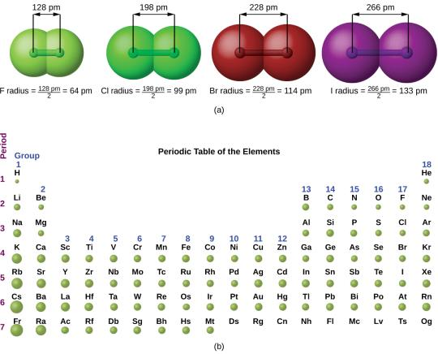
Figure 6.30
(a) The radius of an atom is defined as one-half the distance between the nuclei in a molecule consisting of two identical atoms joined by a covalent bond. The atomic radius for the halogens increases down the group as n increases. (b) Covalent radii of the elements are shown to scale. The general trend is that radii increase down a group and decrease across a period.

Slide 139
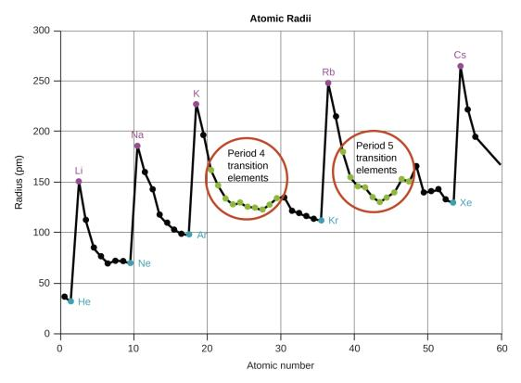
Figure 6.31
Within each period, the trend in atomic radius decreases as Z increases; for example, from K to Kr. Within each group (e.g., the alkali metals shown in purple), the trend is that atomic radius increases as Z increases.

Slide 140
Variations in Ionic Radii
Ionic radius is the measure used to describe the size of an ion.
A cation always has fewer electrons and the same number of protons as the parent atom.
As electrons are removed from the outer valence shell, the remaining electrons experience a greater Z_{eff} charge and are drawn even closer to the nucleus.
A cation is always smaller than the atom from which it is derived.

Slide 141
Variations in Ionic Radii
An anion always has more electrons and the same number of protons as the parent atom.
This results in a greater repulsion among the electrons and a decrease in Z_{eff}.
This causes the valence electrons to be farther from the nucleus.
An anion is always larger than the atom from which it is derived.

Slide 142
Figure 6.32
The radius for a cation is smaller than the parent atom (Al), due to the lost electrons; the radius for an anion is larger than the parent (S), due to the gained electrons.

Slide 143
Isoelectronic
Atoms and ions that have the same electron configuration are said to be isoelectronic.
Examples of isoelectronic species:
N^{3–}, O^{2–}, F–, Ne, Na⁺, Mg²⁺, and Al³⁺ (1s²2s²2p⁶)
P^{3–}, S^{2–}, Cl–, Ar, K⁺, Ca²⁺, and Sc³⁺ ([Ne]3s²3p⁶)
For atoms or ions that are isoelectronic, the number of protons determines the size.
The greater the nuclear charge, the smaller the radius in a series of isoelectronic ions and atoms.

Slide 144
Ionization Energy
The amount of energy required to remove the most loosely bound electron from a gaseous atom in its ground state is called its first ionization energy (IE₁).
X(g) ⟶ X⁺(g) + e⁻ IE₁
The energy required to remove the second most loosely bound electron is called the second ionization energy (IE₂).
X⁺(g) ⟶ X²⁺(g) + e⁻ IE₂
The energy required to remove the third electron is the third ionization energy, and so on.

Slide 145
Variations in Ionization Energies
Energy is always required to remove electrons from atoms or ions, so ionization processes are endothermic and IE values are always positive.
As size (atomic radius) increases, the ionization energy decreases.
First ionization energies:
Decrease down a group
Increase across a period
There are some deviations from this trend.

Slide 146
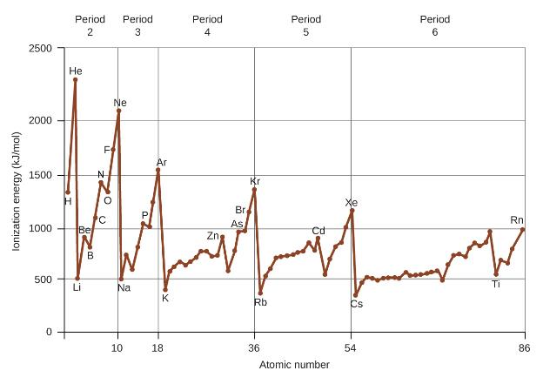
Figure 6.33
The first ionization energy of the elements in the first five periods are plotted against their atomic number.

Slide 147
Figure 6.34
This version of the periodic table shows the first ionization energy of (IE₁), in kJ/mol, of selected elements.

Slide 148
Deviations in Ionization Energy Trend
Deviation: Beryllium (Be) has a higher IE₁ than boron (B).
The electron removed during the ionization of beryllium ([He]2s²) is an s electron.
The electron removed during the ionization of boron ([He]2s²2p¹) is a p electron.
The energy of a subshell increases as l increases.
This means that an s electron is harder to remove from an atom than a p electron in the same shell.

Slide 149
Deviations in Ionization Energy Trend
Deviation: Oxygen (O) has a lower IE₁ than nitrogen (N).
Removing one electron from O will eliminate the electron–electron repulsion caused by pairing the electrons in the 2p orbital.
This means that removing an electron from O is more energetically favorable than removing an electron from N.

Slide 150
Successive Ionization Energies
Removing an electron from a cation is more difficult than removing an electron from a neutral atom because of the greater electrostatic attraction to the cation.
Likewise, removing an electron from a cation with a higher positive charge is more difficult than removing an electron from an ion with a lower charge.
Thus, successive ionization energies for an element always increase.

Slide 151
Table 6.3 Successive Ionization Energies for Selected Elements (kj/mol)
Element | IE₁ | IE₂ | IE₃ | IE₄ | IE₅ | IE₆ | IE₇
K | 418.8 | 3051.8 | 4419.6 | 5876.9 | 7975.5 | 9590.6 | 11343
Ca | 589.8 | 1145.4 | 4912.4 | 6490.6 | 8153.0 | 10495.7 | 12272.9
Sc | 633.1 | 1235.0 | 2388.7 | 7090.6 | 8842.9 | 10679.0 | 13315.0
Ga | 578.8 | 1979.4 | 2964.6 | 6180 | 8298.7 | 10873.9 | 13594.8
Ge | 762.2 | 1537.5 | 3302.1 | 4410.6 | 9021.4 | not available | not available
As | 944.5 | 1793.6 | 2735.5 | 4836.8 | 6042.9 | 12311.5 | not available

Slide 152
Successive Ionization Energies
At some point, there is always a large increase in successive ionization energies for an element.
This large increase corresponds to the removal of core electrons, which are harder to remove than the valence electrons.
Example:
Sc and Ga both have three valence electrons.
The large increase in ionization energy occurs after the third ionization.

Slide 153
Electron Affinity
The electron affinity (EA) is the energy change for the process of adding an electron to a gaseous atom to form an anion.
X(g) + e− ⟶ X−(g) EA1
This process can be either endothermic or exothermic, depending on the element.
For some elements energy is released when the gaseous atom accepts an electron (negative EA).
For other elements energy is required for the gaseous atom to accept an electron (positive EA).

Slide 154
Variations in Electron Affinities
It becomes easier to add an electron as the effective nuclear charge of the atoms increases.
Electron affinities becomes more negative across a period.
There are some deviations from this trend.

Slide 155
Deviations in Electron Affinity Trend
The noble gases, group 18, have a completely filled shell and the incoming electron must be added to a higher energy n level.
Group 2 has a filled ns subshell, and so the next electron added goes into the higher energy np subshell.
Group 15 has a half-filled np subshell and the next electron must be paired with an existing np electron.
In all of these cases, the initial relative stability of the electron configuration disrupts the trend in EA.

Slide 156
Figure 6.35
This version of the periodic table displays the electron affinity values (in kJ/mol) for selected elements.

Slide 157
Exercise 41

Slide 158
This OpenStax ancillary resource is © Rice University under a CC-BY 4.0 International license; it may be reproduced or modified but must be attributed to OpenStax, Rice University and any changes must be noted.

